Slide 1
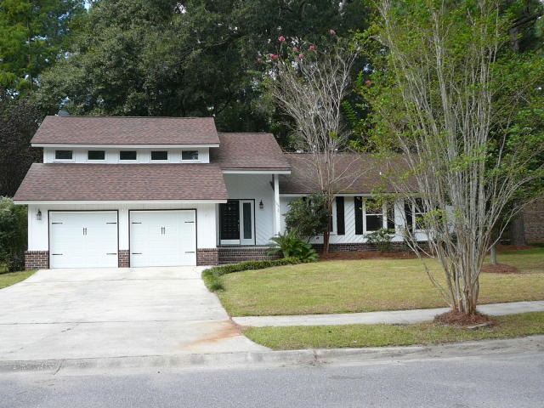
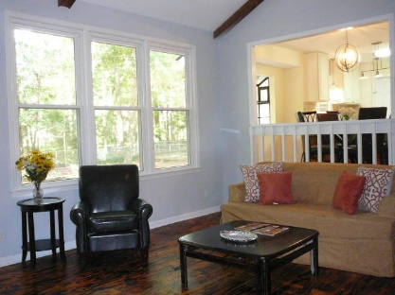
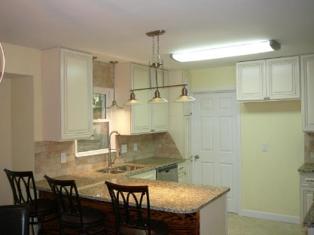
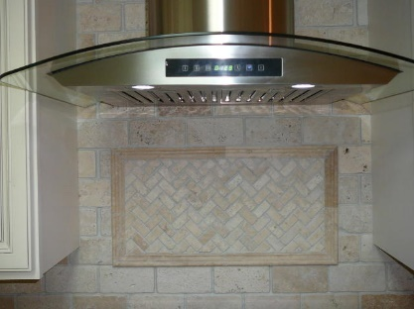
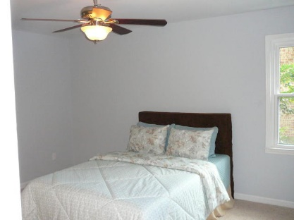
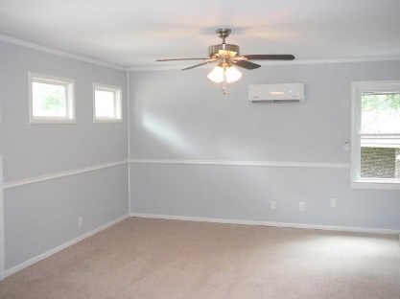
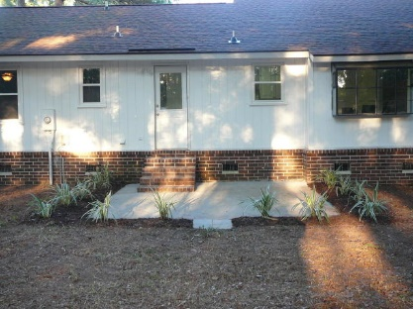
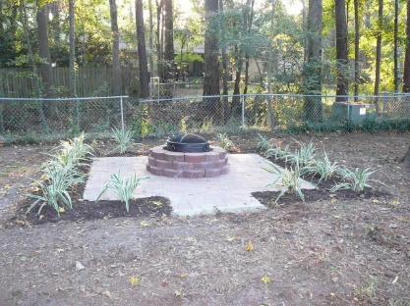

105 Anstead Drive Briarwood Summerville, SC 29485 MLS# 18026366 $249,900 3 Bed · 2 Bath · 1,897sf
3.5% AGENT COMPENSATION BEING OFFERED IF A CONTRACT IS RATIFIED PRIOR TO OCTOBER 22, 2018.
3.5% AGENT COMPENSATION BEING OFFERED
IF A CONTRACT IS RATIFIED PRIOR TO OCTOBER 22, 2018
BEAUTIFUL NEWLY RENOVATED HOME IN DESIRABLE BRIARWOOD SUBDIVISION IN THE AWARD WINNING DORCHESTER 2 SCHOOL DISTRICT!!
New Kitchen Cabinets w/ Granite Tops and Stainless Appliances
New Wood Floors, New Carpet, and New Tile
Beautiful Updated and Tiled Bathrooms
New Packaged HEIL HVAC Unit
New Low E Vinyl Replacement Windows
New Garage Doors with New Remote Controlled Openers
Newer Architectural Shingles on Roof
Freshly Painted Interior and Exterior
Nice Landscaped Patio and New Fire Pit
Bryant Pearson
(843) 860-7667
Bryant@SouthernShoresRE.com
Southern Shores Real Estate Group
834 Wappoo Rd
Charleston, SC 29407

