Slide 1
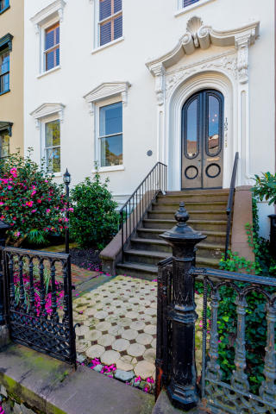
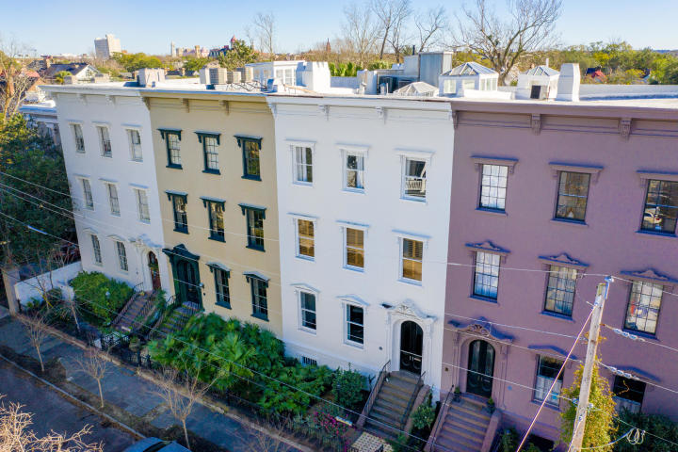
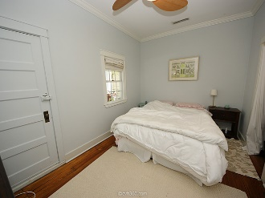
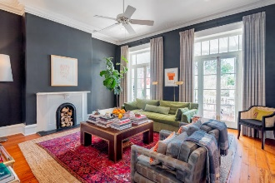
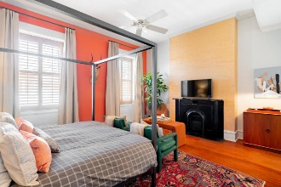
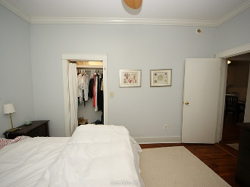
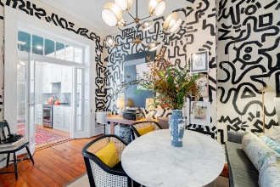
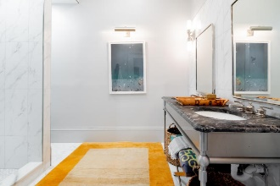
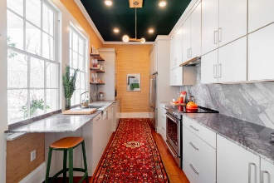
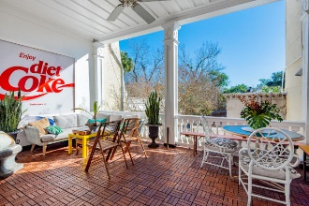


Agent Open House Tuesday 11-1
105 Bull Street B
Harleston Village :: Charleston
MLS# 20000274 :: $819,900
Incredible opportunity to own a meticulously restored light-filled condominium in historic Bee's Row. These homes were taken over during the Civil War by William C. Bee, who owned a blockade-running firm. This unit comprises the entire second floor and underwent a high-end renovation with a modern flair, while keeping true to the historic significance of the building. 11+ ft. ceilings, original wood floors and trim, and oversized windows blend seamlessly with the interior design of this unique property. Offered fully furnished minus art and accessories, this unit is truly a turn-key, lock and leave opportunity. Located in historic Harleston Village, it is an easy walk to King St, Colonial Lake, and Broad St. This property has been dry during past storms. List of renovations available. Check the documents section for a list of renovations and finishes.
Check out the virtual tour attached to this listing!
https://mls.immoviewer.com/portal/tour/1659435?accessKey=5e02
Casey Anderson
Cell 843-410-3525
caseysellscharleston@gmail.com
Keller Williams Realty Charleston | 496 Bramson Ct, Suite 200 | Mt Pleasant, SC 29464

