Slide 1

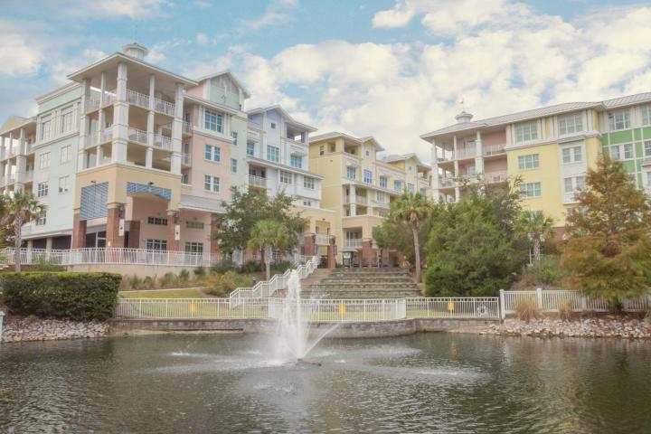
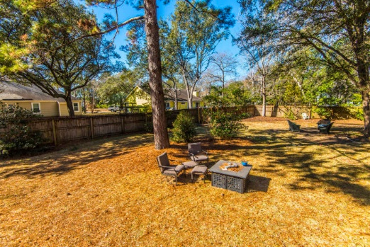
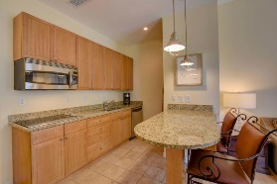
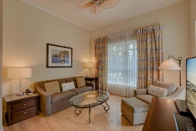
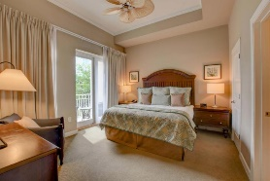
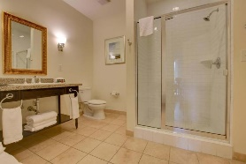
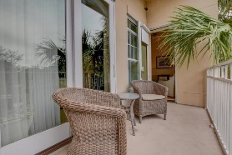
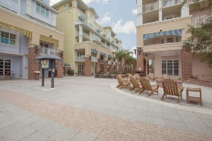
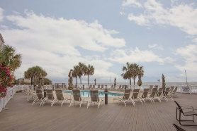
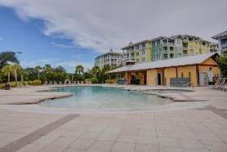
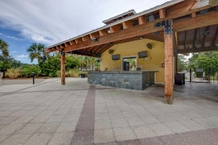
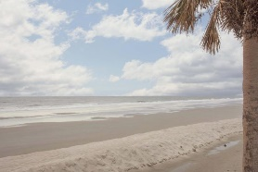


105 B Village At Wild Dunes
Isle of Palms, SC 29451 | MLS# 17028338 | Reduced to $349,300
1 Bed ~ 1 Bath
1 Bed ~ 1 Bath
Bring All Offers!
Paradise Found! Incredible opportunity to own a turnkey luxury condo for your beach and golf getaways in the heart of the prestigious Wild Dunes Resort. Boasting all the high end finishes you would expect: gleaming hardwood floors, spa-like bath, fully equipped kitchen with stainless steel appliances and granite countertops, flat screen TV’s, and outdoor balcony. Average gross rental income exceeded $45k/yr past 3yrs! Sold completely furnished, just bring your suitcase! Ideally located in the center of the resorts world class amenities, owners are steps away from oceanfront golf, pristine beaches, tennis, indoor and outdoor pools, restaurants, shops, salon, spa and fitness center, fishing, miles of biking and walking trails, and much more all behind a 24hr security gate. All this AND under 30 min to historic Charleston, voted #1 Destination City in the World in 2016 by Travel & Leisure magazine. Monthly regime fee includes use of the Grand Pavilion, Swim Center Pool, Palm Cove Pool & Fitness centers, Internet (Wi-Fi), Cable TV, local phone, water/sewer, baggage, concierge, and valet services, covered parking, exterior building maintenance, building insurances, reserve fund, refuse disposal fees, common area housekeeping, and landscaping. Don't miss the virtual tour!
Bonnie Sitsis
(843) 973-0062 | bonnie.sitsis@gmail.com
AgentOwned Preferred Group | 1400-G Palm Blvd. | Isle Of Palms, SC 29451

