Slide 1
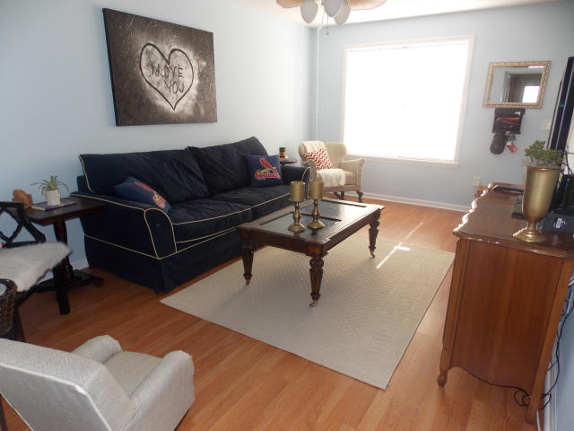
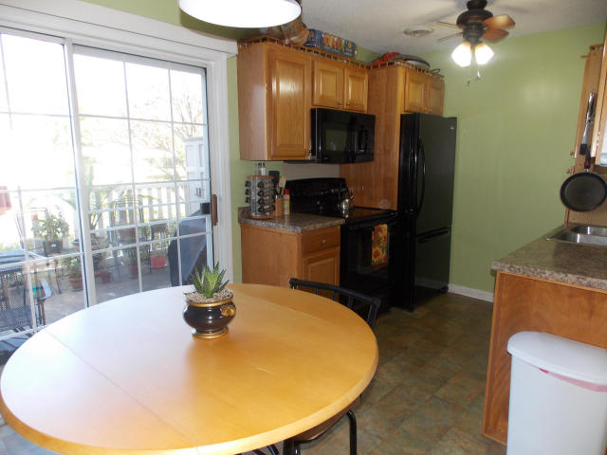
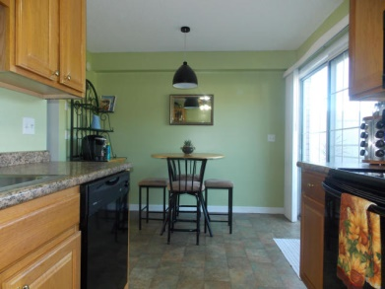
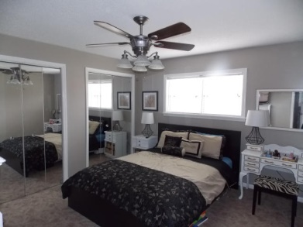
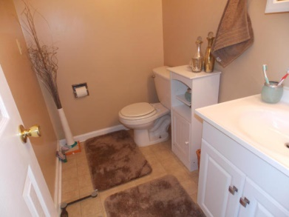
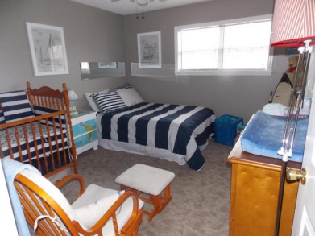
FANTASTIC PROPERTY REMODELED 1 YEAR AGO!!
105-E Hickory Lane
Honey Ridge Villas
Ladson, SC 29456
MLS# 14031701 | $54,000
Move in ready!! Excellent location close to everything you need with all the amenities you can imagine! Pool, tennis courts, exercise room and more! Downstairs has new laminate wood flooring throughout. Kitchen has new countertops and appliances. Clean neutral paint job upstairs and downstairs, and carpet looks brand new! You don't want to miss out on this property. Would be great for a first time homebuyer, or investment property.
Sean Harrington
Office: 843-821-1111
Cell: 843-226-9652
sean@milerproperties.com
www.milerproperties.com

