Slide 1
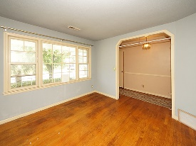
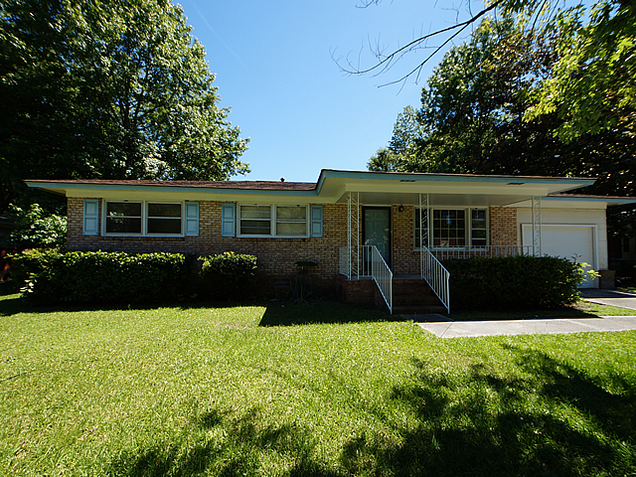
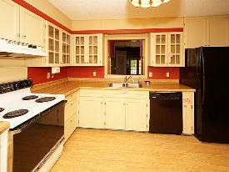
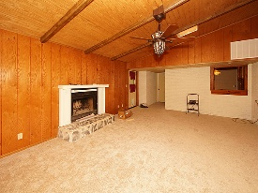
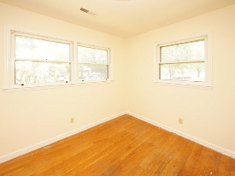
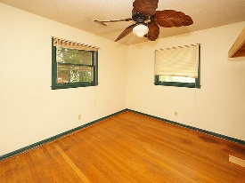
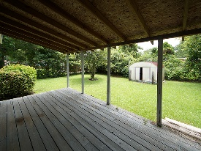
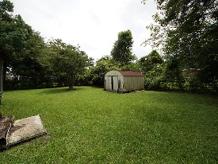


Seller Is Motivated!
105 Elmora Avenue
Sedgefield Section I
Goose Creek, SC 29445
Open House Canceled!
Under Contract In 3 Days!
MLS# 17016139 | $148,000
3 Bed / 2 Bath
This 3 bedroom 2 bath brick home has plenty of living space in a mature neighborhood with no HOA.
We have pulled up the carpet and exposed the hard wood floors that have been covered for 20+ years.
Over sized family room was added to the house and what appears to be a storage room entering from the family room was future plans for a large master suite.
Connie White, Broker
C: 843-532-3356
conniesyouragent@gmail.com
Charleston Homes
597 Old Mt. Holly Road
Suite 301
Goose Creek, SC 29445

