Slide 1
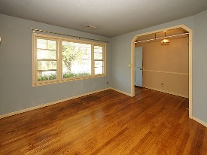
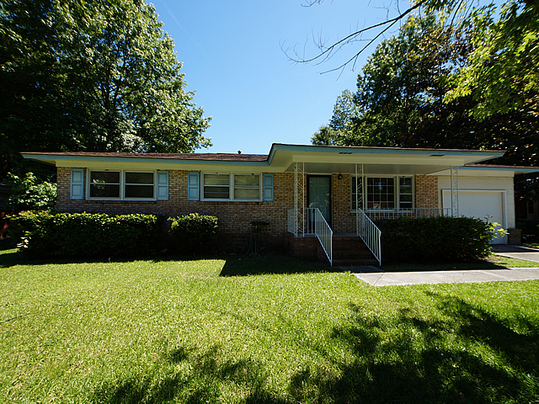
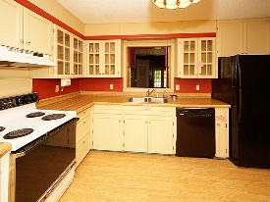
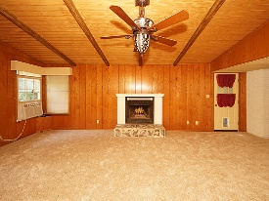
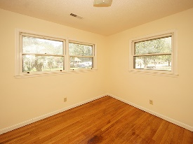
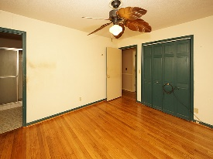
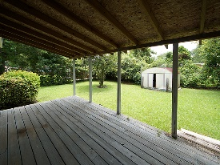
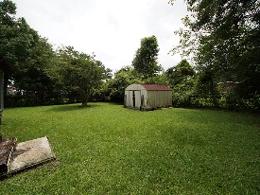

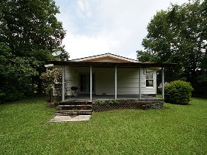

Seller is motivated! Price Reduced $10,000!
105 Elmora Avenue
Sedgefield Section I
Goose Creek, SC 29445
Open House Canceled!
Under Contract In 3 Days!
MLS# 17016139
$138,000
3 Bed / 2 Bath
Move-in ready home! Including refinished hardwood floor, new carpeting, new HVAC condenser for hot weather cooling, replaced dishwasher (2016) and clothes dryer (2015), and a new door on the garage... so Agents, please look at this home again!! This is a 3 bedroom 2 bath brick home, with a separate dining room, office and roomy kitchen with lots of storage.
Overall the home has plenty of living space in a mature neighborhood with no HOA, and is walking distance to the newly renovated High School. Spacious family room addition AND bonus additional square footage in the form of an unfinished room adjoining the family room, great place for storage or a new large master suite.
Connie White, Broker
843-532-3356 · conniesyouragent@gmail.com
Charleston Homes · 597 Old Mt. Holly Road · Suite 301 · Goose Creek, SC 29445

