Slide 1
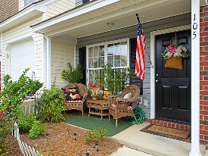
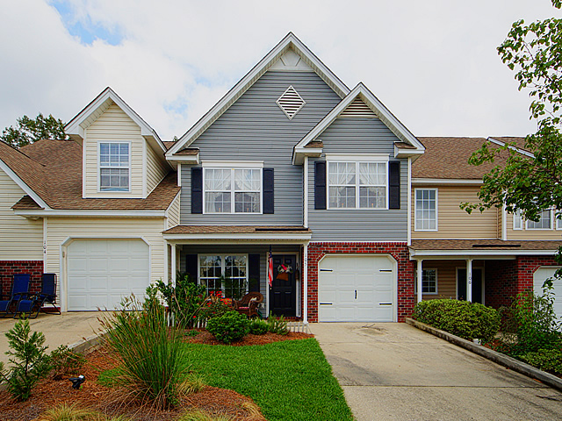
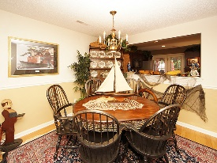
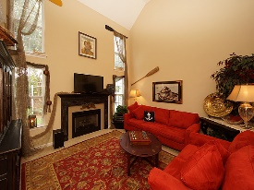
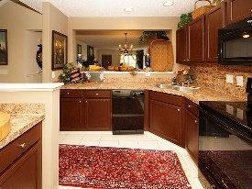
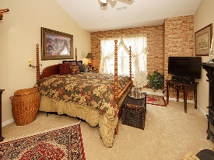
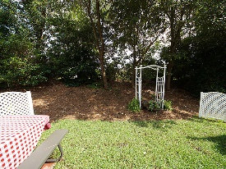
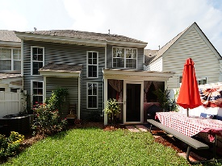
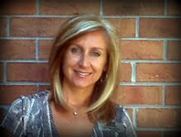

This Home Is Breathtaking! $1,000 Agent Bonus!
105 Greyson Circle
Persimmon Hill Townhouses
Goose Creek, SC 29445
Open House Canceled!
Under Contract In 3 Days!
MLS# 17021001 | $159,900
3 Bed / 2½ Bath
Stunning describes this professionally painted and decorated town home!
New AC, New hot water heater, New carpet, New appliances all installed and designed by a professional interior designer! This home is amazing inside and relaxing on the outside when you enter the screened porch and back yard. Two bedrooms and a loft with a closet upstairs could easily convert to a third bedroom. Formal living, dining and family room provide plenty of space for the family. This home is breath taking!
Pictures are worth a thousand words!
Connie White, Broker
C: 843-532-3356
conniesyouragent@gmail.com
Charleston Homes
597 Old Mt. Holly Road
Suite 301
Goose Creek, SC 29445

