Slide 1
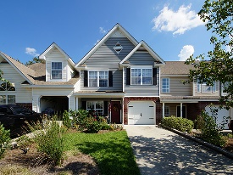
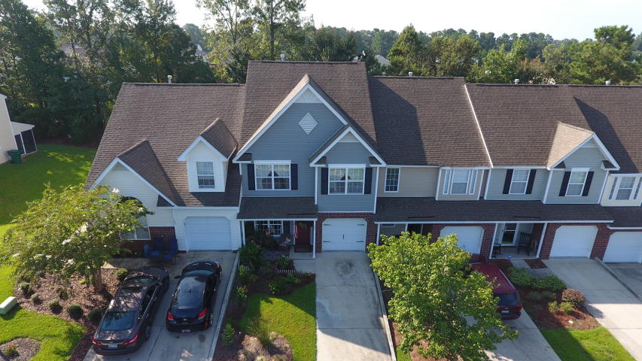
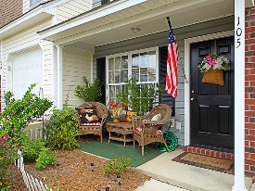
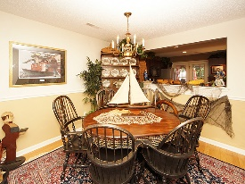
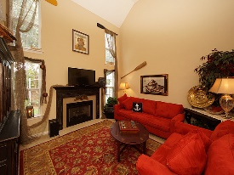
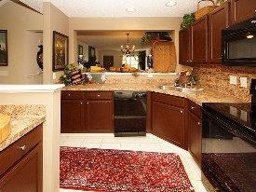
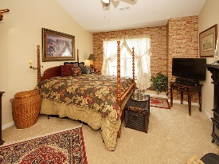
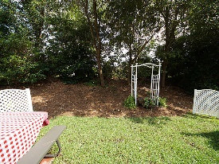

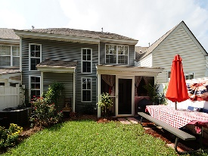

This Home Is Breathtaking!
105 Greyson Circle
Persimmon Hill Townhouses
Goose Creek, SC 29445
MLS# 17021001
$159,900
3 Bed / 2½ Bath
Open House Canceled!
Under Contract In 3 Days!
Stunning describes this professionally painted and decorated town home!
Home done in popular HGTV Show Fixer Upper with Chip and Joanne's paint colors! New Heating & Air Conditioning, New hot water heater, New carpet, New appliances all installed and designed by a professional interior designer!
This home is amazing inside and relaxing on the outside when you enter the screened porch and back yard. Two bedrooms and loft with a closet upstairs could easily convert to a third bedroom. Formal living, dining and family room provide plenty of space for the family.
Connie White, Broker
843-532-3356 · conniesyouragent@gmail.com
Charleston Homes · 597 Old Mt. Holly Road · Suite 301 · Goose Creek, SC 29445

