Slide 1
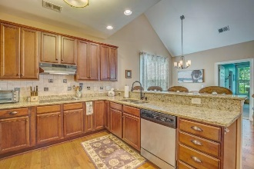
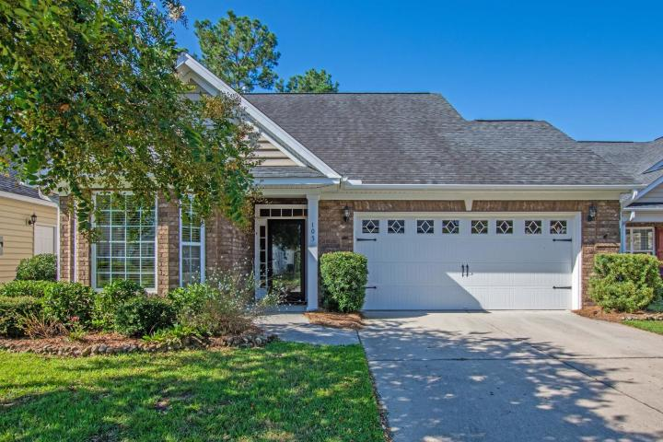
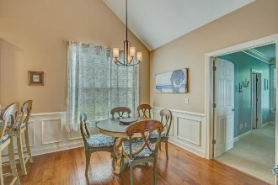
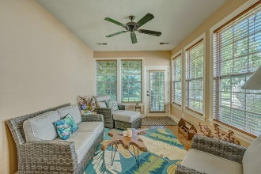
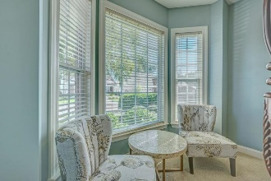
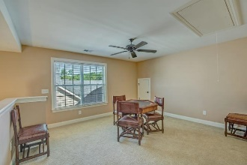
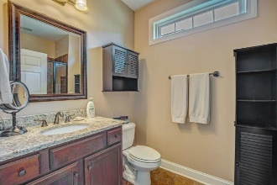
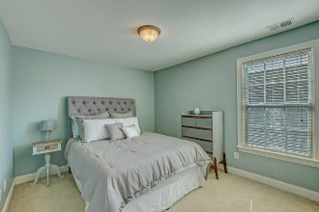
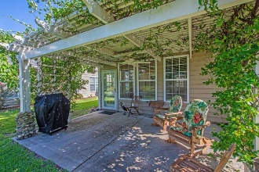
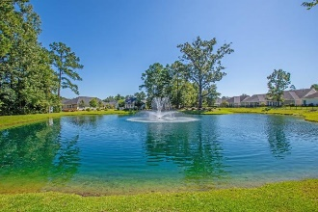


Open House
Saturday 11a-2p
Starbucks card to first 10 agents
105 Lilith Lane
Pines at Gahagan ~ Summerville, SC 29485
MLS# 19025139 ~ $315,000
Peaceful Pond view
Minutes to the fun & food of downtown Summerville.
Master suite & 1 other bedroom suite down
Granite & Stainless entertainers kitchen open to the living & dining space.
Tiled sunroom and back patio on pond!
Second floor loft w a bedroom & bath.
The luxurious resort-style clubhouse has a pool, library, great room, a gym billiard room.
HOA provides lawn service, pressure washing & pine straw.
Up grades include extra long garage, Custom wood floors & Blinds Irrigation.
Many Energy saving features. Tankless water heater energy star appliances.
Di Johnson, ABR, EPRO
(843) 270-6448
dijohnsonsc@gmail.com | charlestonrealestatefind.com
The Boulevard Company, LLC | 806 Johnnie Dodds Blvd Ste 100 | Mt Pleasant, SC 29464

