Slide 1

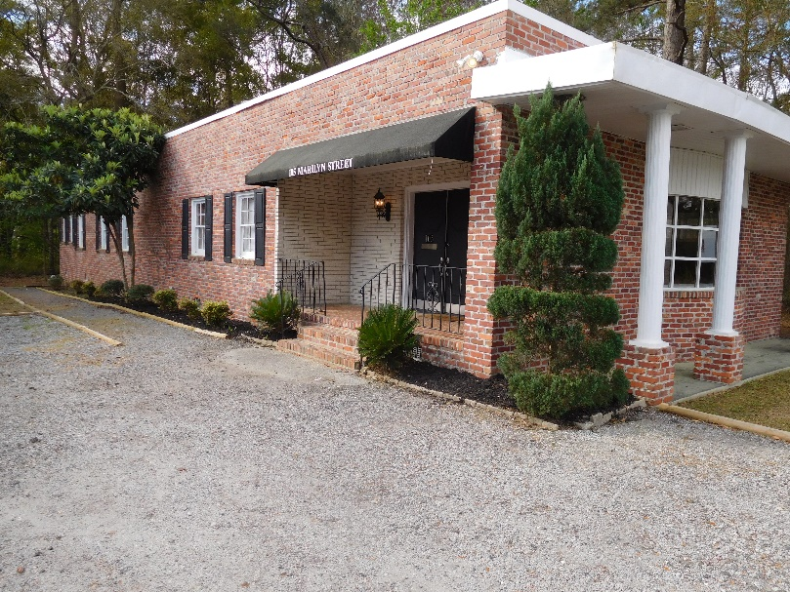
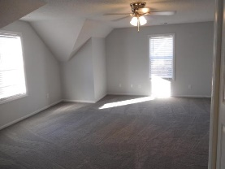
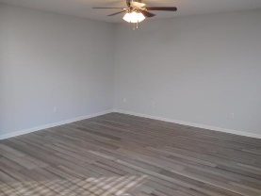
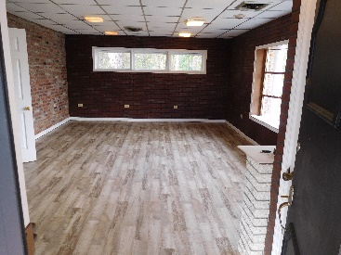
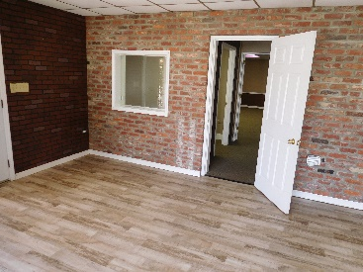
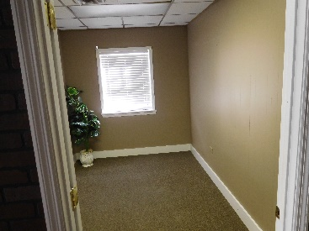
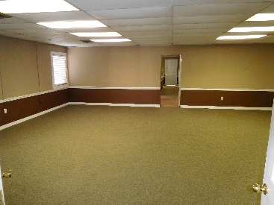
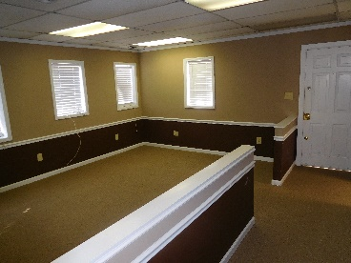
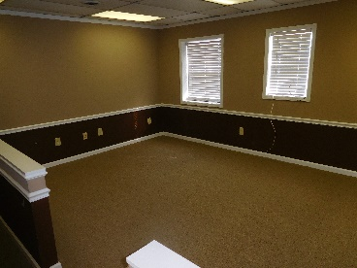
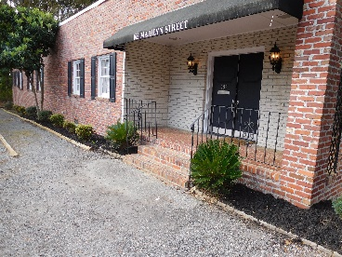
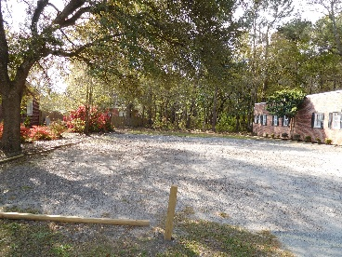
Don C. Mason, CIAS, CNE
(843) 364-9090
nibsc@aol.com
COMMERCIAL OFF
HWY 176 & HWY 52
105 Marilyn St
Goose Creek, SC 29445
Property Subtypes: Executive Suites, Office Building
Building Size (RSF): 2,400 SF
Sale Price: $379,000
Cooperation Compensation: 3%
Property Use Type: Investment/Professional Office
Usable Size (USF): 2,400
Sale Terms: Cash to Seller
Agency Type: Exclusive Right to Sell/Lease
Commercial Building just off of Hwy. 176 & Hwy. 52. National Developers are showing interest in this property. Gorgeous old Charleston brick office building. Professional Landscaping. Black shutters at every window. A nice black rain canopy over the front door entrance. Has a large bay window, with four big columns in the front of the building. Also has a large sign out front for your business marketing. 3 separate bathrooms.one with a shower. Plenty of off street parking. Can be used as two separate offices. There is a separate entrance for the back office. You can lease the front office 1,400 and move your office in the back 1,000 and let your leased space make your payment. If you need expansion, or control what is built next to you the lot next to this is also for sale.
Real Estate Advocates LC
7613 Hwy 544 | Myrtle Beach, SC 29588
www.realestateadvocates.com

