Slide 1
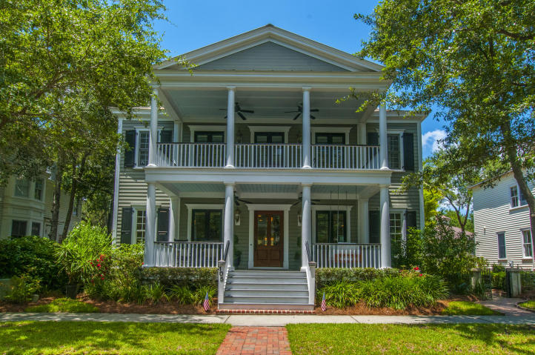
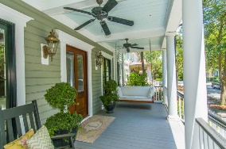
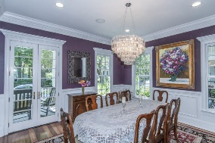
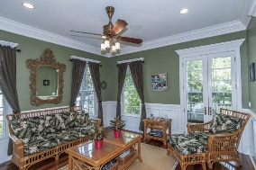
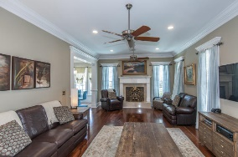
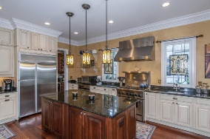
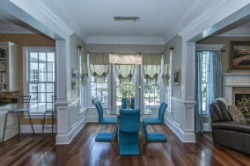
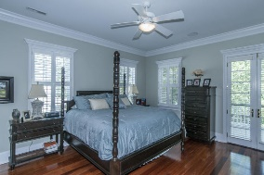
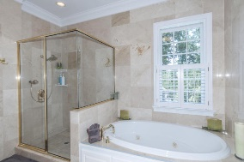
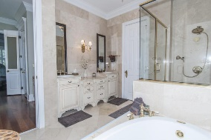
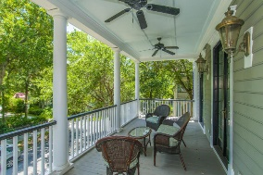
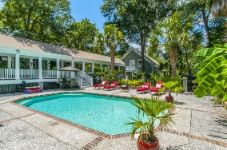
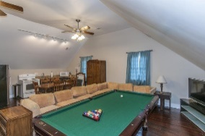

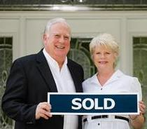
105 N Shelmore Boulevard Mount Pleasant · MLS# 16019528 · $1,495,000
New Listing In I'on With In-Ground Pool & An Apartment Over Garage
$564,900
This totally customized executive home has quality features throughout including Brazilian Cherry hardwood floor and custom moldings and trim throughout, gourmet kitchen with professional grade stainless appliances (6 burner gas cooktop with warmer and gas oven, second built in conventional oven, commercial grade dishwasher granite countertops with under mount double sink). Large center island with storage cabinets and custom painted cabinets with plenty of storage, walk in pantry and Butler's pantry with wine cooler and custom wine rack. Formal dining room, parlor style living room with pocket doors, den with wood burning fireplace, breakfast room and mudroom off kitchen. In ground pool, covered walkway to outdoor bath area, apartment over garage complete with kitchen and full bath.
Tommy Lovett Tommy - (843) 442-1276
tlovett@carolinaone.com www.tommylovettrealestate.com
Carolina One Real Estate
628 Long Point Rd.
Mt Pleasant, SC 29464-3032

