Slide 1
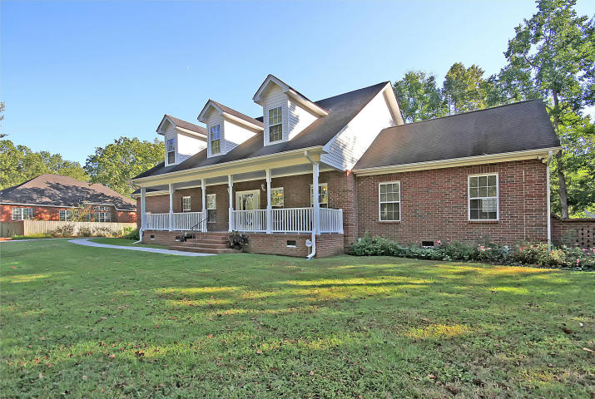
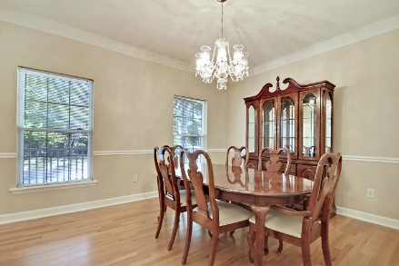
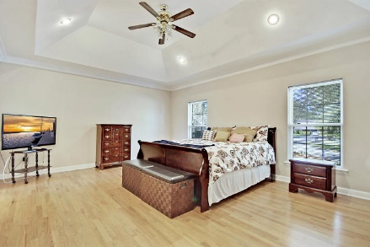
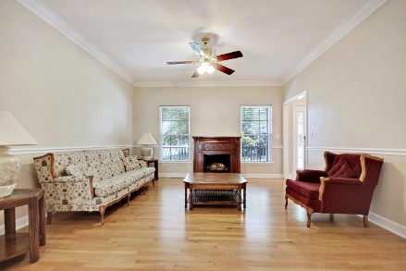
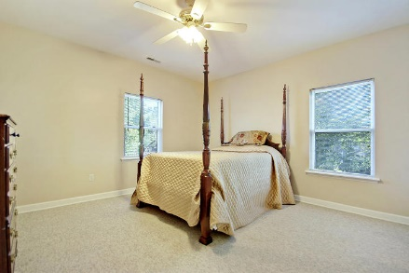
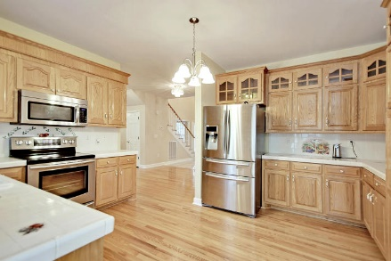
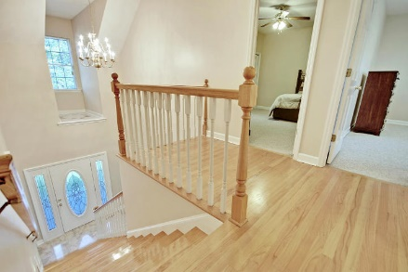
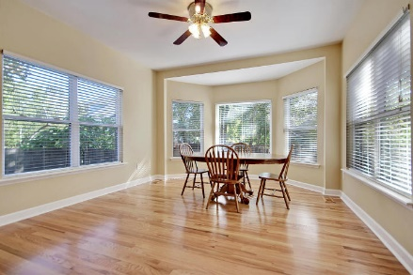
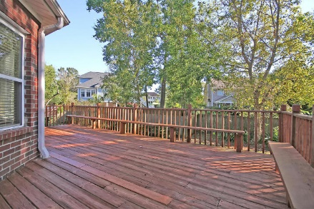
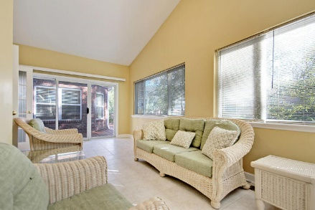
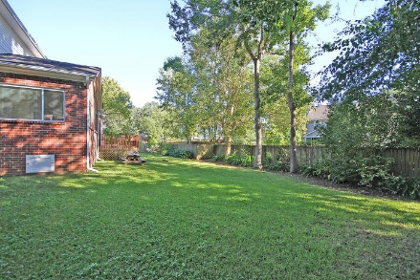

Price Reduced!
105 River Oak Lane
Bakers Landing ~ North Charleston ~ MLS# 17027744 ~ $439,900
Beautiful, brick, two story home with convenient, central low country location delivers at every turn. You’ll be welcomed by, and have no problem imagining yourself spending hours in a rocking chair on, the spacious front porch. Come inside to be greeted by a grand, two story foyer, gleaming hardwood floors, crown molding, chair rail molding and an open floor plan. A sun room off of the family room and the huge breakfast nook off of the kitchen with its bay window allow the natural light to pour into the home. A first floor master suite boasts a walk-in closet and en-suite bathroom with jacuzzi tub and walk-in shower. The FROG offers a private additional living space and the expansive deck and fenced-in backyard are perfect spots to enjoy the outdoors. Be sure to see this home today!
Additional features include:
Large lot
Kitchen boasts oak cabinets, stainless steel appliances, and lots of countertop space
Great deck to enjoy the outdoors
Crawl space is 100% encapsulated
Close to Northwoods Mall, Tanger Outlet, Boeing, Charleston Airport, shopping and dining
Book your showing soon!
Leslie Toller Leslie@Mattoneillteam.com 843-972-3244

