Slide 1
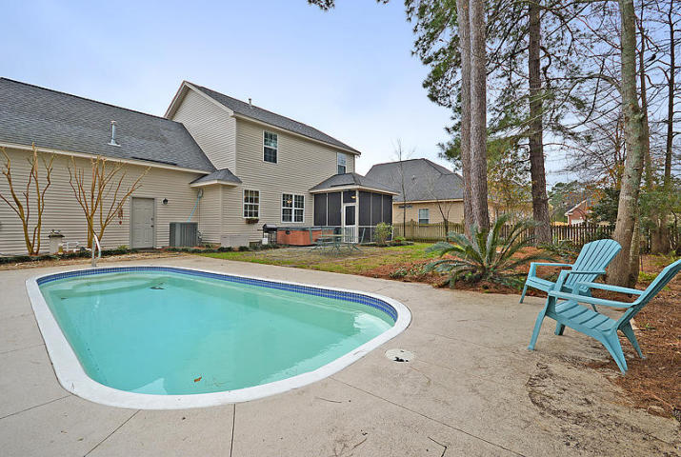
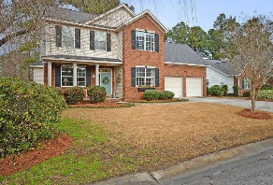
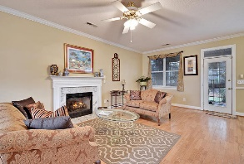
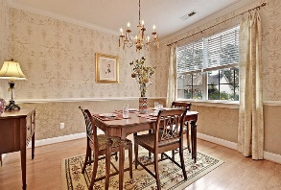
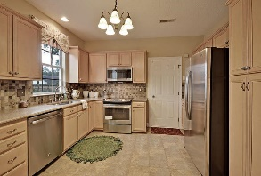
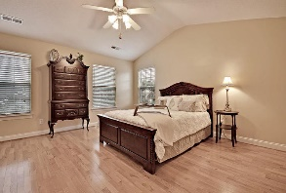
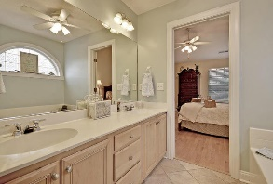
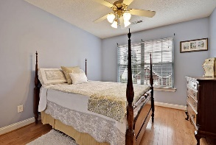
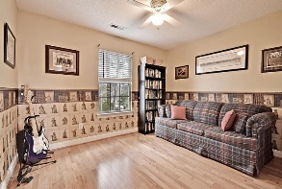
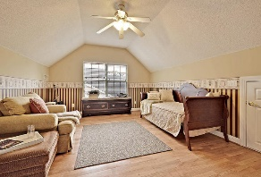
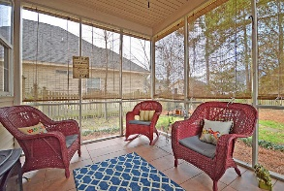
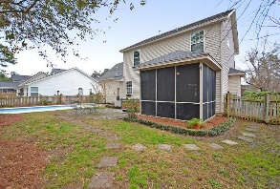
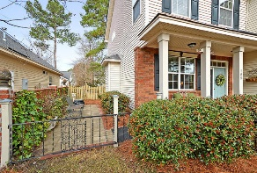


Open House this Sunday from 12-3
105 Royal Troon Ct
Pine Forest Country Club
Summerville, SC 29483
MLS# 16002795
New Low Price! $262,000
4 Bedrooms | 2½ Baths | 2,047 sf
This Pine Forest Country Club beauty feels brand new it's been so well take care of! Plus it has a built in pool and a hot tub!!! Curb appeal galore as you are welcomed by the front porch and a gorgeous courtyard seating area off the porch. Beautiful attention to detail landscaping including a rose garden! Upon entering the home, you'll immediately notice the wood floors. These are throughout the entire home! Large family room with gas fireplace is open to the kitchen which is a cooks delight! Gorgeous tile backsplash as well as all new appliances! The large dining room finishes off the first floor and offers molding and a chair rail. Upstairs you'll find the master suite with its own full bath, separate shower and tub and walk in closet. There's a full bath in the hall that the remaining three bedrooms share. Bedroom four can be used as a bedroom, media room, game room...whatever you may need! Plenty of storage off of this room as well. Head out the back door in to the tiled screened porch. This porch overlooks your private backyard of entertainment and relaxation! On the patio is a hot tub with a brand new cover. Then, when you're done in the hot tub, walk on over to the gorgeous in ground swimming pool! Being at home will be like being on vacation every day! This pool and yard have been meticulously taken care of and it shows! Two year old energy efficient HVAC unit with an extended 10 year warranty. Brand new energy efficient hot water heater as well! Pine Forest Country Club is a great community with an 18 hole golf course, active tennis club, and clubhouse. Close to downtown Summerville! Come make this home your home today!
Larry & Kathy Mazalatis
Larry Cell 843-693-0529
Kathy Cell 843-693-0159
Office 843-871-9133
AGENTOWNED PREMIERE GROUP | 1800 TROLLEY RD | SUMMERVILLE, SC 29485

