Slide 1
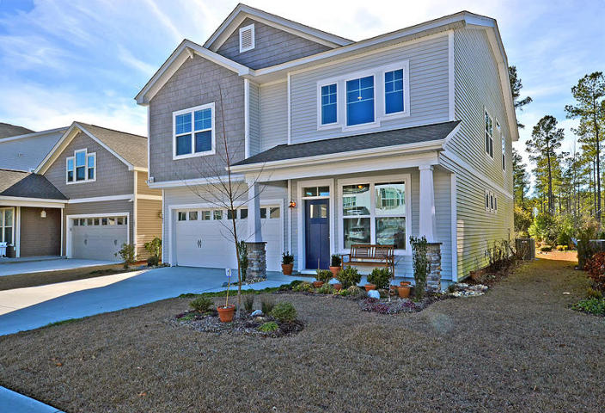
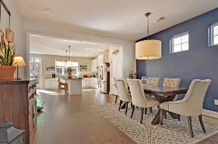
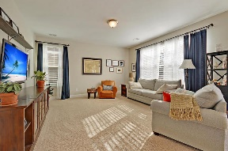
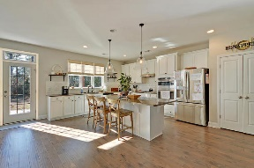
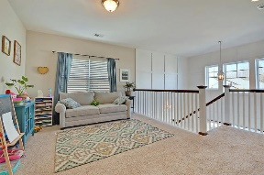
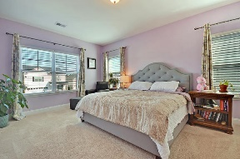
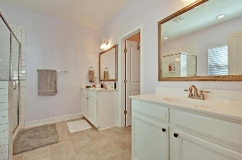
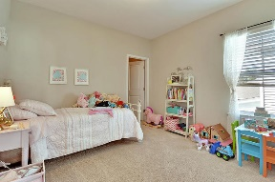
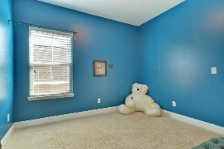
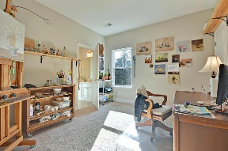
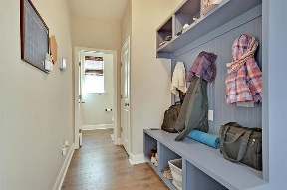
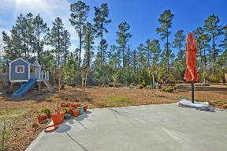
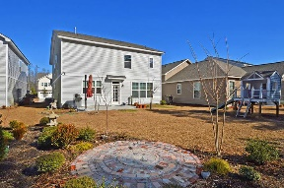


Like New Cane Bay- Walk To Shopping!
105 Sago Court
Cane Bay Plantation
Summerville, SC 29486
MLS# 18002780
$290,000
4 Bedrooms | 3½ Baths | 2,540 sf
Get ready to be Wowed!! Why wait for new construction when this beauty is ready and waiting for you? You'll be immediately impressed when you enter the front door and see the stunning two story foyer that has extensive trim work. Your eyes will also be drawn to the beautiful wood floors. The open floor plan is perfect for entertaining. The dining room flows right in to the gorgeous custom kitchen. Tons of cabinet space, pantry, island, gas stove, subway tile backsplash, quartz countertops, gas cooktop and stainless steel appliances. The kitchen overlooks the large family room which has tons of natural light and overlooks the backyard. The backyard offers a back patio plus an additional patio made from historic Charleston brick. Woods behind the home provide privacy.
Downstairs, you'll also find a cubby storage area perfect for book bags, coats and shoes. Upstairs, you'll find a great sized loft, perfect to use as an office space or media area. Off the loft, is a full bath which connects to a great sized bedroom. Two other bedrooms upstairs share a jack and jill bath. The master bedroom offers walk in closets and a lovely master bath that has dual vanities and a separate large shower and tub. This home is located in walking distance to food shopping, restaurants, banks and a short drive to the new Volvo plant! Don't miss out on this opportunity to move in to a home that is ready now!
Larry & Kathy Mazalatis
Larry Cell 843-693-0529
Kathy Cell 843-693-0159
Office 843-871-9133
AGENTOWNED PREMIERE GROUP | 1800 TROLLEY RD | SUMMERVILLE, SC 29485

