Slide 1


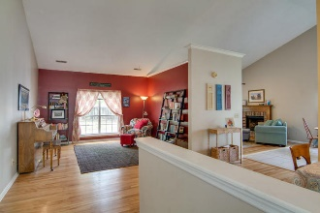
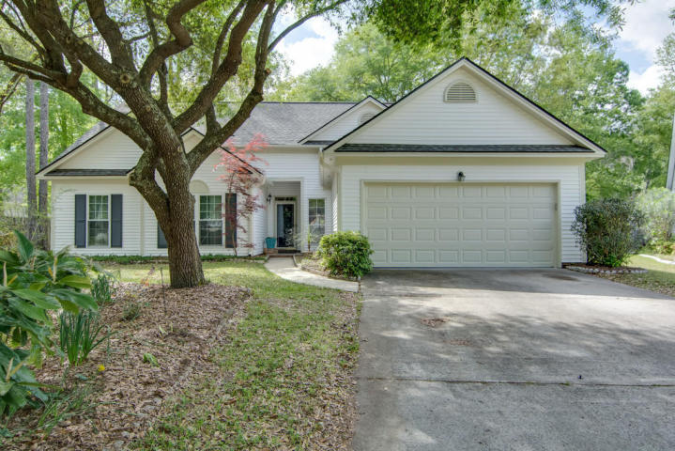
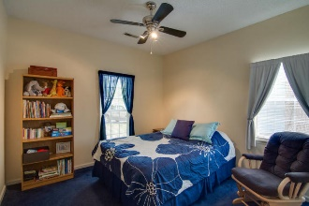
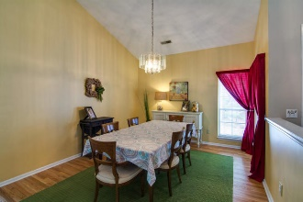
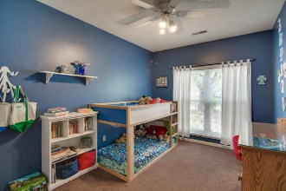
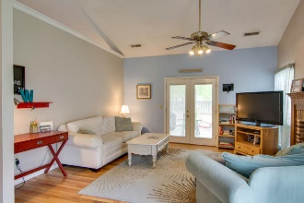
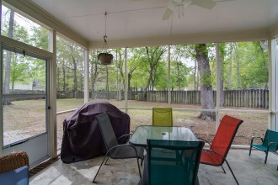
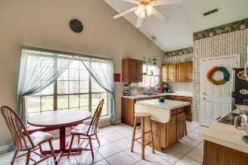
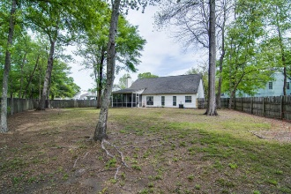
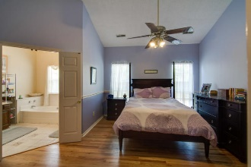
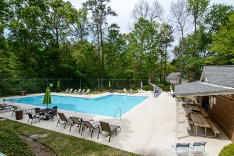
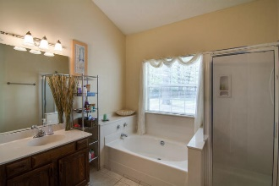
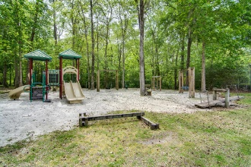

Open House Saturday 11-1
105 Thomaston Avenue
Brandymill ~ Summerville
MLS# 16009770 ~ $209,900
Just Reduced!
Huge lot! Walk to shops! Dorchester II! Open plan! Immaculate! Welcome to this Beautiful, open, single story home on a huge lot! You will be amazed by the space and lay out of this home. Enter into the foyer with formal dining room to the right. Straight ahead is a flex room, could be a living area, study, music room, library; whatever you need. Continue to the right and into the large family room with fireplace which is open to eat-in area and kitchen. The cook can be included in conversation with the family. This is a great home for entertaining! Large screened porch off the family room, for added outdoor enjoyment. The bedrooms are located on the opposite side of the home. Master is a great size, with a large walk-in closet, bath with a garden tub and separate shower. Hardwood floors flow throughout the main living areas, master bedroom and hall. Brandymill has a pool, tennis courts, basketball court, pavilion with grills, and access to the Sawmill Branch walking trails. This is a must see! Call to schedule a showings on this home today!
Laurie A Loparo, ABR laurieloparo@gmail.com
lauriesellscharleston.com
Golden Bear Realty | 654 Coleman Blvd, Suite 100 | Mt Pleasant , SC 29464
Cell (843) 442-1290 | Office (855) 352-9088 | Fax (561) 721-3311

