Slide 1
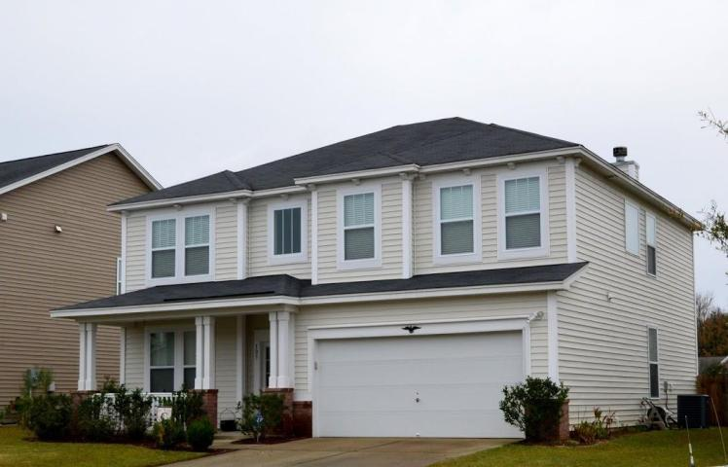
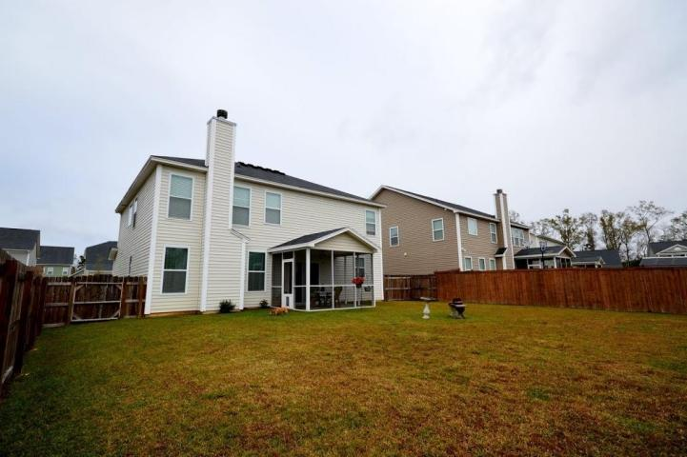
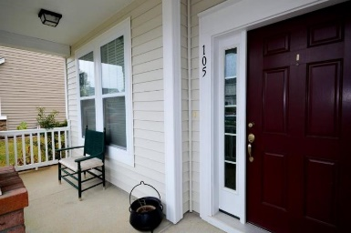
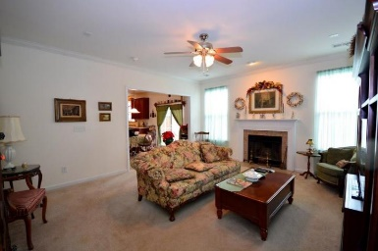
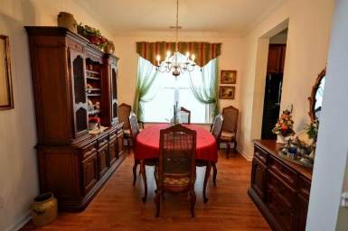
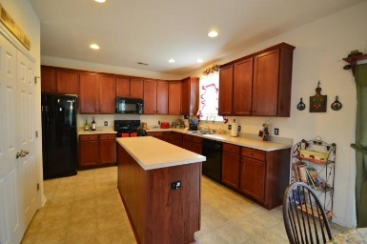
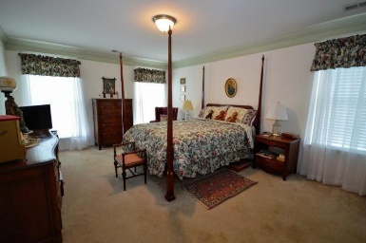
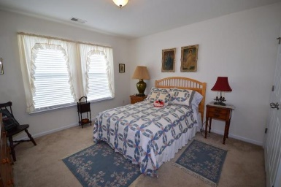
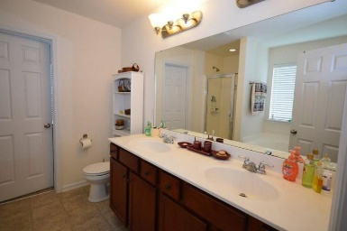
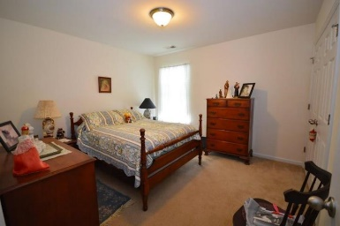
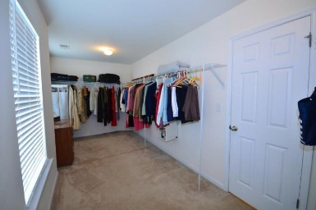
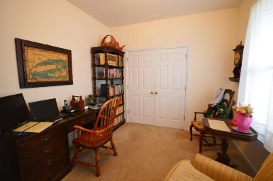
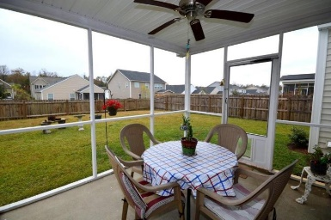
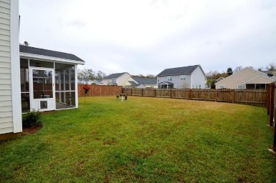


105 Tin Can Alley
Summerville, SC 29483 ~ MLS# 15029862 ~ $219,900
Motivated Seller in Reminisce
~ All Offers Considered ~
Wonderful 4 true bedroom, 2478 sqft home! Incredible location in Reminisce!
2.5 bath, Well kept and sellers have put some upgrades into this home.
Spacious family room, home office or study, Crown mouldings, screened back patio for entertaining.
Dorchester 2 schools! Private, fenced back yard.
Christopher McCormick
Office - 843-974-6200
Cell - 843-224-3204
cjmccormick@carolinaone.com
Carolina One Real Estate
900 N Main St
Summerville, SC 29483

