Slide 1
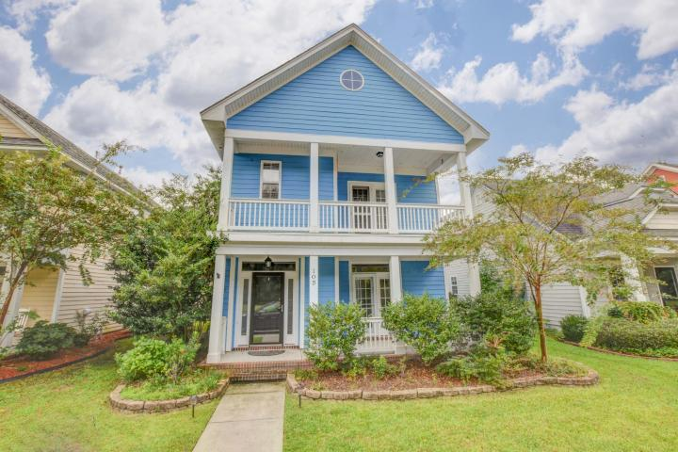
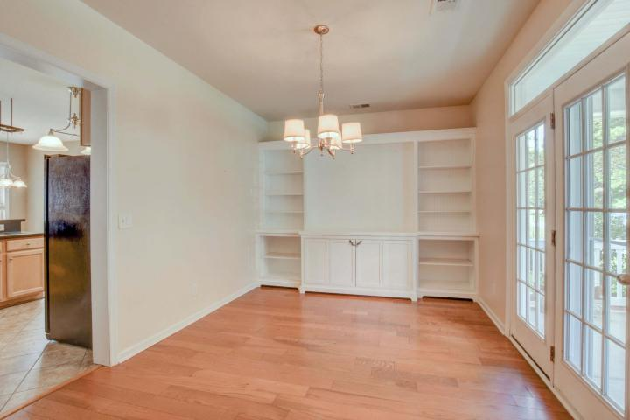
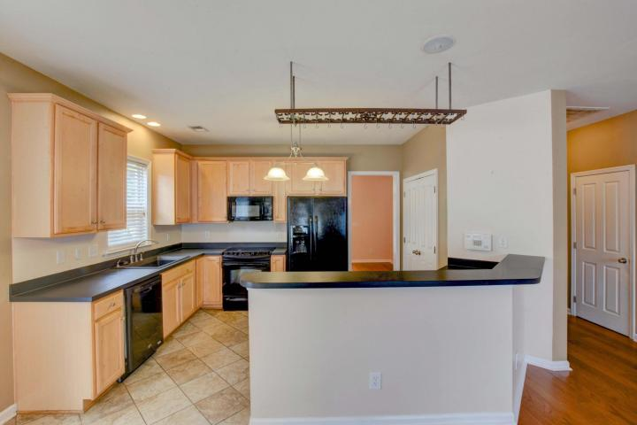
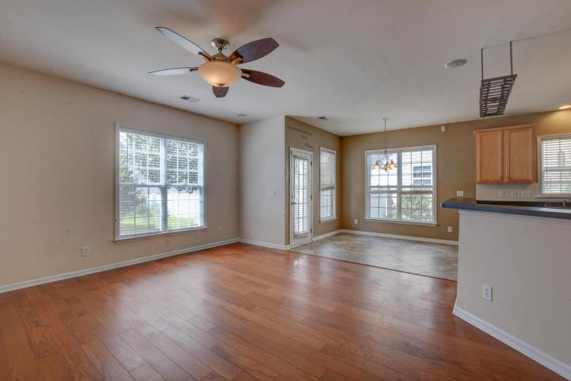
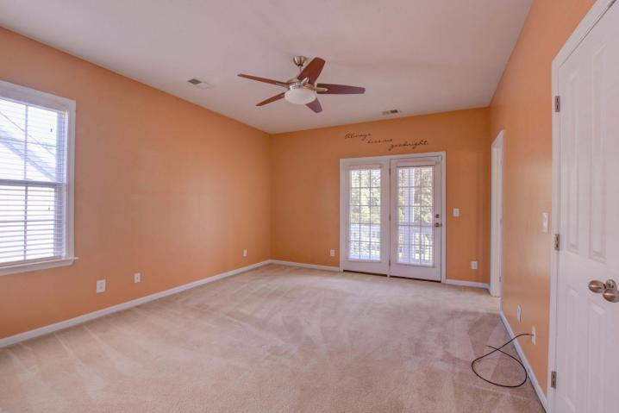
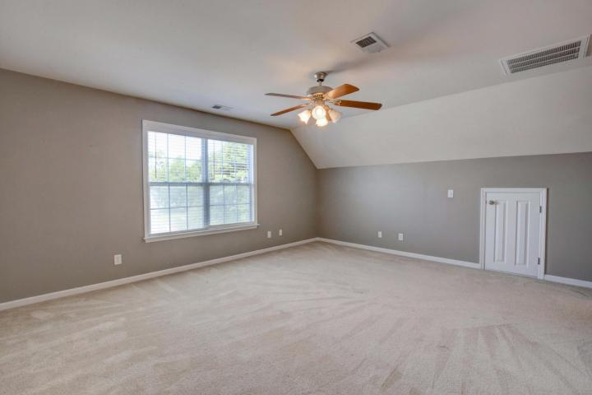
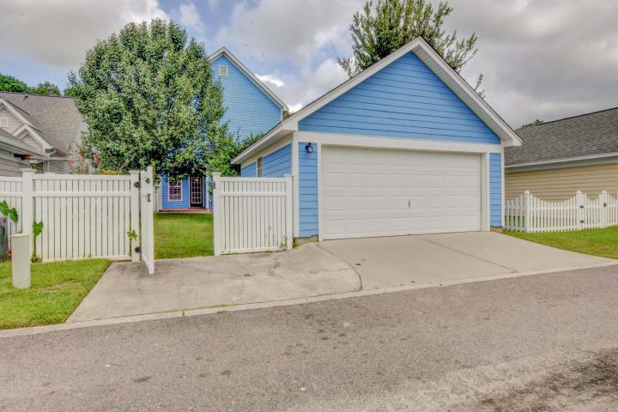


Come See This Home Today!
White Gables Is Where Your White Christmas Should Be
105 Trillium Avenue
White Gables ~ Summerville
MLS# 17023532 ~ $253,000
Welcome Home!
Your new home is shouting to you from this private one sided street across from woodlands, where parking is NEVER an issue. This full double porch,4BR(double master suites)3.5BA has tons of upgrades; double French doors off the dining room & master onto the porches, perfect place for your rocking chairs & birdwatching. Walk into your formal dining room with built-in custom bookcase perfect for moms china or use the room as a man cave and set up TV and trophies! Large open kitchen to living space with enough space for family gatherings. 42'' cabinets, enormous pantry of your dreams, upgraded lighting & unique overhead pot storage. First floor is gorgeously adorned with gleaming hardwoods. Upstairs find the 1st master suite opening onto upstairs full porch, garden tub, dual vanity sinks, amazing tile floor in your master bath. 2nd & 3rd bedrooms are perfect size for your growing family. 3rd floor setting can be used as a guest suite, MIL suite or your MB away from everyone else with a full bath as well. All rooms equipped with ceiling fans, and BRAND NEW HVAC. Out back find upgraded 20x20 garage beyond the beautifully landscaped private backyard. Enjoy the privacy fence and backyard oasis perfect for entertaining. White Gables welcomes your family into this highly desired community with all the amenities: clubhouse, soccer fields, tennis, basketball, fishing ponds, Olympic sized pool & 2 playgrounds. DD2 school bus picks up at the clubhouse! You do not want to miss owning this beauty!
Lisa Horan
Full Service Realtor
843-501-8856
lisaghoran@gmail.com
AgentOwned Premiere Group • 100 Crowfield Blvd • Goose Creek, SC 29445

