Slide 1
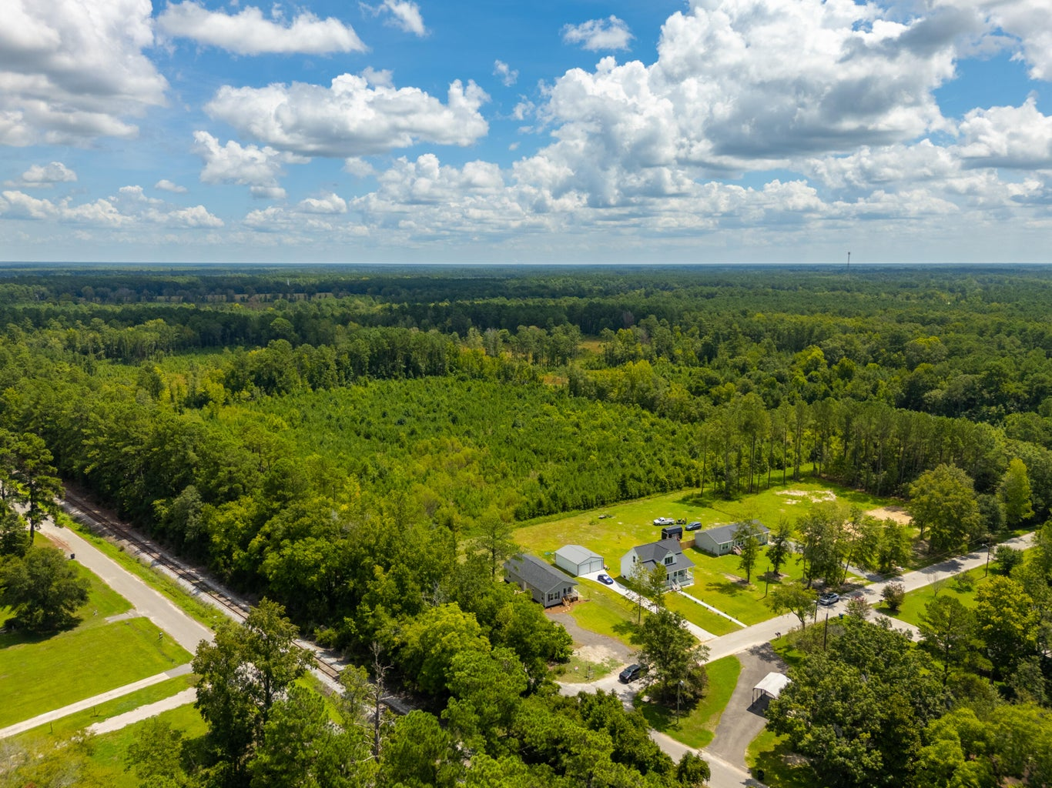




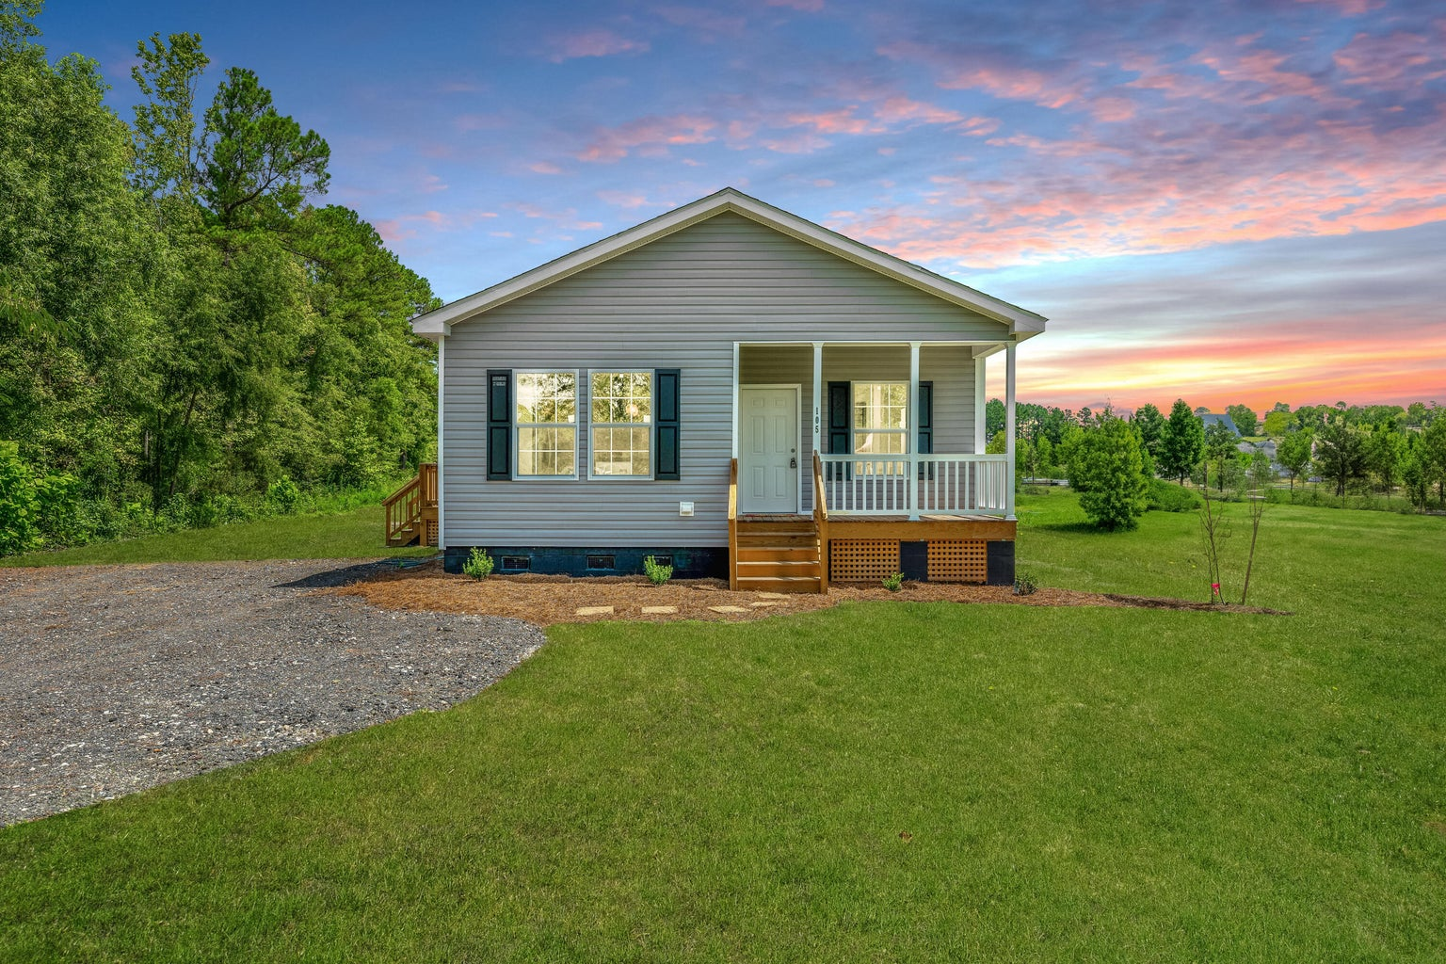
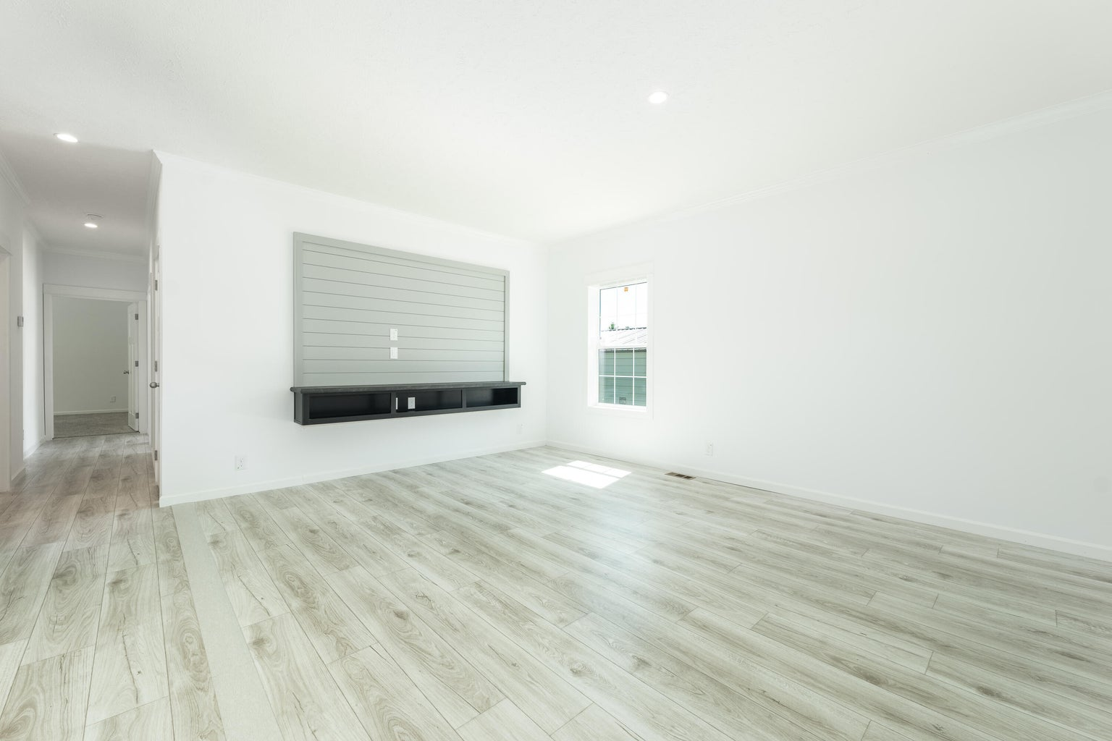
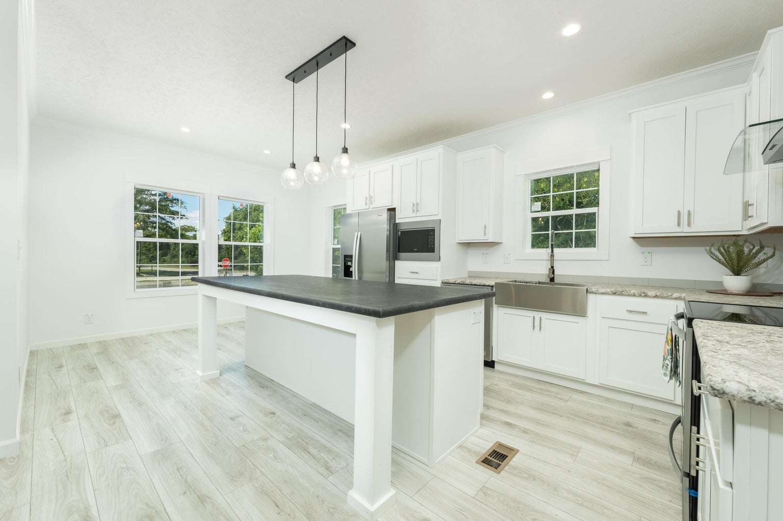
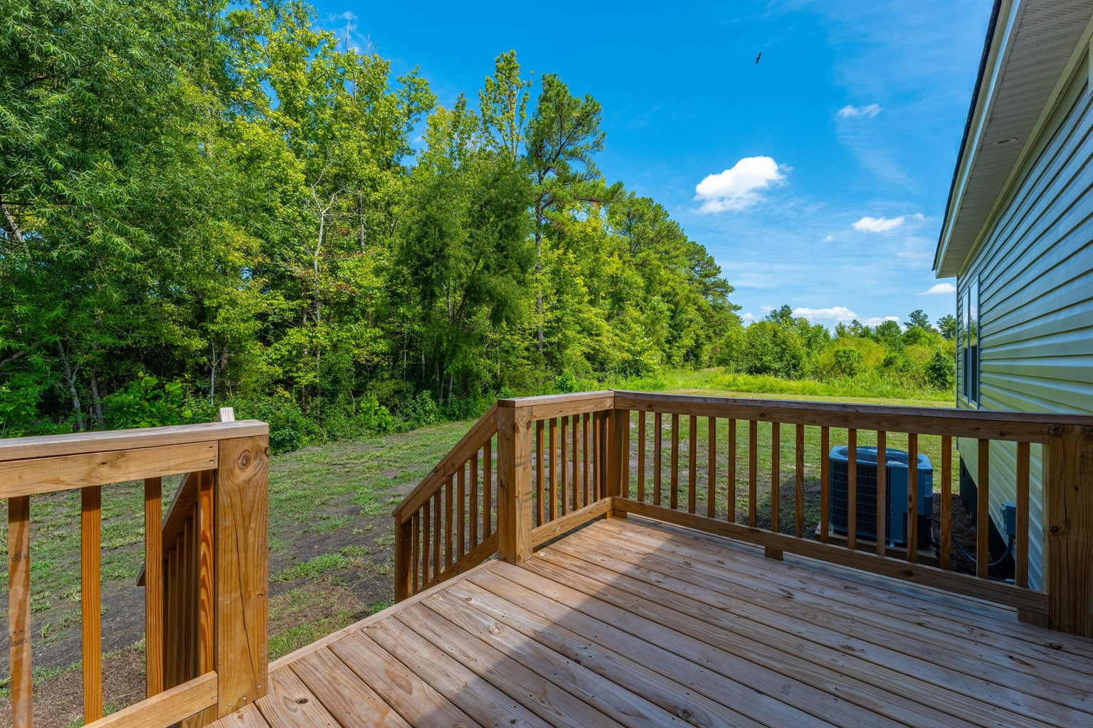

NEW HOME UNDER $300,000
105 Dotson Street
Harleyville, SC 29448 | MLS# 24019193 | $299,000
NEW CONSTRUCTION located in the town limits of Harleyville on a half acre lot with no HOA! 2 miles off I-26 & easy commute to I-95, Summerville, St George, Holly Hill and Volvo. This lovely home is a modern 3 bedroom 2 bath open kitchen and living area floor plan with a welcoming front porch and a deck for those barbecues and entertaining. The large kitchen has all stainless steel Energy Star appliances, craftsmen style cabinets, and a centrally located island for friends and family to enjoy. An adjacent dining area and living room coupled with the 9' ceilings and crown molding. Bedrooms are carpeted and LVP flooring throughout. This home is turnkey and ready to move in!
VIDEO TOUR
Telecia Bilton 843-412-3586
tmbilton@rogcoastal.com
Realty ONE Group Coastal
1510 Trolley Rd
Summerville, SC 29485

