Slide 1
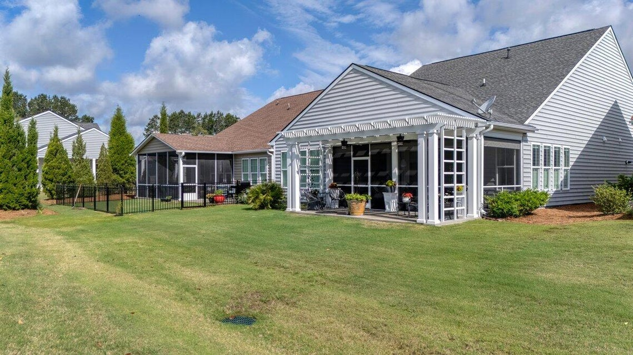
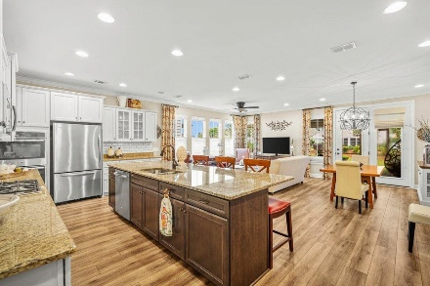
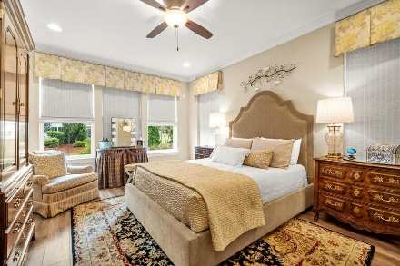
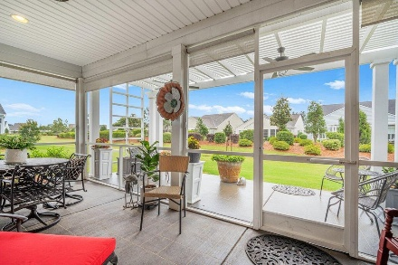
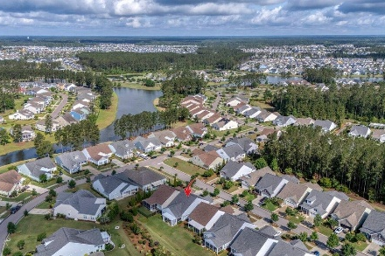

105 Harbor Trace Lane
Four Seasons @ Cane Bay Plantation | Summerville, SC 29486
MLS# 25014235 | $429,900
Darrell Creek Elevated Home With Elevator & Salt Pool
Back On The Market At No Fault Of The Seller
Open House Saturday 7/19 11am-2pm
Co-hosting with
Lisa Wood from
Crown Home Mortgage
Offering $2500
Lender Credit
The lowest price /SF of all the resales in the Neighborhood.
2-Bed, 2- Bath, Office, 2 outdoor patios, 1853 Sq Ft PLUS an additional bonus Storage Room above the garage.
Welcome Home to 105 Harbor Trace Lane - Where Luxury Meets Low Maintenance in Four Seasons at Lakes of Cane Bay! Located in Summerville's premier 55+ lakeside community, this stunning Donegal floorplan is the most popular layout in Four Seasons - and for good reason. Designed with comfort, convenience, and entertaining in mind, this home offers 2 bedrooms, 2 bathrooms, a versatile den or study, and a bonus walk-up storage room with endless potential. Step into the welcoming 9-foot foyer, beautifully upgraded with crown molding, wainscoting, and durable luxury vinyl plank flooring. At the front of the home, guests will enjoy a spacious guest bedroom and full bath, while the flexible den can serve as a cozy office, craft room, or even a third bedroom if desired. The heart of the home.
opens into an expansive living and dining area, anchored by a gourmet kitchen featuring an oversized granite island, gas cooktop, tiled backsplash, and pull-out cabinetry, perfect for culinary enthusiasts and effortless entertaining. The kitchen flows seamlessly into a bright and airy open-concept living and dining space, ideal for gatherings or quiet evenings at home. The private owner's suite is a true retreat, featuring a spa-inspired ensuite bathroom with his-and-hers vanities, a large walk-in shower, and an expansive walk-in closet built for sharing. Just off the kitchen, you'll find a convenient drop zone and a large laundry room with built-in shelving and an additional closet for all your storage needs. From the two-car garage, you'll find access to an incredible walk-up bonus room, perfect for use as a guest suite, man cave, hobby room, or simply a well-organized space to store all "Four Seasons" of items. With its finished walls and full-sized entry, it's much more than just storage, it's space that adapts to your lifestyle.
The crown jewel of this home is the beautifully landscaped private lot and the two inviting outdoor living areas. Enjoy your mornings on the screened-in stamped concrete porch complete with dual ceiling fans. In the evening, relax under the covered pergola, also equipped with ceiling fans, and unwind with a glass of wine while soaking in the peace and tranquility of your own backyard. In Four Seasons you will never be bored, as this is the only Active Adult Community in the area that is built around a 300-acre lake with its own private boat dock. Other amazing amenities include an indoor and outdoor pool, fitness center, ballroom, dog park, bocce, pickleball, tennis courts, a kayak launch and so much more! There is also a packed monthly events calendar and Full-time Lifestyle Director. Once you move to the Four Seasons, you will never want to leave. This is more than a home, it's the lifestyle you've been waiting for. Welcome to your retirement dream. Welcome home to 105 Harbor Trace Lane!
House Tour
Elissa Campbell
843-853-1433 | elissa.campbell@agentownedrealty.com
AgentOwned Realty Preferred Group | 824 Johnnie Dodds Blvd | Mt Pleasant, SC 29464

