Slide 1
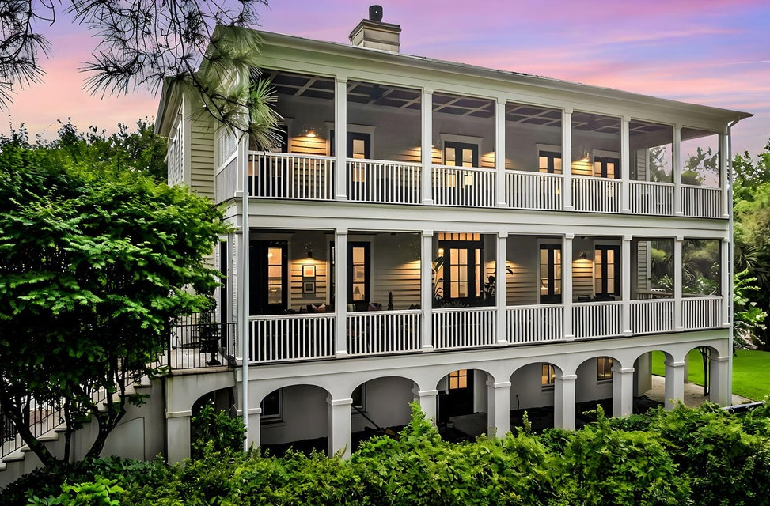
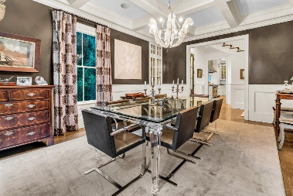
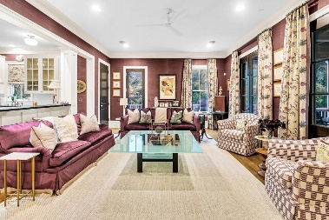
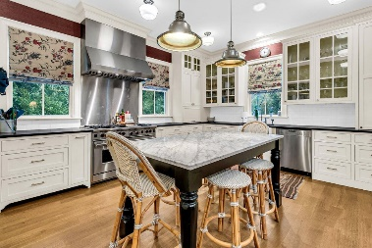
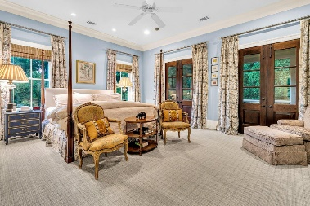
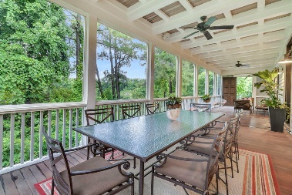


105 Jakes Lane Ion · Mount Pleasant, SC 29464 · MLS# 24016991 · $3,700,000
Broker Open House
Thursday August 15th
12:30 - 2:30
Incredibly elegant home, with 1,100 sf of porches, overlooking a large, quiet pond and Rookery in I'On - completely private, yet you can walk to everything. 10' ceilings downstairs 9' ceilings upstairs, gorgeous finishes; large, comfortable rooms and porches made for entertaining make this home special. Gourmet kitchen with top-of-the-line appliances, a center island that seats six, tons of cabinetry for great storage, wine fridge, ice maker, wet bar and a built-in desk. The kitchen is adjacent to a large family room that has access to a porch to the side yard as well as to the front piazza. Across the front hall is the lovely living room with a fireplace, which leads to the large dining room, which has a built-in display cabinet. A walk-in pantry, coat closet and powder room complete the first floor. Upstairs you will find 4 bedrooms, 3 of which have views of the pond and Rookery, and have access to the full length screened in porch. Large primary bedroom - his and her walk-in closets with built-ins, and in the primary bath, double vanities, WC, tub and shower. Two other bedrooms have en suite baths. Nice laundry room with built in cabinets, drying area and stacked washer/dryer. An oversized two car garage (with storage closets) and a huge room currently used for exercise and storage are on the lower level. There is definitely room for a pool in this yard, if you would like to add one. New roof in 2023. Stunning home and location. Award winning I'On offers many amenities - scenic marsh trails, deep water boat landings and docks, parks, playgrounds, neighborhood events and great restaurants. I'On is a 10-minute drive to Charleston, as well as to the beaches of Sullivan's Island and the Isle of Palms.
Wendy Nixon
203-858-7909
wlknixon@gmail.com
wendynixon.agentowned.com
AgentOwned Realty Co. Preferred Group, Inc. | 824 Johnnie Dodds Blvd | Mt Pleasant, SC 29464

