Slide 1
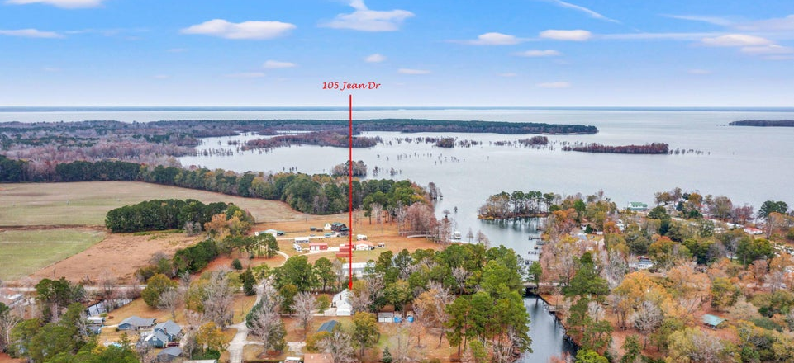
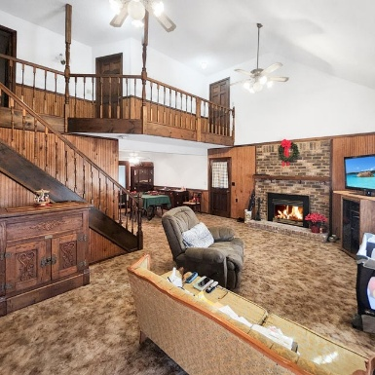
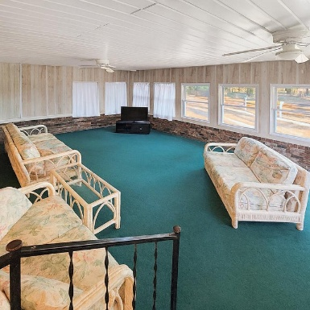
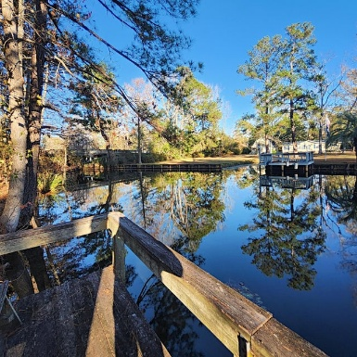


105 Jean Drive Eutawville, SC 29048 | MLS# 25032409 | $465,000
New Price! Lake Marion Waterfront!
Open House
Wednesday, 7/20
3-5PM
Welcome to 105 Jean Drive in Eutawville — a waterfront retreat offering space, comfort, and true Lake Marion living. Set on a generous .93-acre deeded waterfront lot, with an additional .75 acres under marginal lease, this property offers nearly 2 acres total, providing room to relax, entertain, and enjoy the outdoors. A private dock delivers quick, easy access to Lake Marion, South Carolina's largest lake, known for its expansive open water, boating, fishing, and year-round recreation across more than 110,000 acres.
This 6-bedroom, 2.5-bath home offers 2,288 square feet of living space with a warm, inviting lake house feel throughout. The living room features high ceilings and a brick fireplace, creating a cozy focal point for gatherings after a day on the water. A large sunroom extends the living space and is ideal for summer evenings, morning coffee, or hosting friends and family.
The main level includes a primary suite, an additional guest bedroom, and a convenient half bath, while four bedrooms upstairs provide flexibility for guests, home office space, or multi-generational living. Additional features include a 2-car garage and a fenced backyard, offering both functionality and privacy.
Whether you're seeking a primary residence or a secondary home near the lake, this property offers a rare combination of waterfront access, acreage, and versatile living space. Lake Marion's location allows convenient access to nearby towns while maintaining the peaceful, outdoor lifestyle the area is known for.
Schedule your private showing today to explore the possibilities at 105 Jean Drive and experience waterfront living on Lake Marion firsthand.
Brandon Ray
(843) 499-1928
brandon.ray@carolinaone.com
www.lakelifescstyle.com
Carolina One Real Estate
900 N Main St
Summerville, SC 29483

