Slide 1
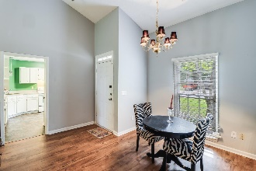
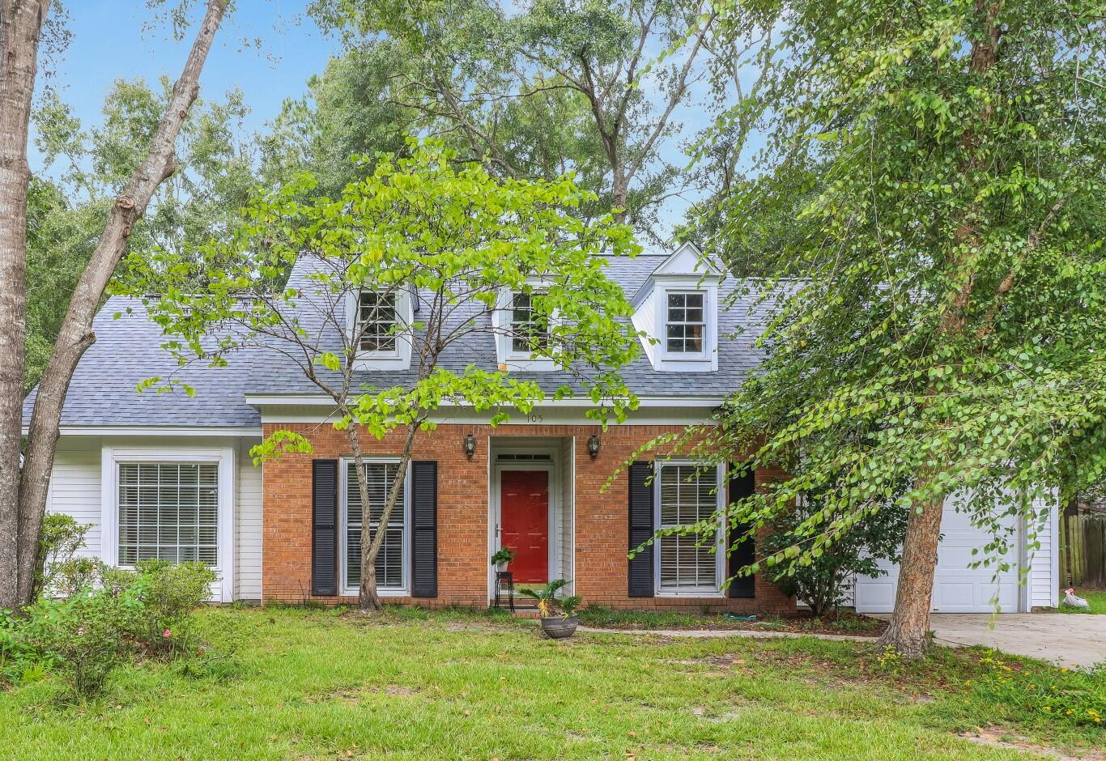
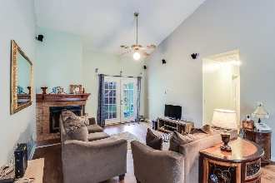
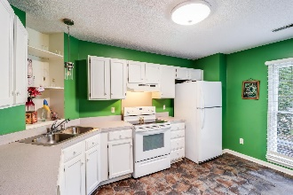
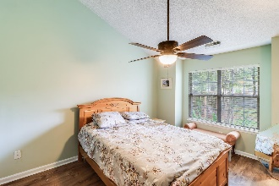
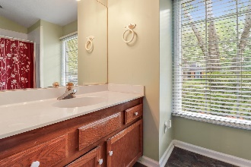
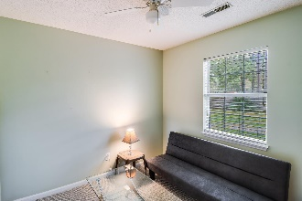
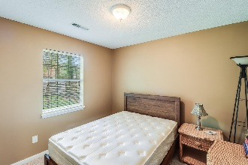
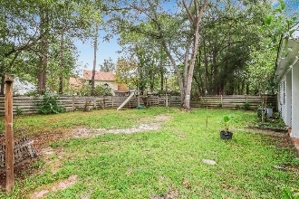
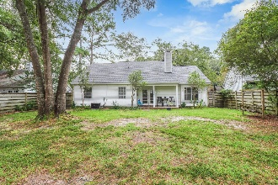


105 Macfarren Lane
Summerville Place | Summerville, SC 29485
MLS# 23021373 | $320,000
Open House
Wednesday, 7/20
3-5PM
New Roof 2023! Motivated Seller!
New Roof -2023! Welcome to this charming ranch-style house located in Summerville. This 1185 sq ft home features 3 bedrooms and 2 full bathrooms, with an attached 1 car garage. One of the standout features of this property is its central location, which provides easy access to various amenities in Summerville. Whether you're looking for shopping centers, restaurants, or recreational facilities, everything is just a short drive away. As you step into the home, you'll be greeted by a light, bright, and airy atmosphere, thanks to the tall ceilings in the open family room and dining area. The family room has a wonderful brick surround cozy fireplace, perfect for those chilly evenings. The spacious kitchen offers plenty of white cabinets for storage and ample counter space for food preparation. Whether you enjoy cooking delicious family meals or hosting dinner gatherings, this kitchen has you covered. The primary bedroom is generously proportioned and features tall ceilings, adding to the overall sense of space. The two bathrooms in the home both have tub shower combos, ensuring convenience for family members and guests alike. In addition, two more bedrooms offer space for family, guests staying over, or office space if needed. Outside, you'll find a back covered patio, perfect for enjoying outdoor meals or hosting barbecues. The backyard is fenced in offering a private and perfect space to enjoy outdoor activities or entertaining. The mature landscaping adds to the overall aesthetic appeal of the property.
This charming ranch-style house offers a comfortable and convenient living experience in Summerville. With its spacious rooms, central location, and attractive features such as a fireplace and private backyard, this home is sure to impress. Don't miss out on the opportunity to make this house your new home.
Brandon Ray
(843) 499-1928
brandon.ray@carolinaone.com
www.therightrayhome.com
Carolina One Real Estate
900 N Main St
Summerville, SC 29483

