Slide 1
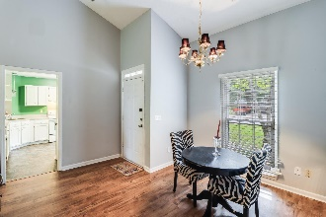
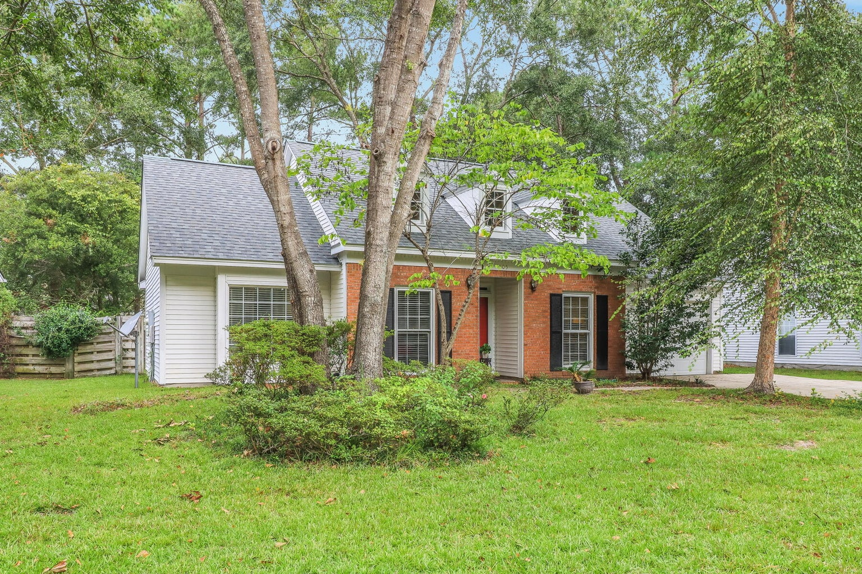
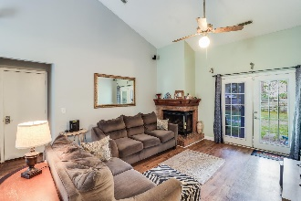
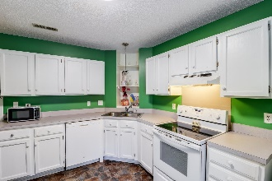
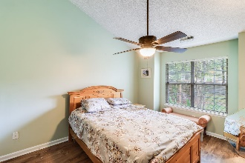
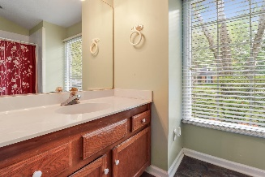
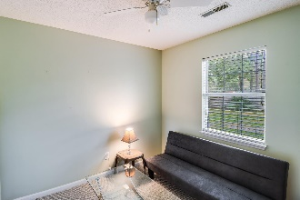
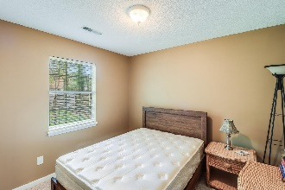
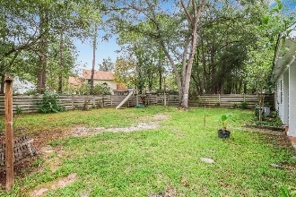
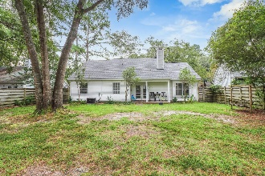


105 Macfarren Lane
Summerville Place
Summerville, SC 29485
MLS# 23021373 | $312,500
Motivated Seller! Bring All Offers!
Open House
Wednesday, 7/20
3-5PM
Welcome to this inviting ranch-style haven, nestled in the heart of Summerville. This meticulously maintained 1,185 sq ft residence boasts 3 spacious bedrooms, 2 full bathrooms, and the added bonus of an attached 1-car garage. Fresh Appeal - New Roof in 2023! One of the standout features of this property is its unbeatable location, offering convenient access to Summerville's finest amenities. Whether it's shopping, dining, or recreational pursuits, you're just a stone's throw away from everything you desire. Step inside, and you'll be immediately captivated by the light, airy ambiance that fills every corner of this home, courtesy of its lofty ceilings. The open family room and dining area are perfect for entertaining and relaxation, especially with the cozy brick surround fireplace to warm up those chilly evenings.
The kitchen is a chef's dream, featuring ample white cabinets for storage and an abundance of counter space for culinary adventures. Whether you're preparing weekday dinners or hosting grand feasts, this kitchen is your culinary playground. The primary bedroom is an oasis of tranquility, with its generous size and lofty ceilings adding to the overall sense of space. Both bathrooms in the home are equipped with tub-shower combos, ensuring convenience for family and guests alike. Plus, two additional bedrooms provide flexibility for family, guests, or even a home office.
Step outside, and you'll discover a covered patio that's perfect for al fresco dining and hosting memorable barbecues. The fenced backyard offers privacy and a serene space for outdoor activities and gatherings. The mature landscaping enhances the property's overall charm and curb appeal. This charming ranch-style house offers the perfect blend of comfort and convenience in Summerville. With spacious rooms, a central location, and attractive features like the cozy fireplace and private backyard, this home is poised to steal your heart.
Don't let this opportunity slip away - make this charming house your forever home today!
Enjoy a video tour!
Brandon Ray
(843) 499-1928
brandon.ray@carolinaone.com
www.therightrayhome.com
Carolina One Real Estate
900 N Main St
Summerville, SC 29483

