Slide 1
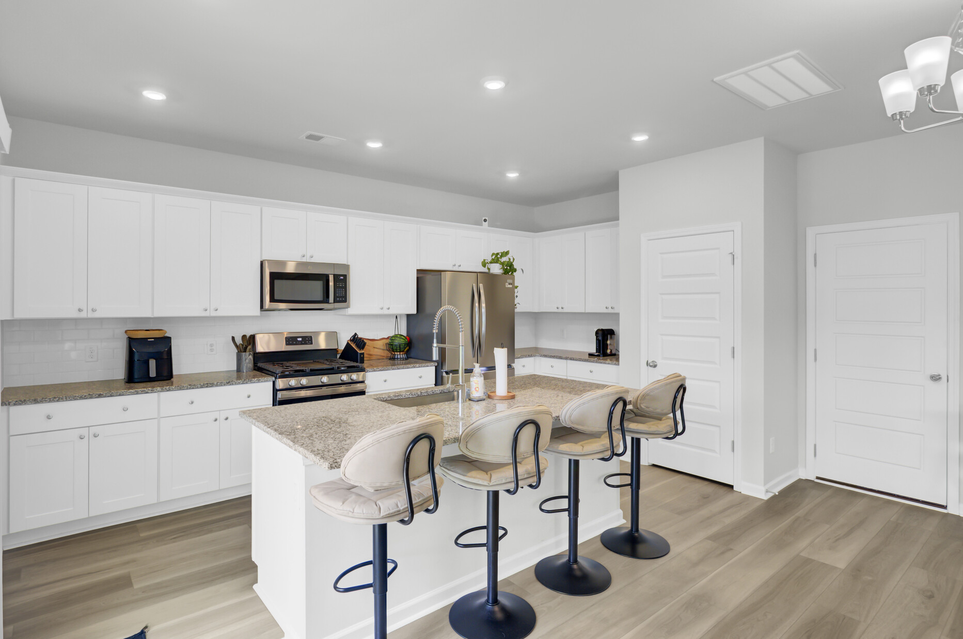

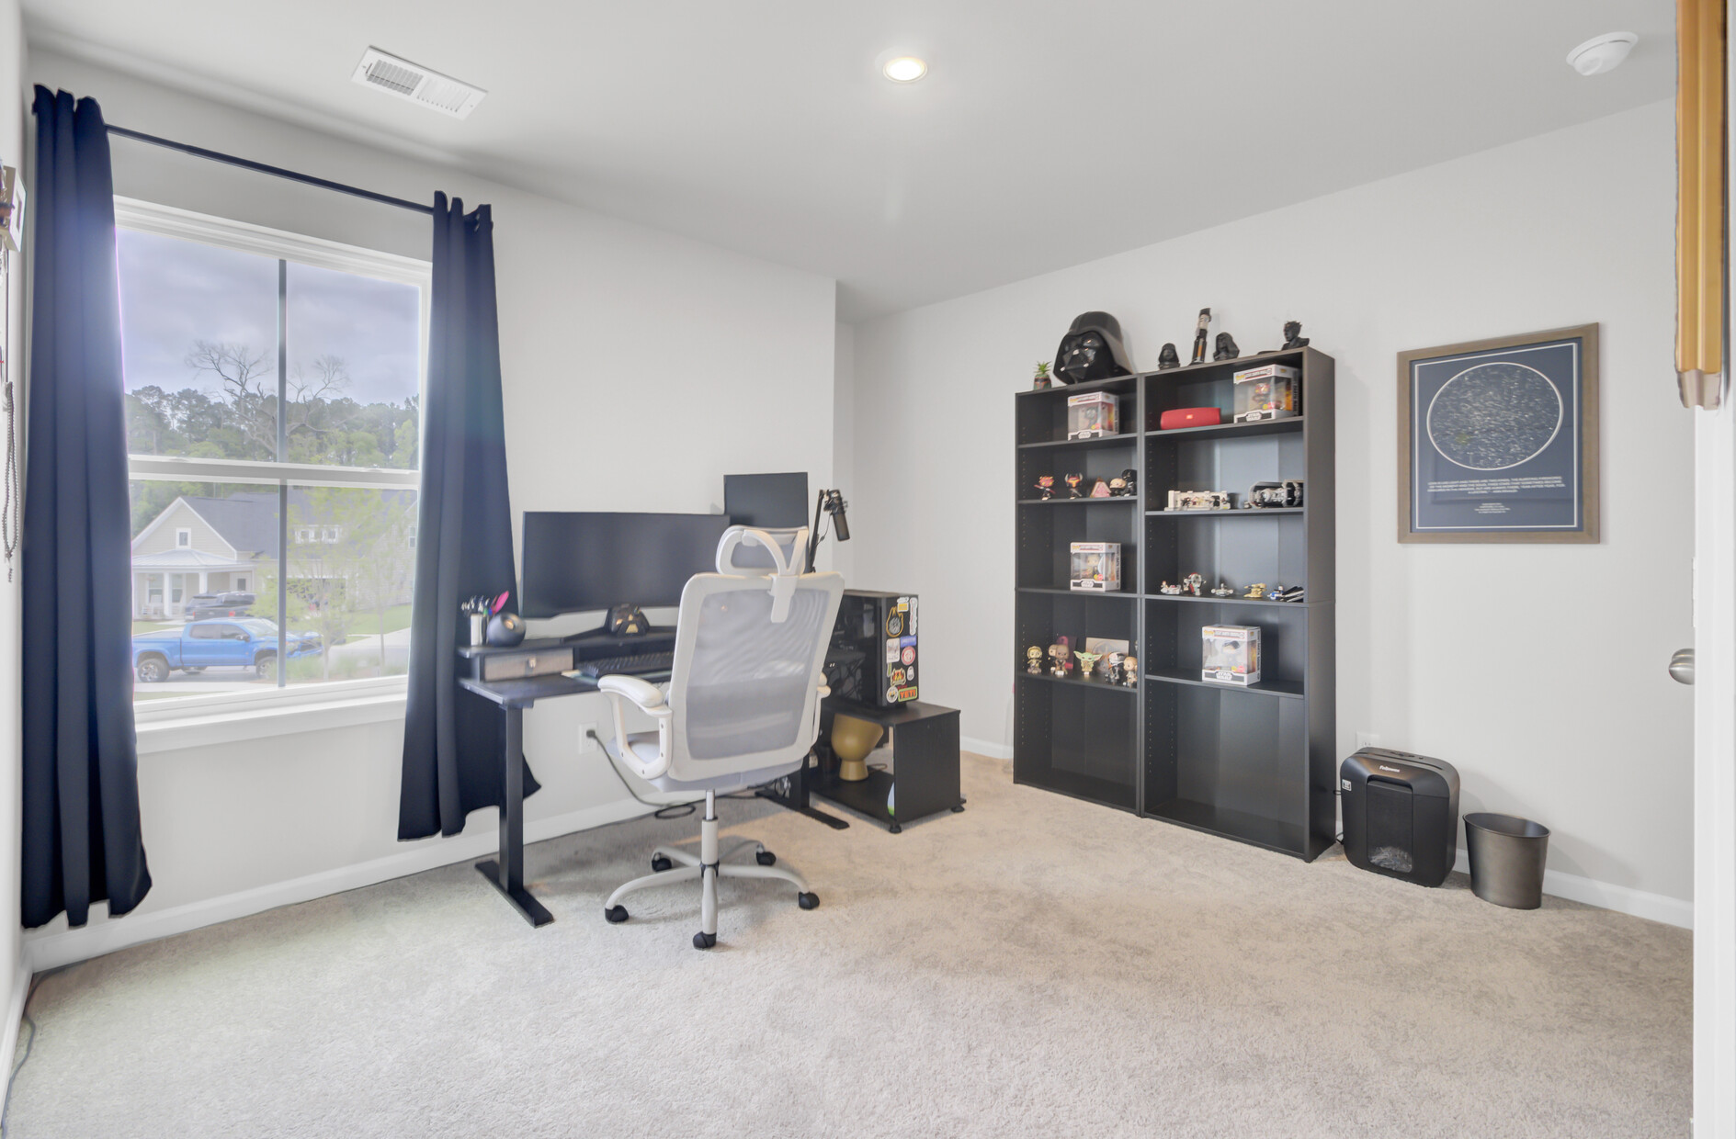
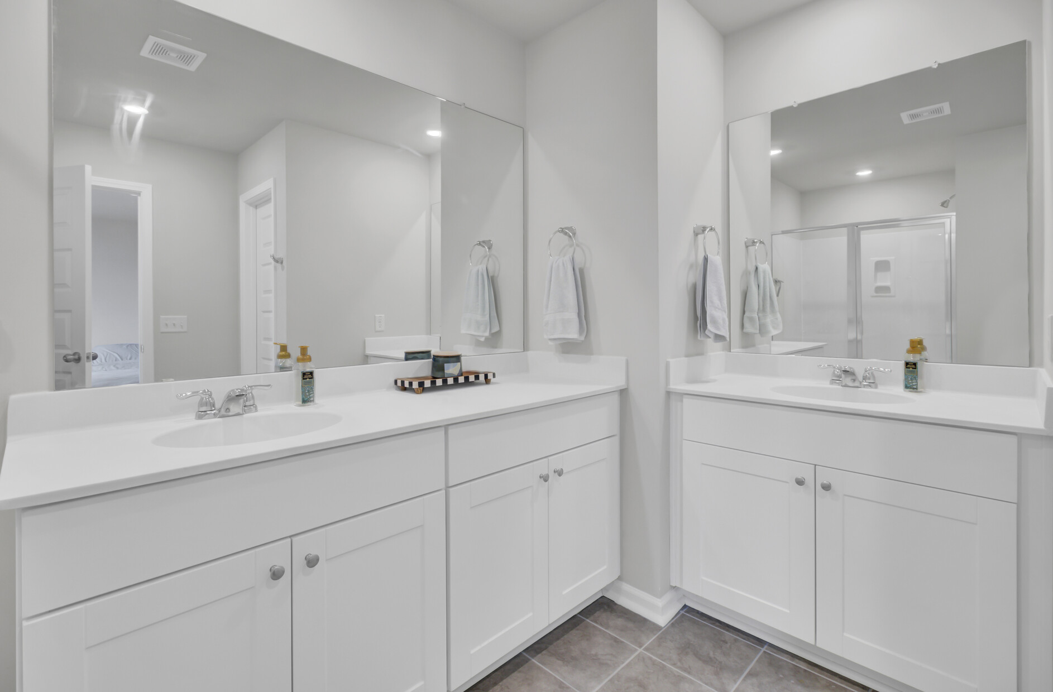
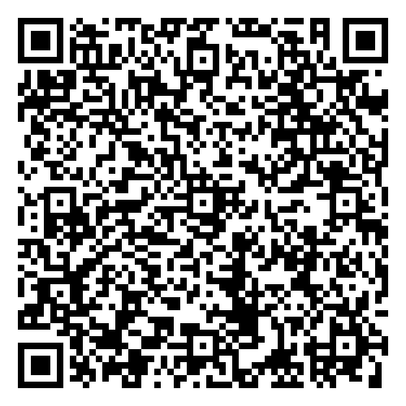
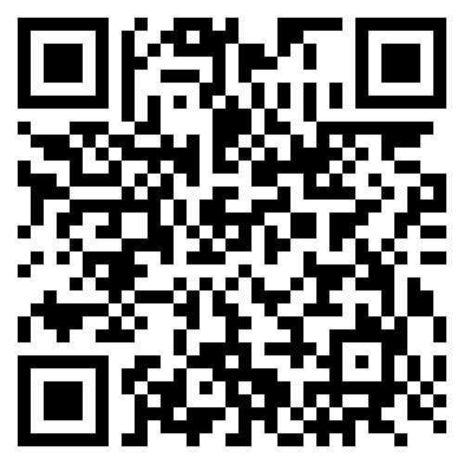
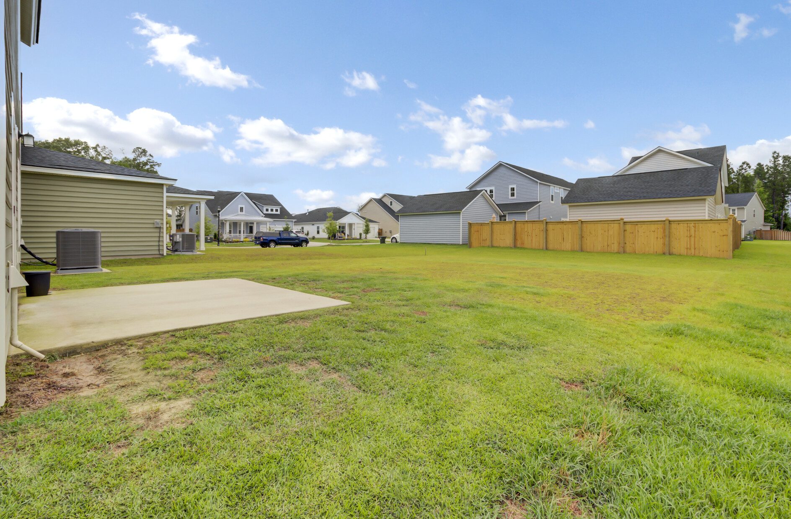


New Listing and Open House
Sellers are offering buyer agent compensation at 2.5%
Virtual
Tour
Video Tour
105 Oast Lane | Summerville, SC
2,027 SF | 4 BR | 2.5 BA
Built in 2024
Schedule your private tour today—this one won’t last long!
Looking for a move-in ready home in one of Summerville’s most desirable communities? Welcome to 105 Oast Lane, located in the Heron’s Walk section of Summers Corner! This stylish 4-bedroom, 2.5-bath Sweetgrass Plan offers open-concept living, a huge backyard, and all the benefits of a nearly new build. You’ll love the convenient location near Hwy. 165 and Ashley Ridge High—and the lifestyle perks of a community with resort-style amenities, including South Carolina’s largest pool (now under construction).
Video Tour
Ellen O'Neil
Broker/Owner, ABR, e-PRO, CNE
Charleston Realtor of Distinction
843-300-8530
www.EllenONeilProperties.com

