Slide 1
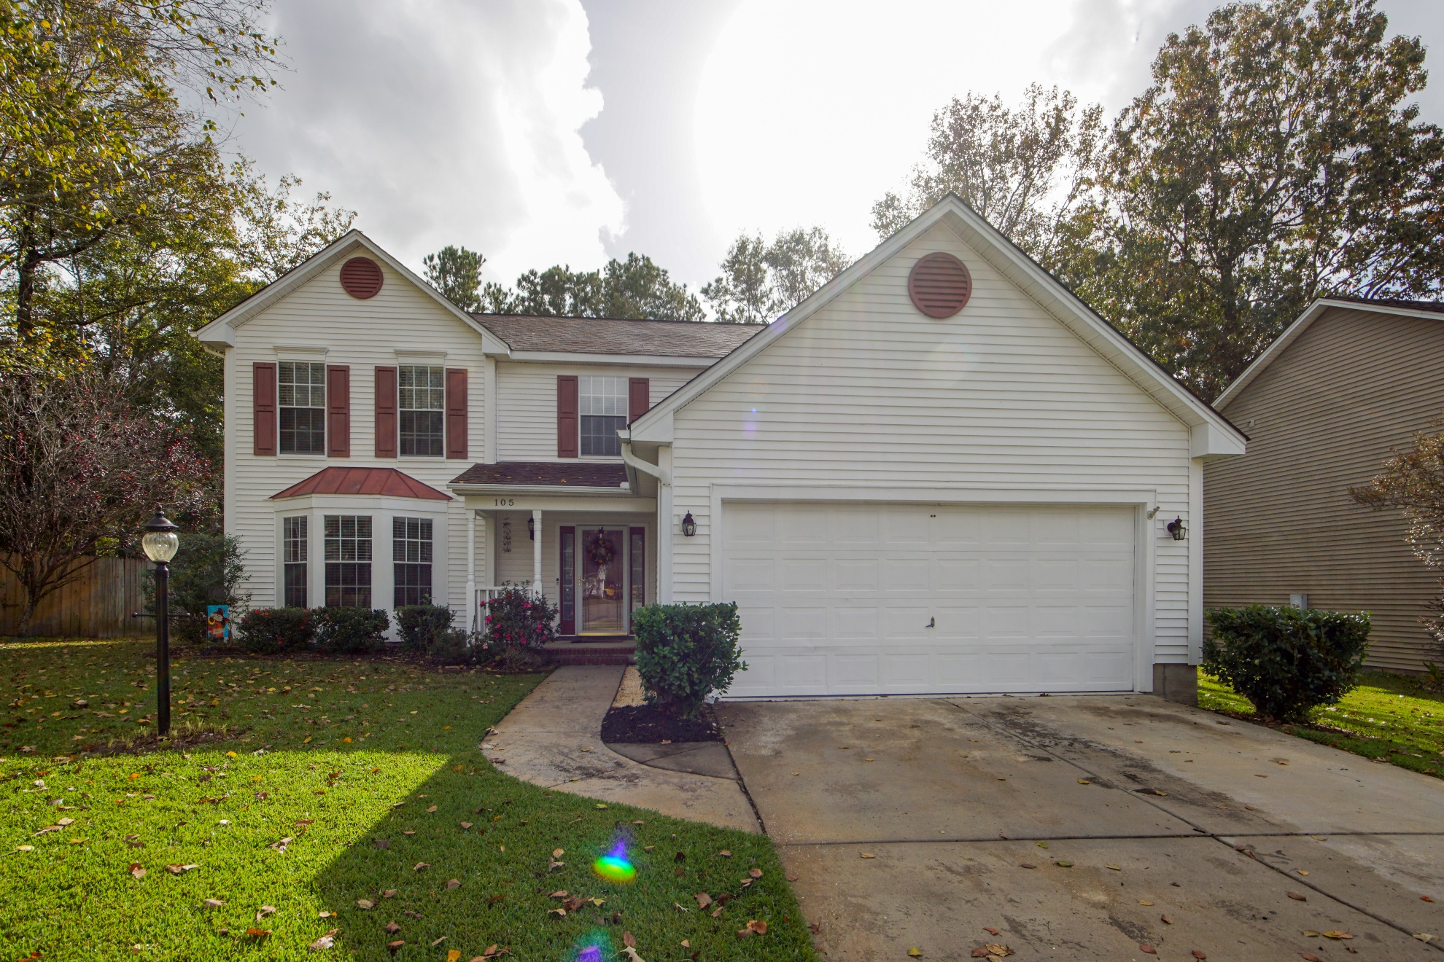
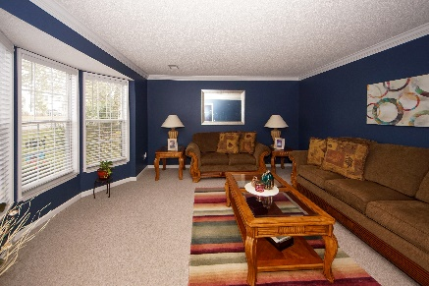
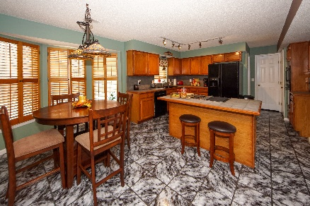
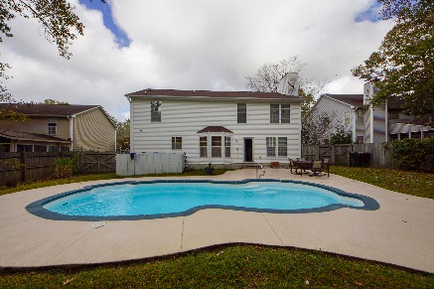


105 S Pembroke Drive
Crowfield Plantation :: Goose Creek, SC 29445
MLS# 20030673 :: $339,900
5 Bed / 2½ Bath
Come Visit on Saturday from 12-3
Open House
Get ready for for summer with your own Swimming Pool! Own this stunning 5 bedroom home in Crowfield Plantation. Sellers have maintained their home ready for the new owner. S Pembroke is a traditional home with plenty of space....Formal Living, Formal Dining, Family Den connected to spacious kitchen great for entertaining. Kitchen has an island stove and 2 pantries! 5 bedrooms are found upstairs with a spectacular master bedroom and master bath! Find your outdoor paradise lounging by your Inground Swimming Pool in a private back yard!!!
Connie White, Broker
843-532-3356
connie@chrepros.com · conniewhiterealestate.com
Charleston Homes · 597 Old Mt. Holly Road · Suite 301 · Goose Creek, SC 29445

