Slide 1
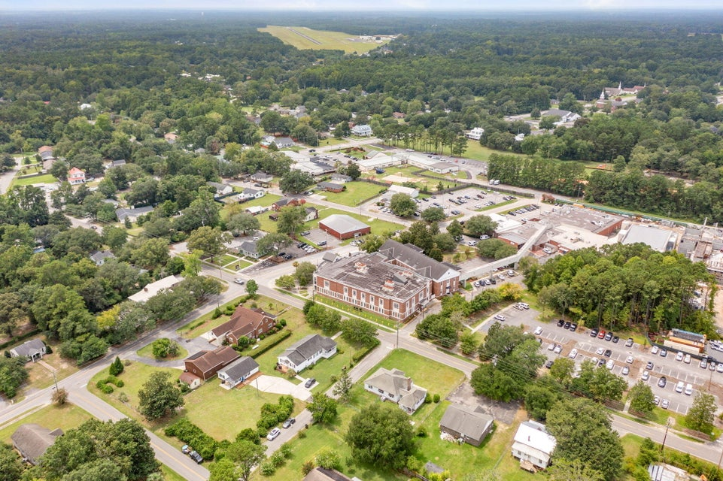




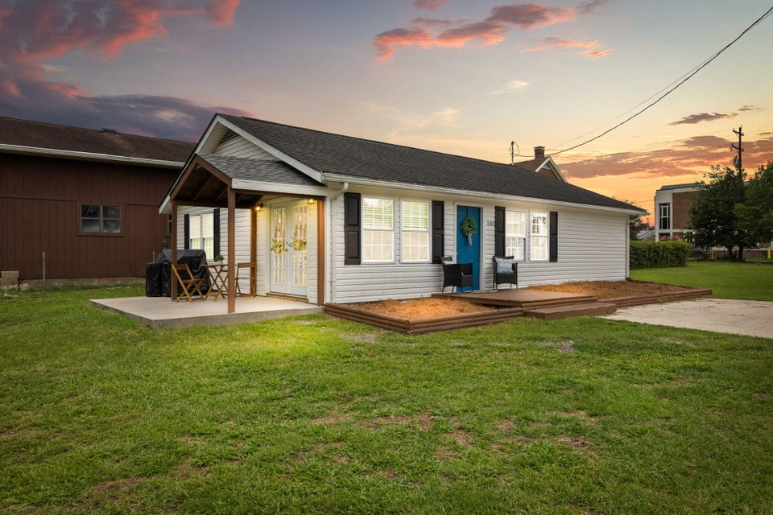
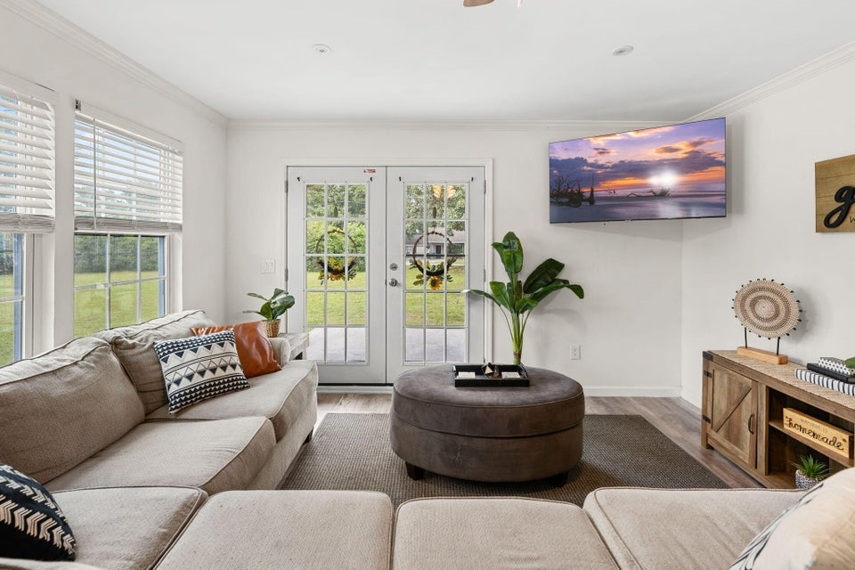
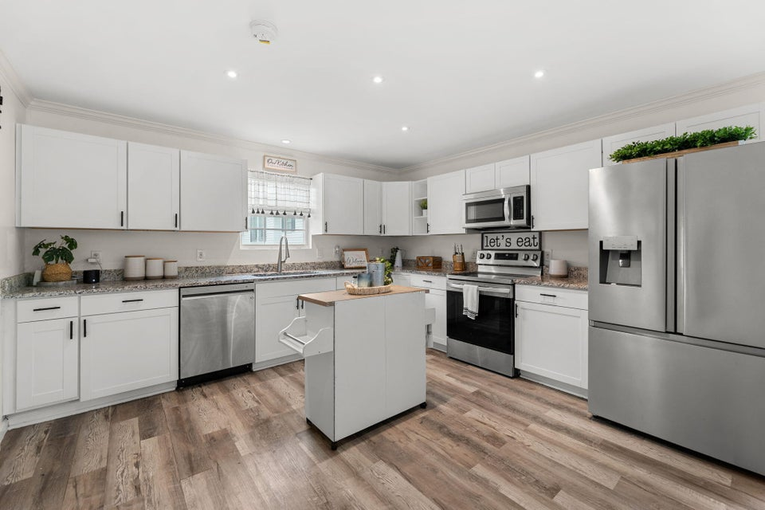
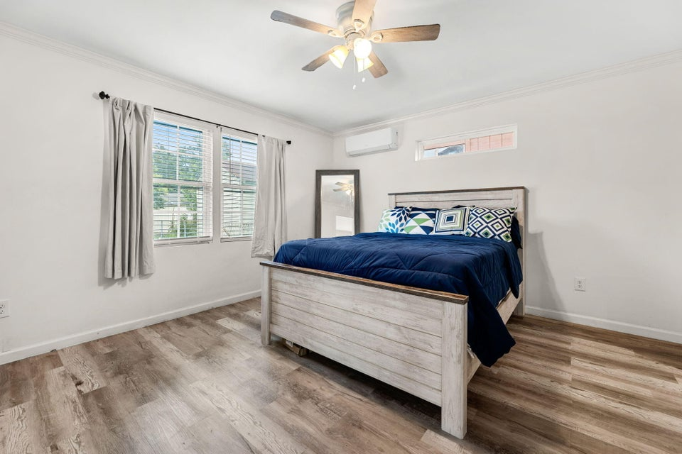

Perfect starter Home
105 Whetstone
Mitten Park & Terrace | Moncks Corner, SC 29461 | MLS# 24020116 | $280,000
Welcome to 105 Whetstone St. located in the quaint town of Moncks Corner, affectionately known as ''The Low Country's Hometown.'' This 2 year old home is 1100 square feet, with 2 bedrooms, 2 full bathrooms and an open concept living space. Set on a large lot, with 2 adorable porches you'll have plenty of room for outdoor activities, gardening, or creating your own outdoor oasis while enjoying the freedom of no HOA. Just minutes to exploring the charming old Main Street filled with unique shops, local boutiques, and delightful cafes. In under 10 minutes you can be at Lake Moultrie where you can enjoy hunting, fishing, hiking, kayaking and so much more. Experience the relaxed low country way of life and the rich history of Moncks Corner.
VIDEO TOUR
Kerry Roberts 843-304-5689
kerrysellscharleston@gmail.com
Realty ONE Group Coastal
1510 Trolley Rd
Summerville, SC 29485

