Slide 1
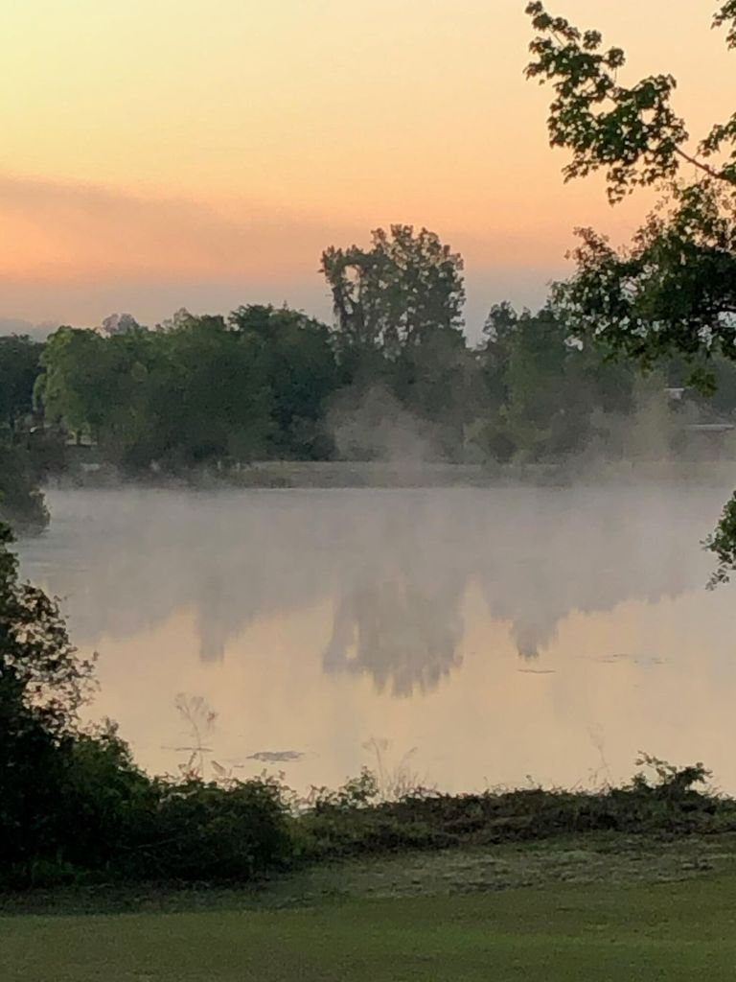
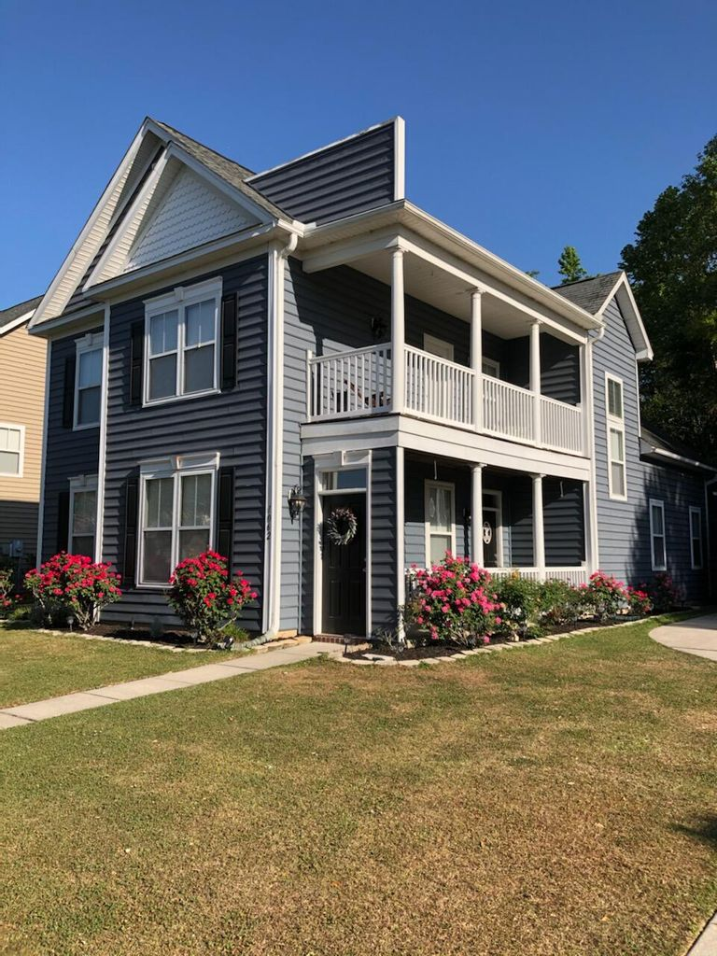
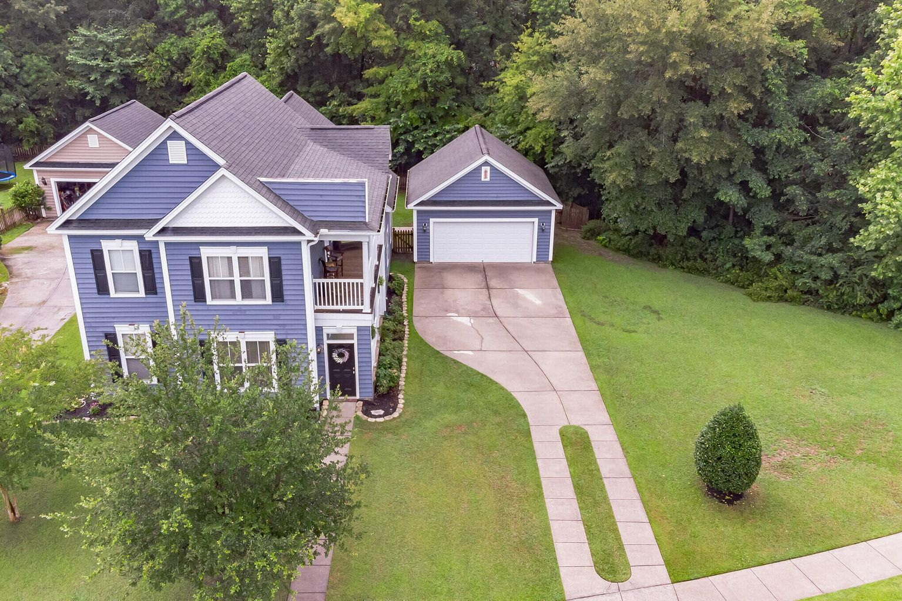
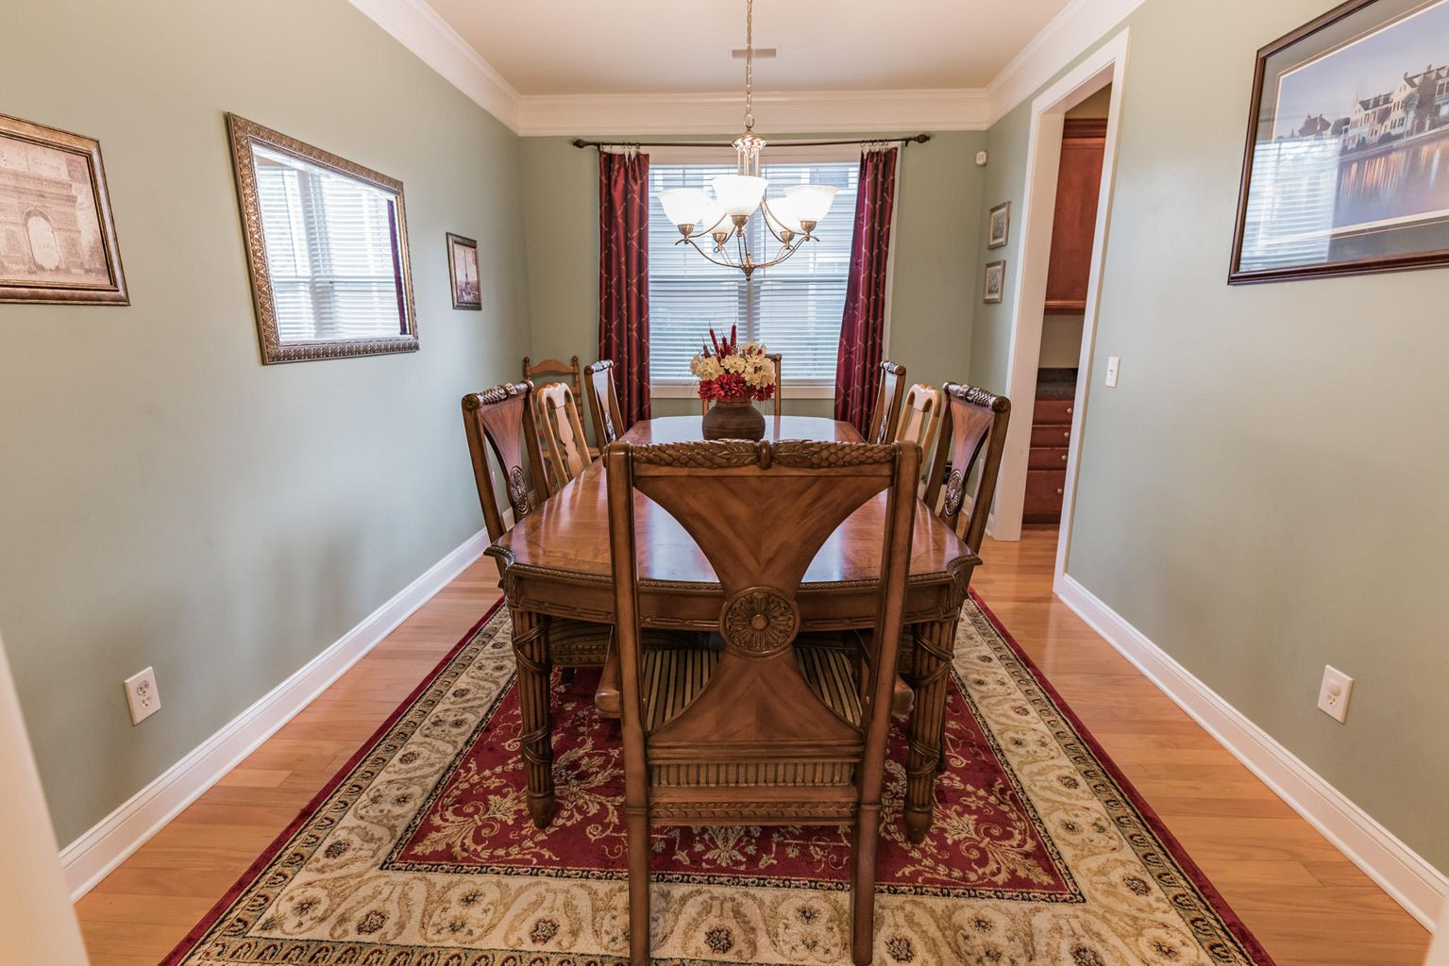
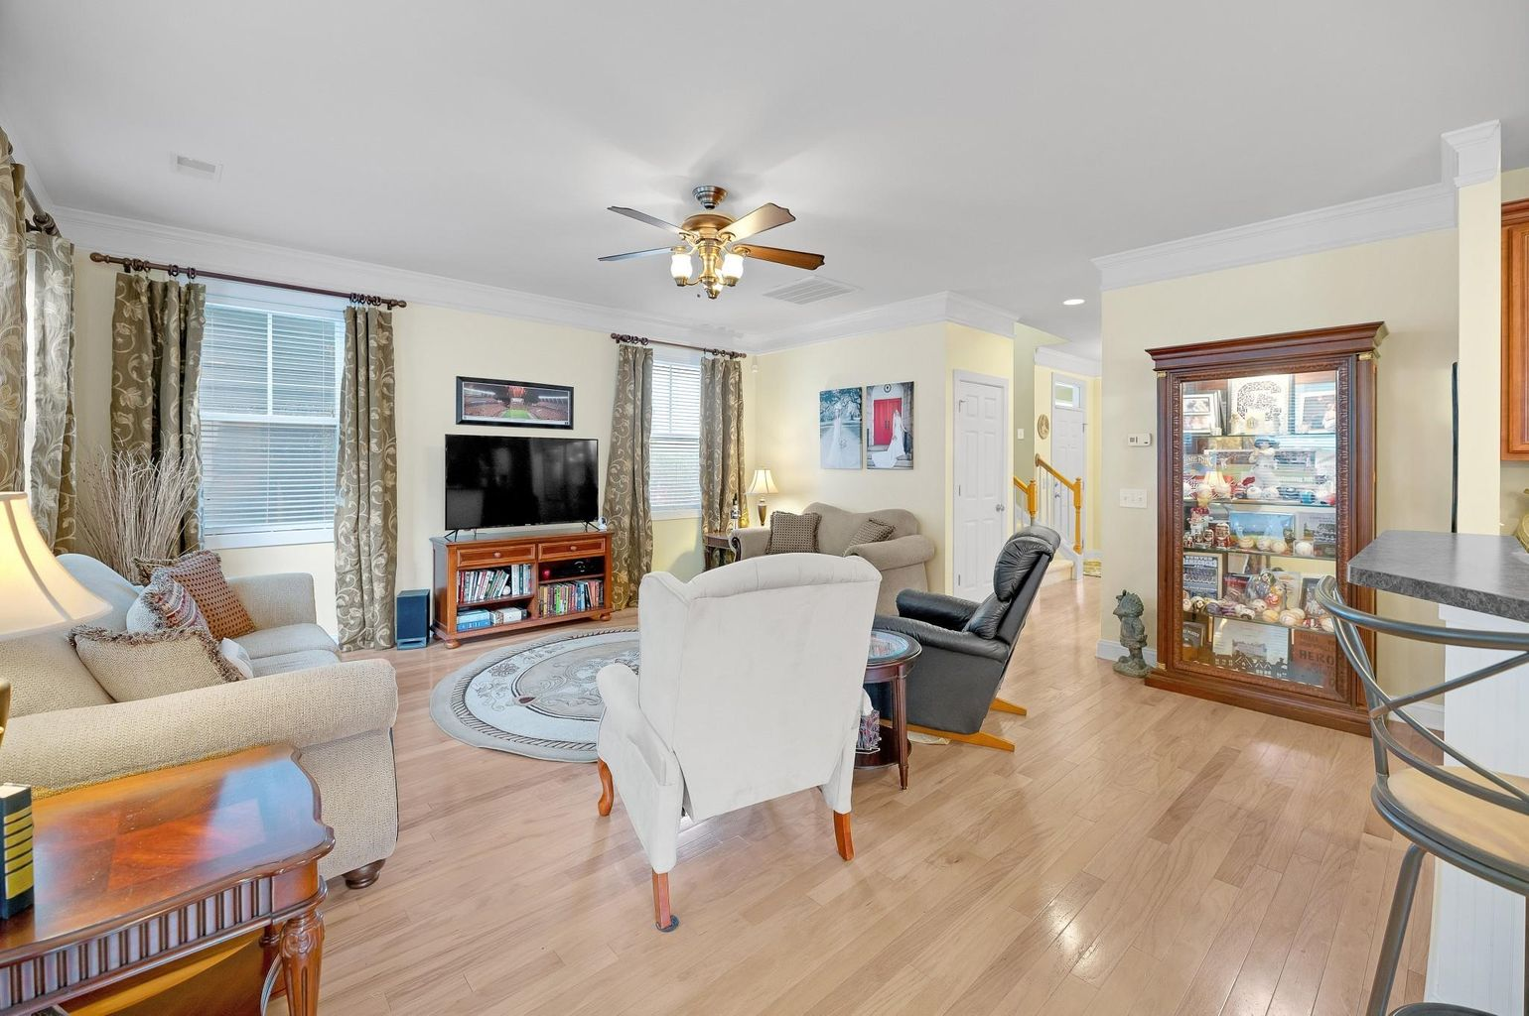
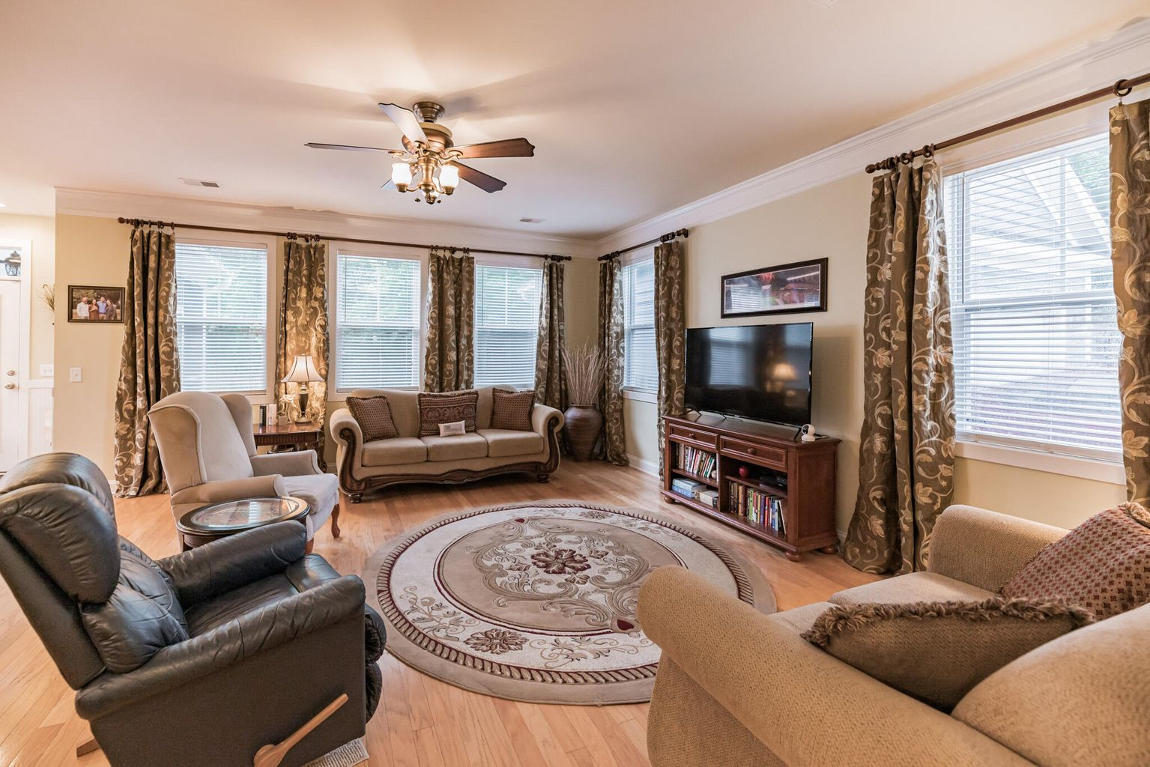
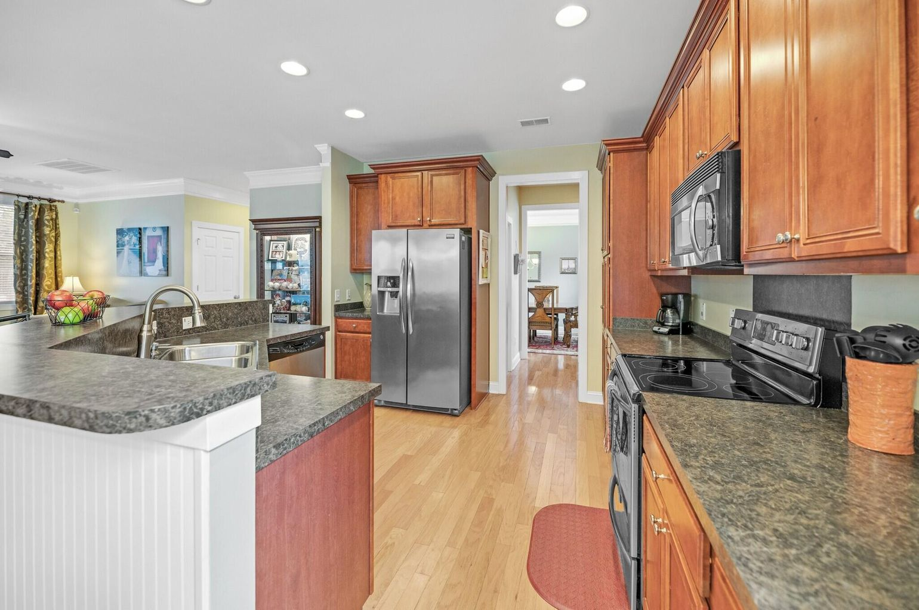
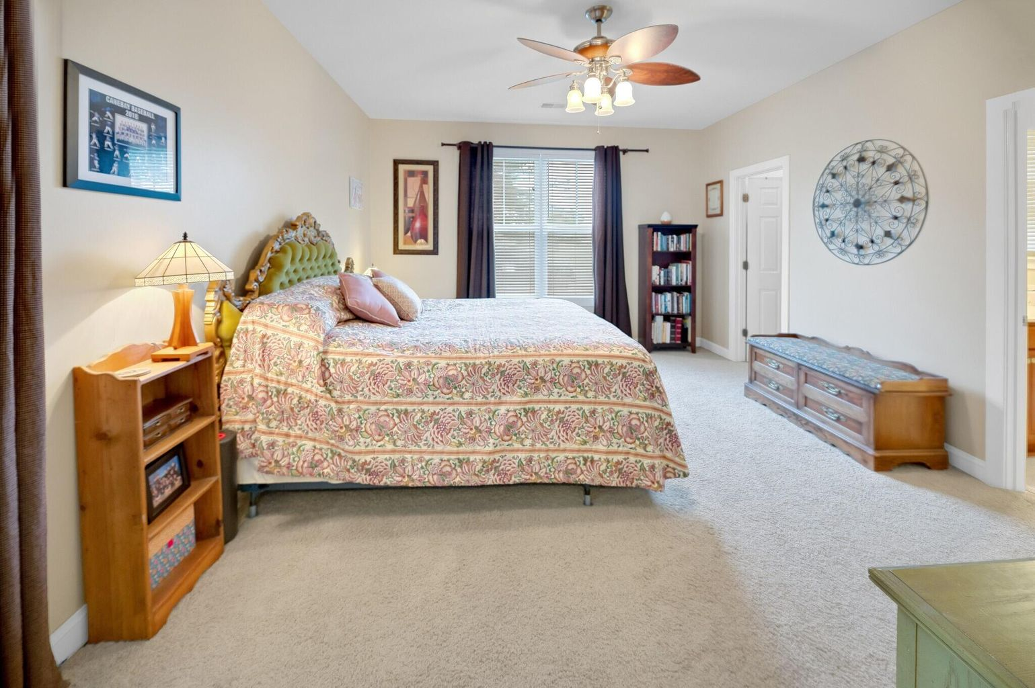
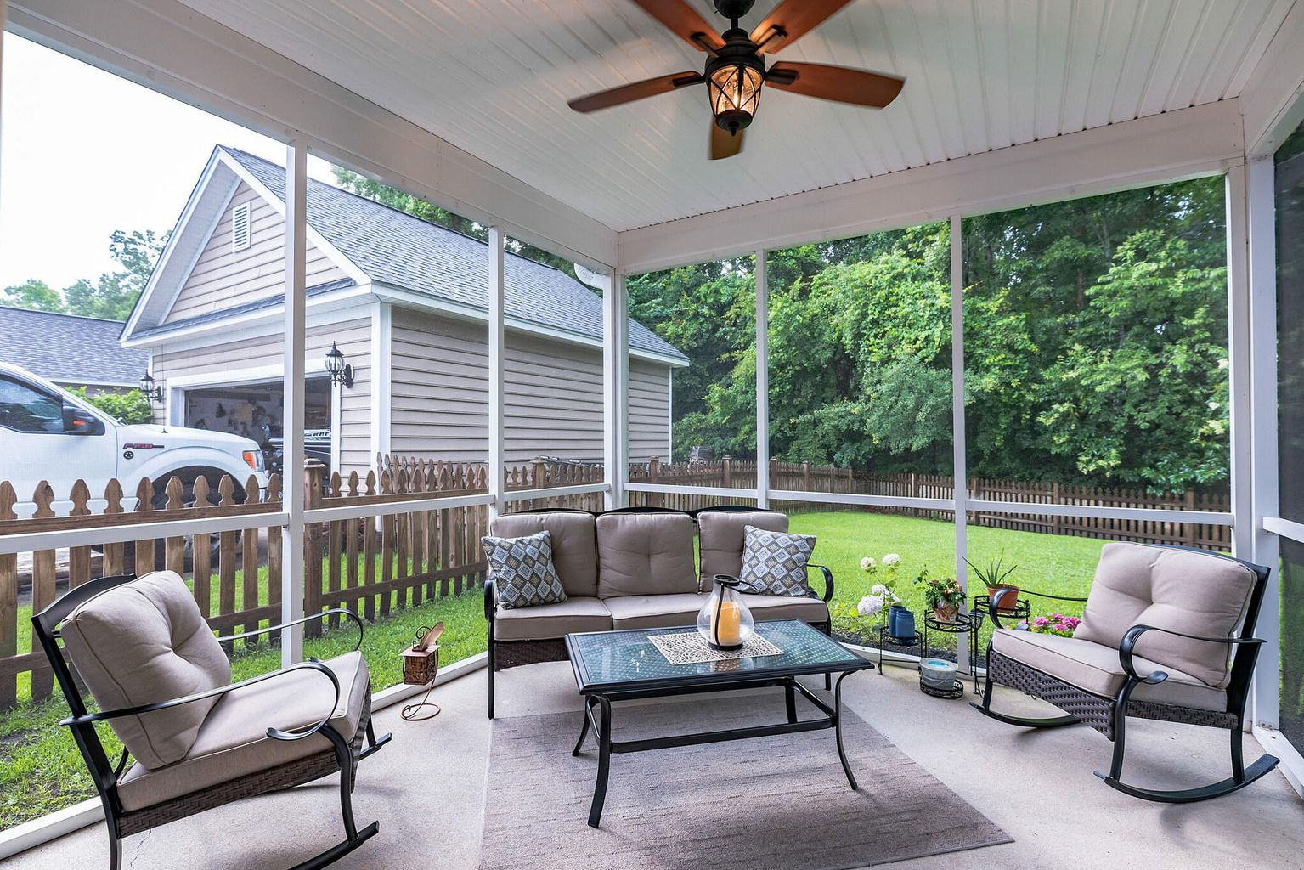
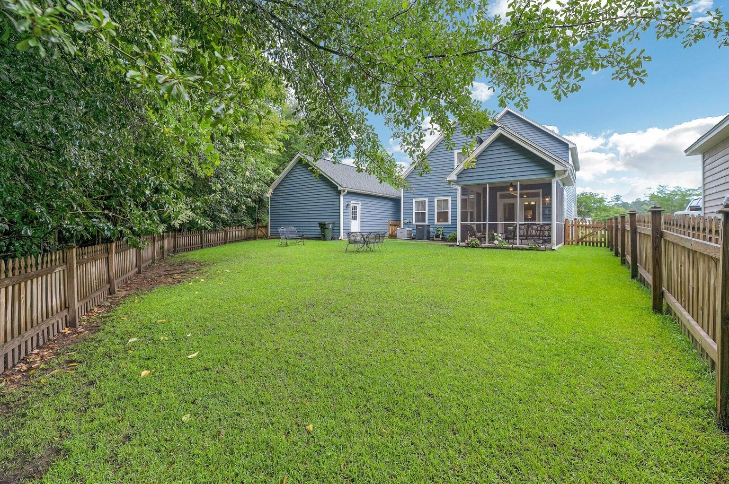
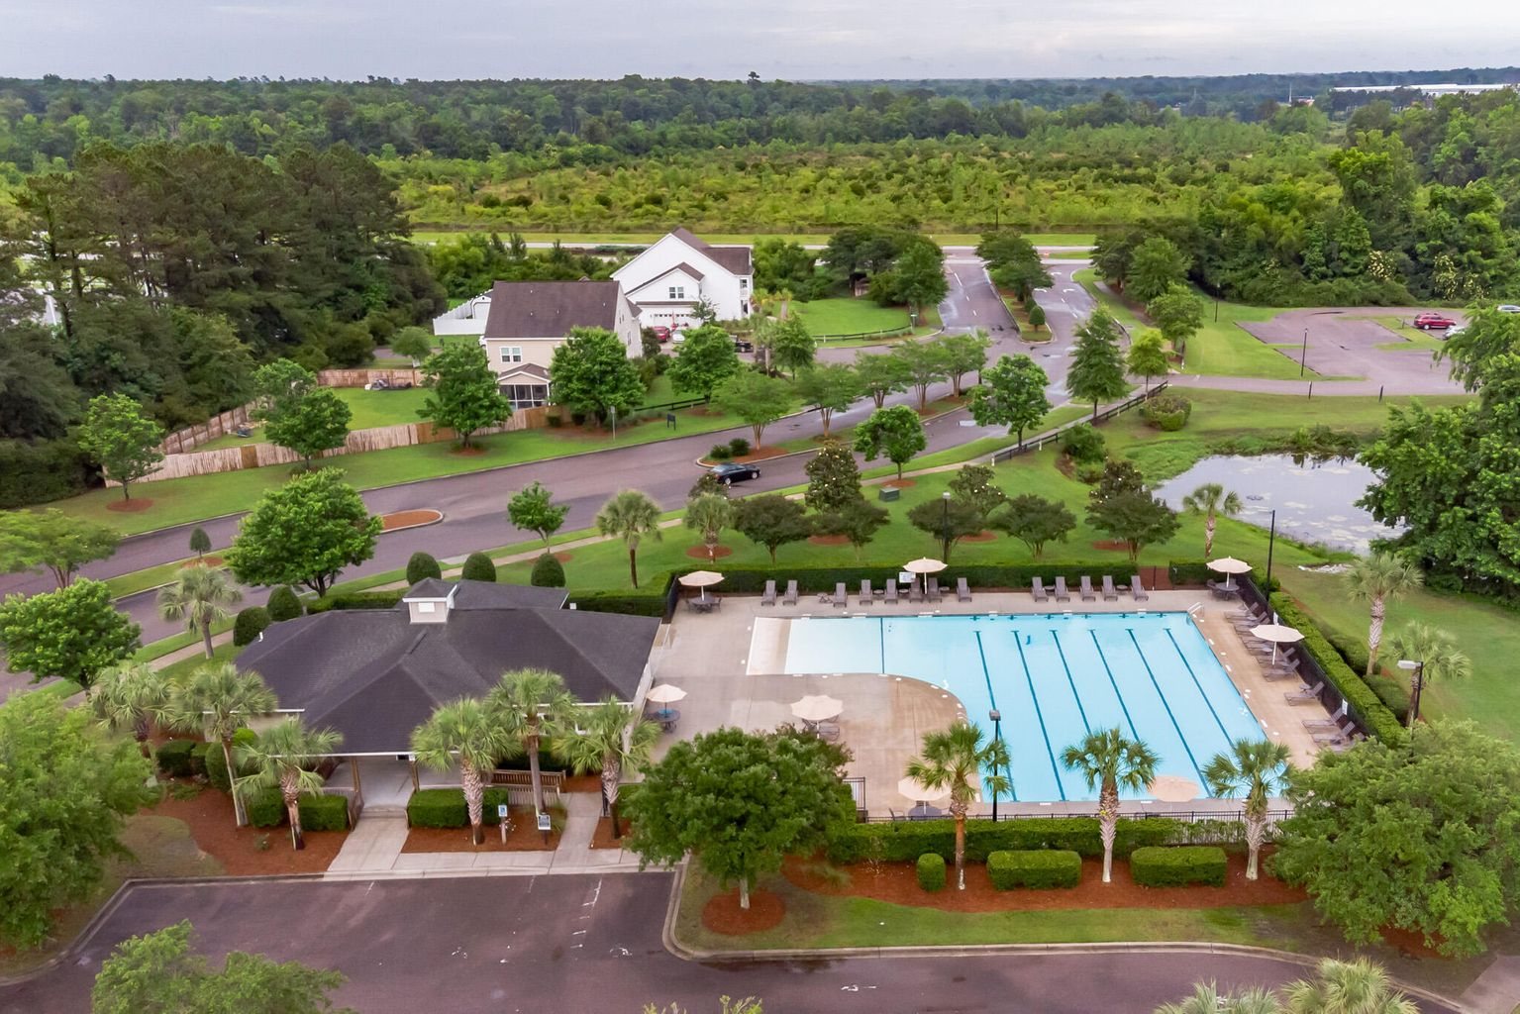


1062 Moss Grove Drive
Moncks Corner, SC 29461 ~ MLS# 21016432 ~ $320,000
REDUCED!
Need New Buyer/ Full Price / MUST close by JULY 23, 2021
WELCOME HOME TO YOUR CHARLESTON STYLE HOME WITH DOUBLE PORCHES LOCATED ON A CORNER LOT. Front yard is beautifully landscaped with mature rose bushes that bloom several times a year. Easy to maintain with the built in sprinkler system. Open floor plan with 4 BR/2.5 BA, 2450 square feet, and 9ft. ceilings. Light oak hardwood flooring and lovely crown molding throughout the downstairs. Carpet in all bedrooms and upstairs loft. Kitchen has under cabinet lighting, 42'' cabinets, center island, and breakfast area. Screened in patio with high quality remote controlled ceiling fan right off the breakfast nook. Formal Dining Room can seat 8. Butler pantry and laundry room with shelving centrally located between kitchen and dining room.
Master on main floor, raised double vanities, walk in closet, garden tub, stand up glass shower. Heading up the curved staircase are other bedrooms and bath. There is a landing on top of stairs. With a sitting area that has a window, and the Best, View of the Lake. Relax, read a book. The entertainment center can convey at full price. Stairs to the side, not right at front door. Other Bedrooms are quite large. 1 has a walk in closet, access to the veranda / porch. Beautiful views. Blinds without the Home. Amazing sunrises to feel the peace within this Home. Fenced yard with 4ft picket fencing. 2 car Garage has storage 660sqft. Oversized garage might I add, park 2 vehicles and still have room to move on each side. Attic access. Garage door with opener and side door as well.
The screened in porch has a high quality outdoor ceiling fan. Enjoy looking at your backyard that backs up to Protected Wooded Wetlands at rear and right side of the Home. All, will enjoy the Walking distance to pool, clubhouse, 2 outside pavilions, soccer fields, playground, common areas, kayak ready on lake, no motorized boats. Also a picnic shelter. Fishing is okay also. HOA Restrictions and Community Guidelines available upon request. The Home has termite bond already in place with Palmetto. Located close to Moncks Corner, Goose Creek, Summerville, and just a small distance to the Interstate I-26. Oh, wait did I mention the NEW HVAC unit, see Sellers Disclosure, they have done a lot to the Home to keep it as Wonderfully nice as it is.
Johnson & Wilson Real Estate
1830 Savannah Hwy
Charleston, SC 29407
Linda D'Angelo
843-822-3607
linda@johnsonandwilson.com
http://www.lindadangelo.com

