Slide 1
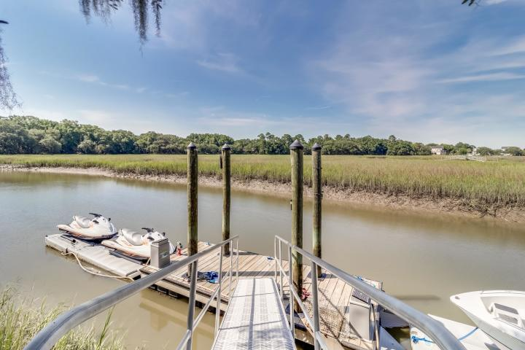
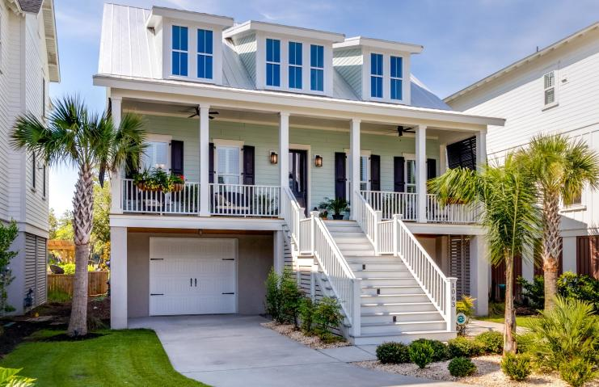
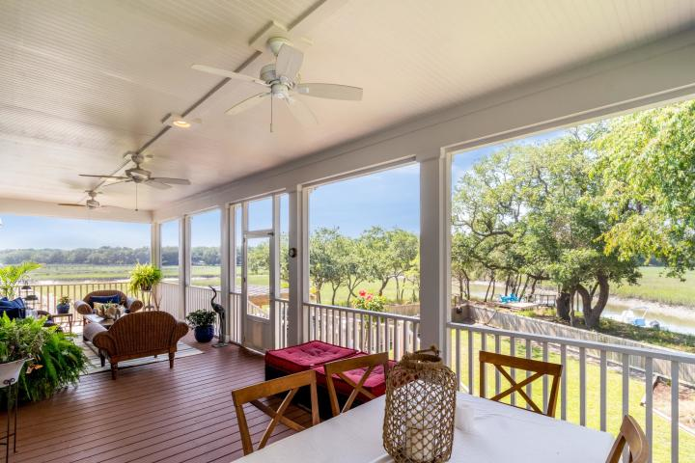
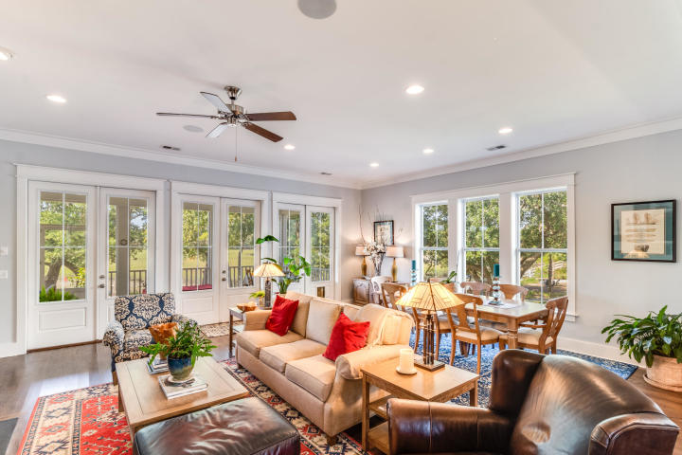
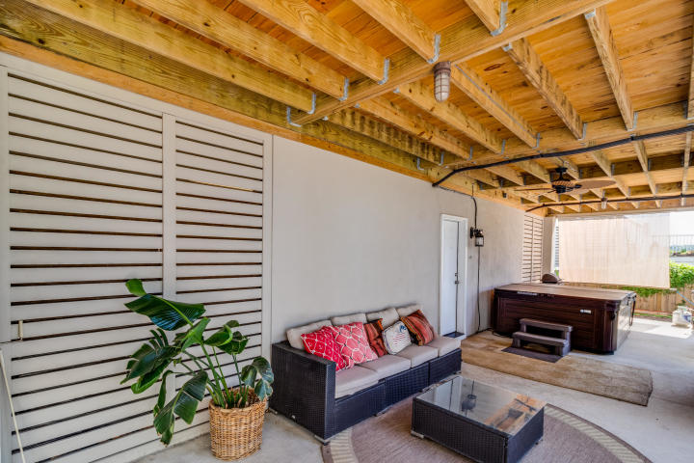
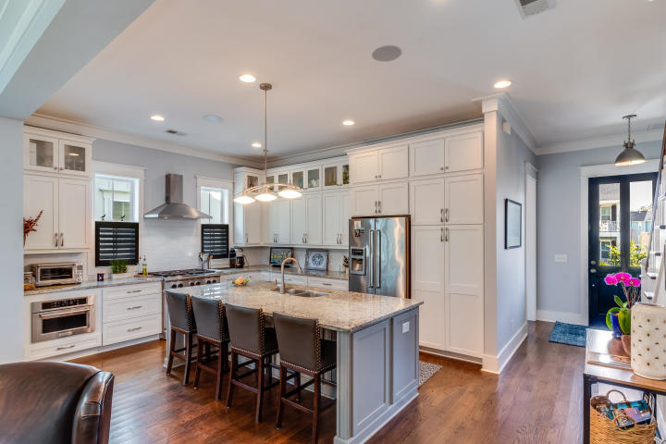
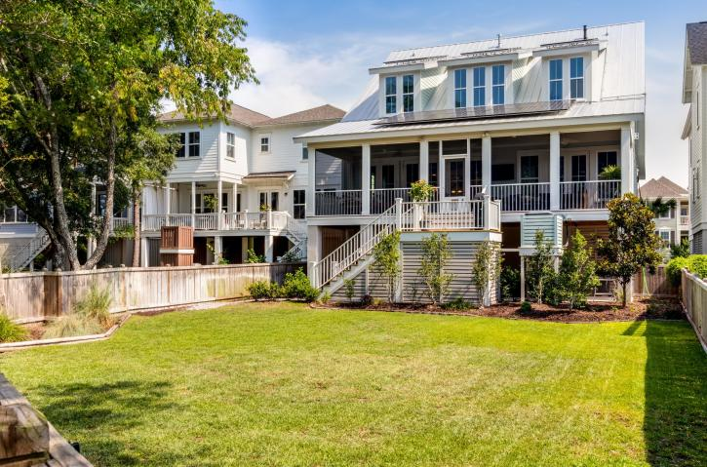
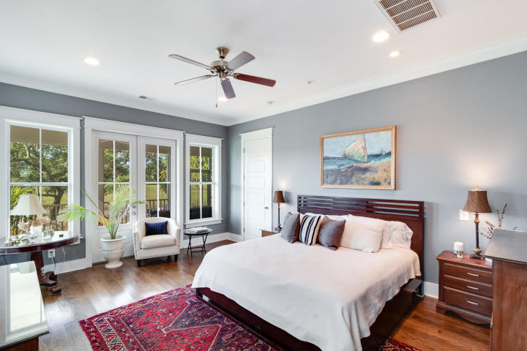
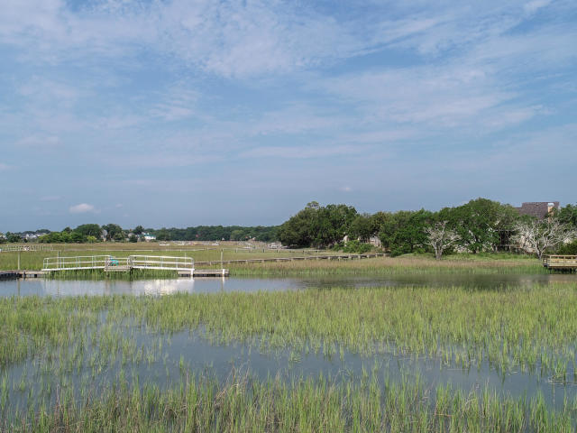
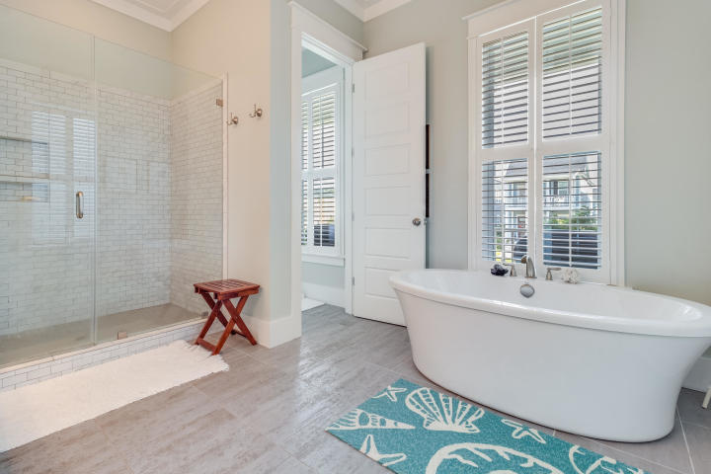
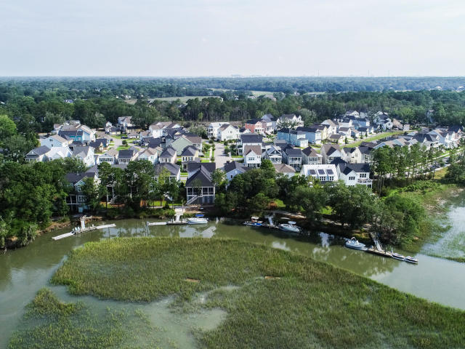


Agent Open House
Wednesday 11a-1p
1063 Hills Plantation Drive
Seaside Plantation ~ Charleston, SC 29412
MLS# 19019167 ~ $1,200,000
Custom Waterfront Dream home on the banks of Seaside Creek. Welcome to your creek front home in Freeman's Point, James Island's Premier Waterfront Community, perfectly situated minutes to Historic Charleston and minutes to Beautiful Folly Beach. Start living the marsh front lifestyle from your screened porch which spans the entire length of the home. A few steps away is your floating dock, jump on your boat for a relaxing ride into Charleston Harbor. This home perfectly captures Charleston charm with a tin roof, welcoming front porch and open living space with expansive owners suite on the main level. A custom gourmet kitchen with large island for entertaining opens to the living space with a large shiplap fireplace. On the second floor you will find 3 bedrooms, 2 jack and jill baths, a loft and an office. This elevated home has garage space for 3 cars plus store you boat under the house in the winter. Energy efficiency abounds with this solar powered home! In addition to the private boat launch in the neighborhood, every homeowner will also enjoy an abundance of creekside amenities: a children's playground, dog park, bocce ball court, gazebo, walking trails and a neighborhood pool. Boat, trailer, spa all convey with acceptable offer.
Jason Newhauser
(843) 534-6564
jasonsellscharleston@gmail.com
www.jasonnewhauser.com
Coldwell Banker Residential Brokerage
1127 Queensborough Blvd. 103
Mt Pleasant, SC 29464

