Slide 1
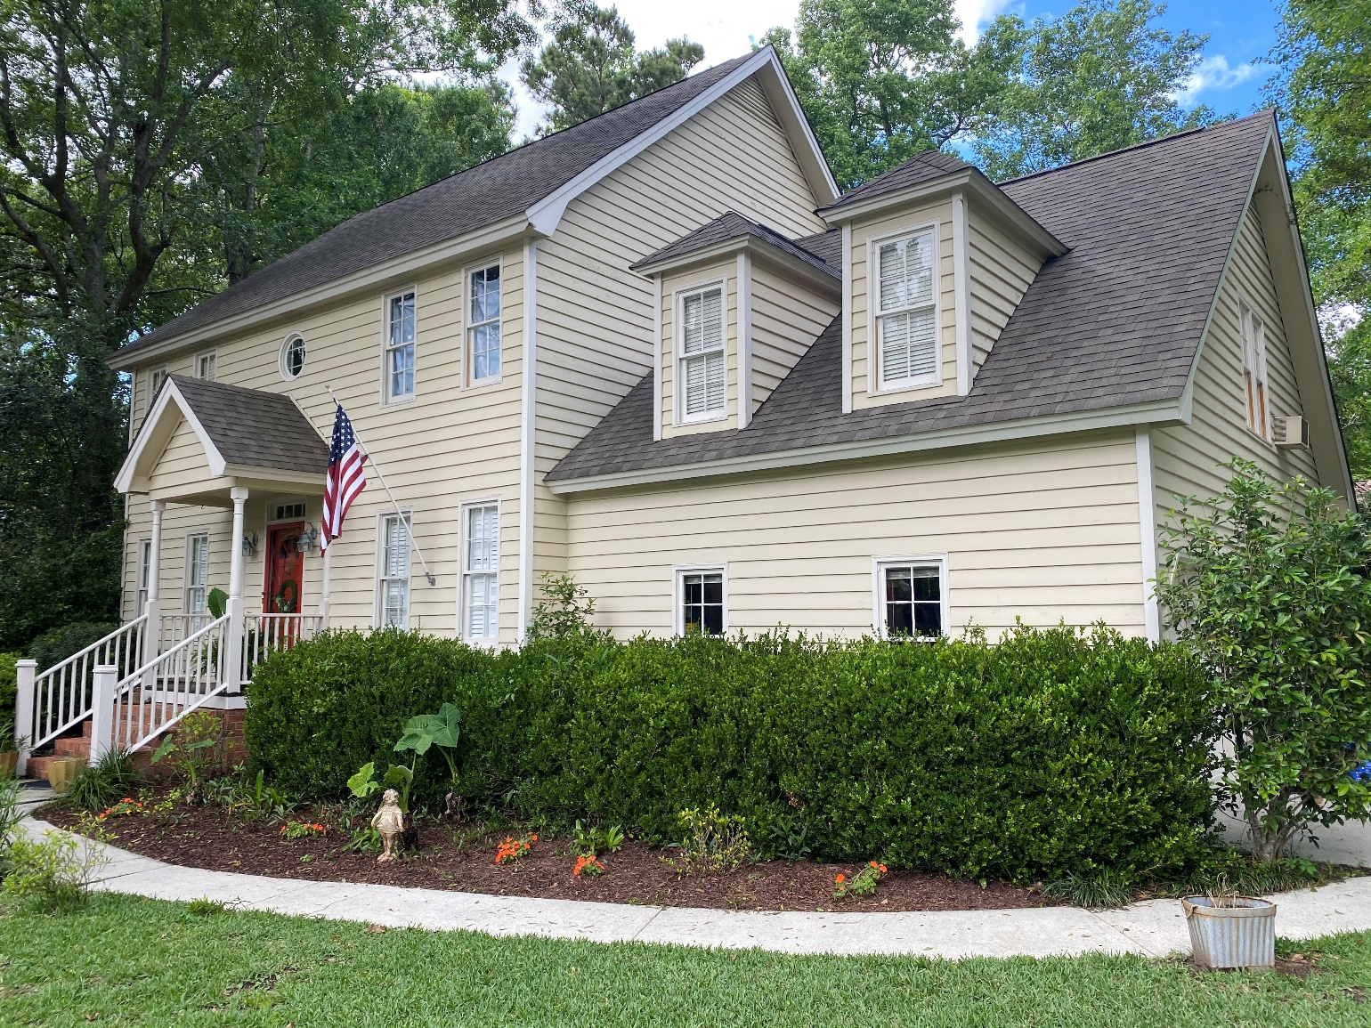
1063 Plantation Lane
Darrell Creek Elevated Home With Elevator & Salt Pool
Snee Farm -- COMING SOON!
This is a 2566 sq ft, 4 bedroom, 2.5 bath home and was updated in 2014. It sits on a beautiful .3 acre lot and has a pool.
List price is $649,000.00.
It will be listed on the MLS early next week.
Please feel free to call me with any questions. 843.532.3010
Andrea Rogers
(843) 532-3010 | andrearogers1@gmail.com | www.andrearogersrealtor.com
AgentOwned Preferred Group | 1400-G Palm Blvd | Isle Of Palms, SC 29451

