Slide 1
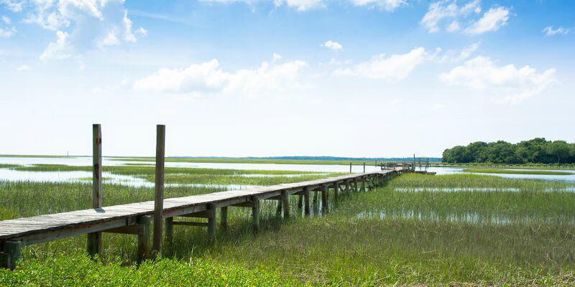
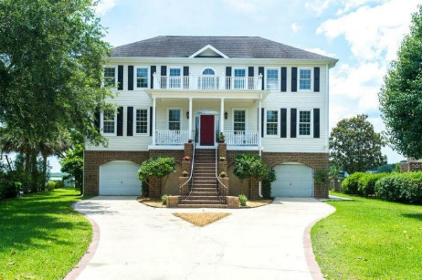
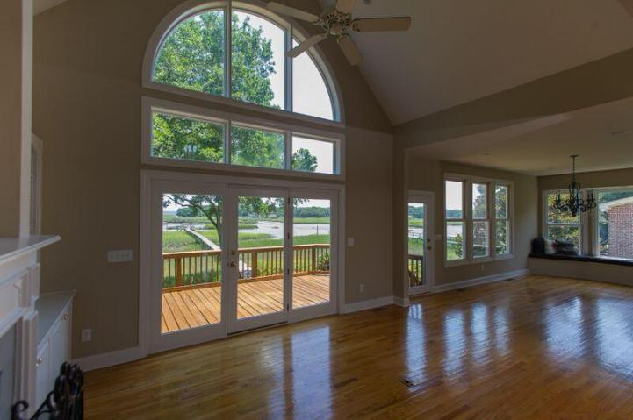
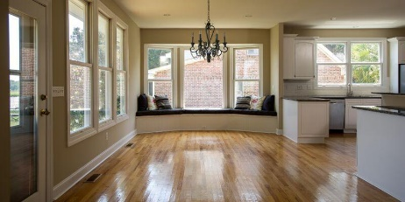
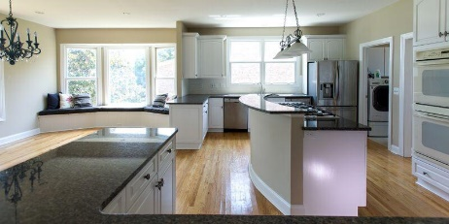
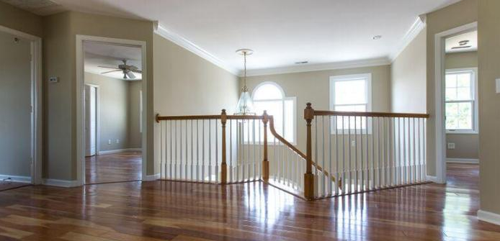
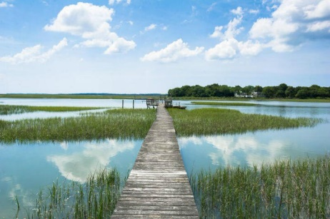
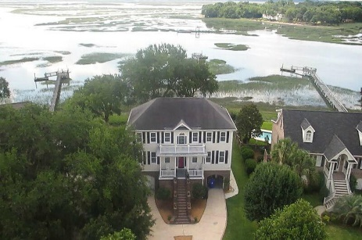
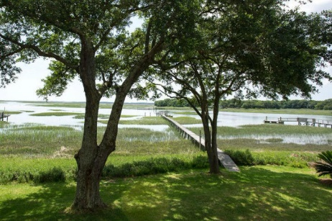


Deep Water Estate on James Island
1066 Sea Eagle Watch
Seaside Plantation
Charleston, SC 29412
MLS# 15013204 ~ $997,500
THIS IS A STUNNING HOME OVERLOOKING TWO LIGHTHOUSES AND ON DEEP WATER TIDAL CREEKS WITH DIRECT ACCESS OUT TO THE OCEAN. BEAUTIFUL DOCK AND OAK TREE SETTING WITH A CUL-DE-SAC LOCATION. SPACIOUS HOME WITH MANY WATER OVERLOOKS AND BREATHTAKING VIEWS. NO OTHER HOME QUITE LIKE THIS IS ON THE MARKET TODAY. EASY DISTANCE FROM DOWNTOWN AND FOLLY BEACH. DOCK AND FLOATING DOCK WITH JET-SKI RAMP, FRESH WATER SHOWER/SINK, ELECTRICITY AND TWO-FOUR FEET AT LOW TIDE! A MASTER BEDROOM LOCATED DOWNSTAIRS WITH AMAZING VIEWS. MASTER BATH HAS IMPORTED CERAMIC TILE, MARBLE COUNTERTOPS, LARGE JACUZZI TUB, SEPARATE SHOWER WITH BUILT IN BENCH AND DUAL SHOWERS. VERY LARGE KITCHEN WITH LARGE EAT IN DINING AREA PLUS FORMAL DINING ROOM. KITCHEN HAS 6-BURNER GAS COOKTOP.
Bryan Thompson
Office - (843) 769-5100
Mobile - (843) 452-1686
bryan.thompson@agentownedrealty.com
www.bryanthompsonrealestate.com
AgentOwned Charleston Group | 902 Savannah Hwy | Charleston, SC 29407-7802

