Slide 1


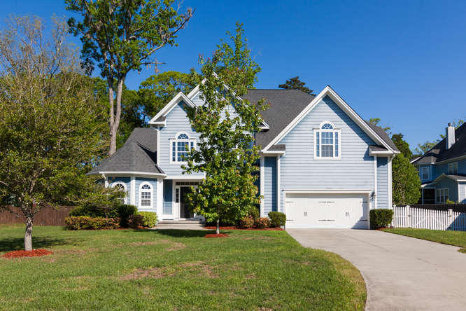
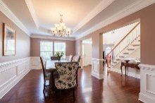
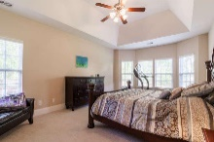
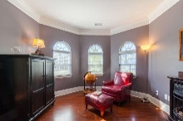
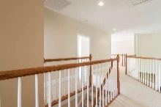
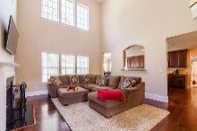
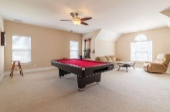
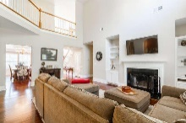
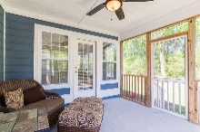
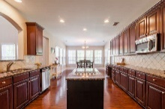
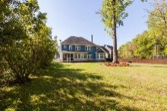
$3,000 Agent Bonus if ratified before July 1
1066 Shipton Court
Hunt Club ~ Charleston, SC 29414
MLS# 16009559 ~ $480,000
One of the best lots and homes in Hunt Club! .53 acre lot backing up to the ultimate private lush wooded area for plenty of privacy and tucked in the back of a quiet cul-de-sac enabling the ultimate enjoyment of this lot. The home is just as amazing. Beautiful hardwoods ,cathedral and tray ceilings, double ovens, huge master suite bathroom, and the best game room a homeowner could ask for. The kitchen and the great room were perfectly designed for entertaining with ample granite counter top space and plenty of top of the line cabinet storage space, along with a beautiful great room wood burning fireplace with tasteful built-ins on either side. This home was built to impress and it doesn't let anyone down. Elegance and quality best describe this wonderful home. It will go quickly.
Johnny Crosby
(843) 270-9407
jcrosby@propertyadvisorsinc.com
Brand Name Real Estate
4 Carriage Lane Suite 106
Charleston, SC 29407
www.newcongroup.com

