Slide 1
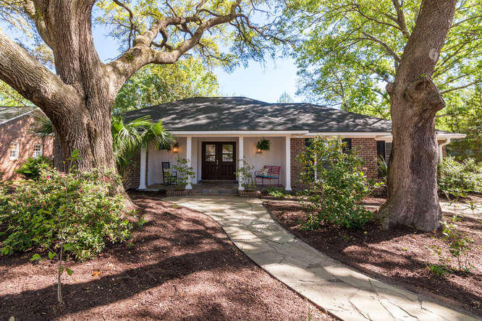
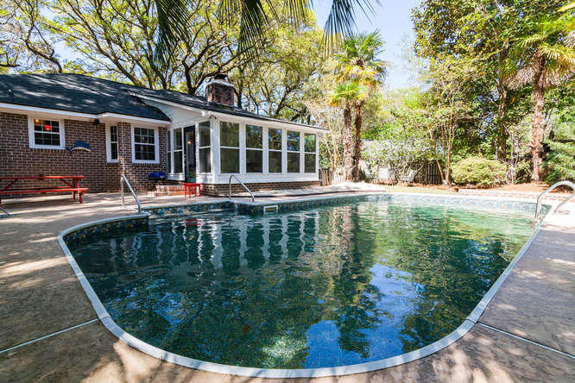
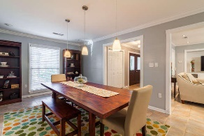
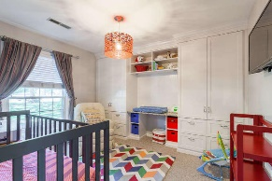
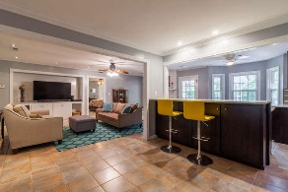
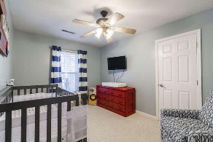
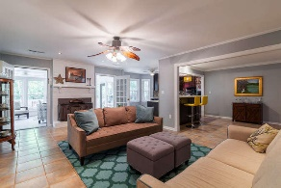
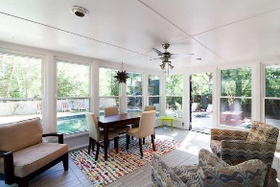
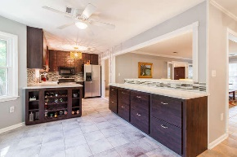
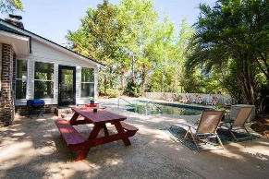
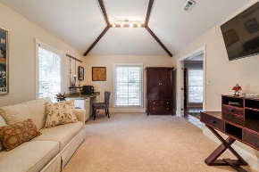
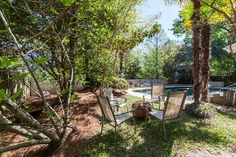
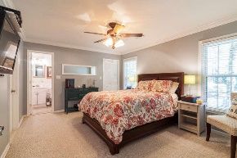
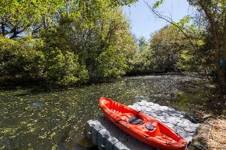


The Perfect James Island House
Open House Sunday 2-4
1066 Wellington
Lawton Bluff ~ Charleston, SC 29412
MLS# 16009021 ~ $469,900
Open floor plan designed with entertaining in mind. And the entertaining doesn't stop indoors! Easy sunroom access to the backyard greets the guests with a pool (4/2016 new pump, liner, and plumbing) and KAYAK access to the fishing lake! The floated dock (Dock Blocks TM) conveys with the right offer. Study/Bonus room can be converted to a master suite since laundry room is plumbed for a bathroom - bigger bonus is its 1000 sq ft attic space! Custom Kitchen gives more than ample storage and cooking ease with pull outs for spices and disposal bins. Don't miss the large walk-in closet in the middle bedroom. 3rd bedroom has the future in mind with custom built-ins which will convert to a student's study area, or remove granite changing table which leaves room for a single bed.
Robin Crump
(843) 813-5688
Robincrumprealestate@gmail.com
Brand Name Real Estate | 4 Carriage Lane, Suite 106 | Charleston SC 29407

