Slide 1
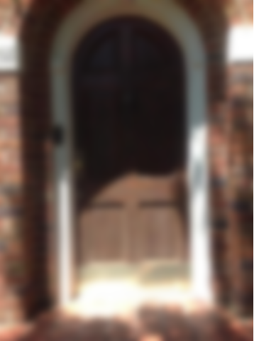
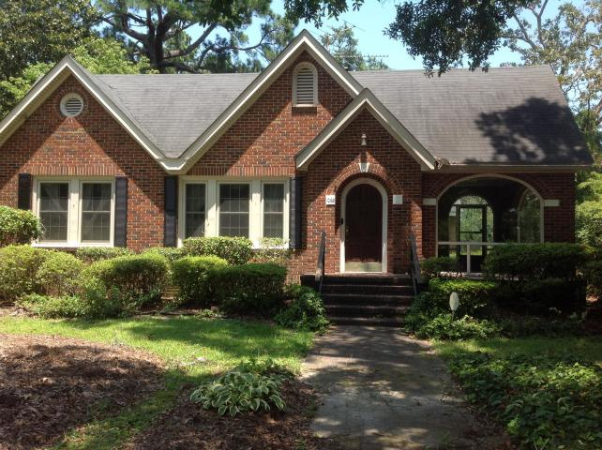
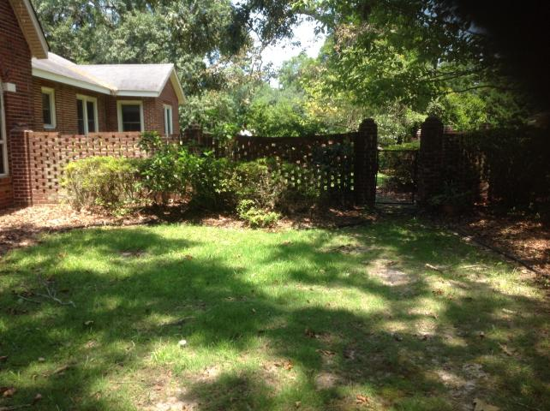
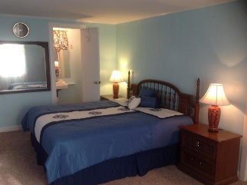
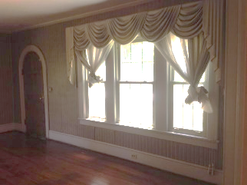
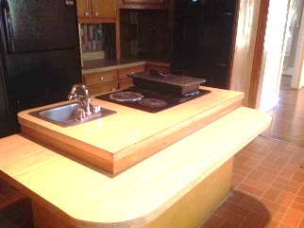
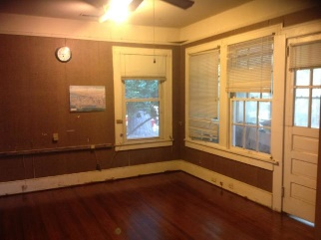
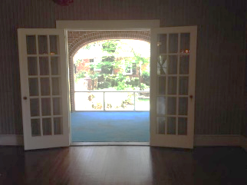
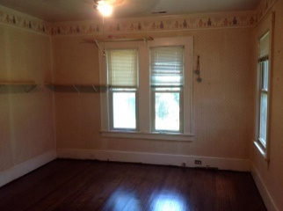

1068 Peake Street
Holly Hill, SC 29059 | MLS# 19019477 | $199,900
This Property Won't Last Long
Make An Appointment Today!!!
This home has three bedrooms and two baths on a quiet street. The hardwood floors in the home have been re-done in June 2019. The home is brick with a sunroom at the front of the house. The front has a wrought iron fence and sitting area on the porch. The house has a history of being a show place at Christmas!!! The owner would decorate the tree with 2000 lights and ornaments she collected over the years. The cars would stop to look at the lights. There is a fireplace in the living room as well as one of the bedrooms. There are also many original glass doorknobs still present.
Karen Brown
(843) 709-4029
karenbrown22@gmail.com
AgentOwned Premiere Group
141 A N. Main Street
Summerville, SC 29483

