Slide 1
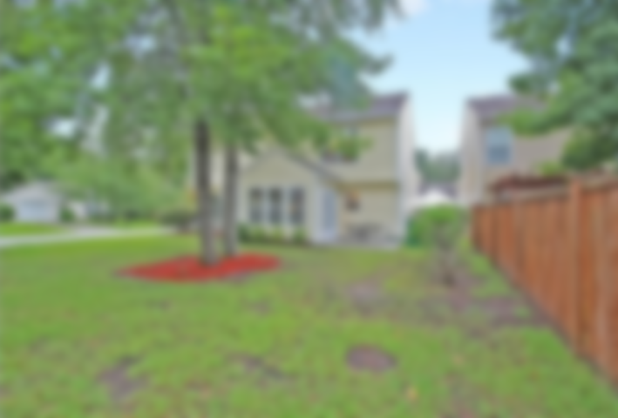
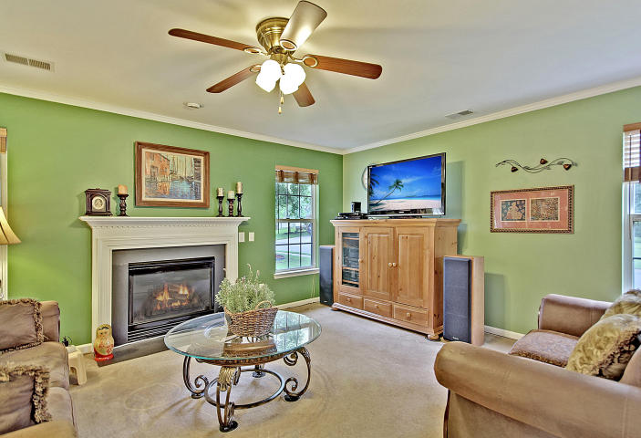
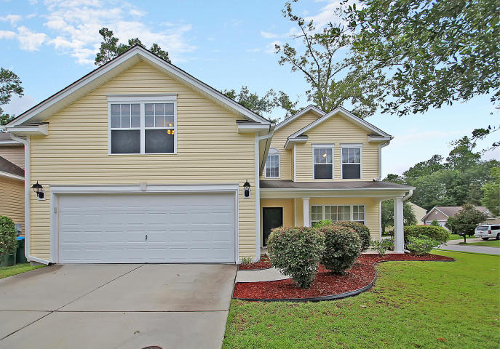
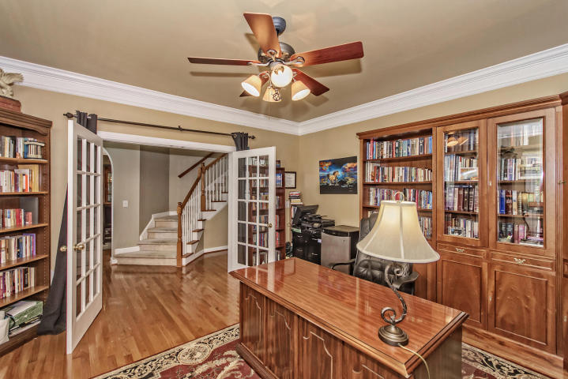
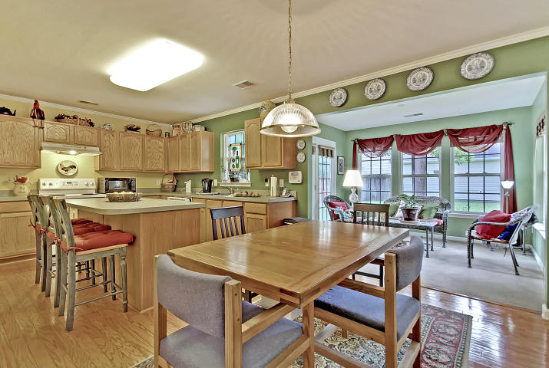
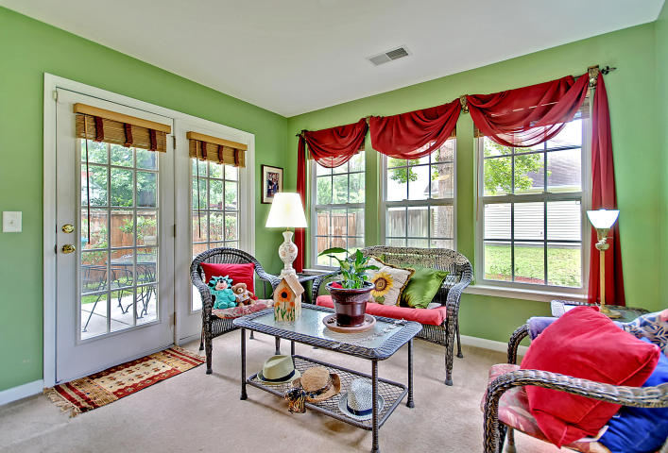
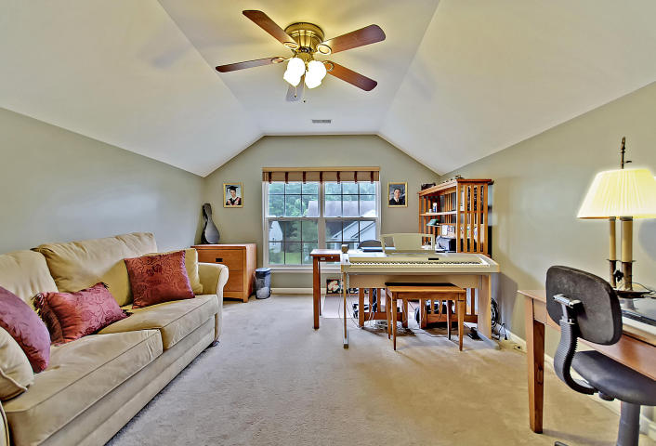
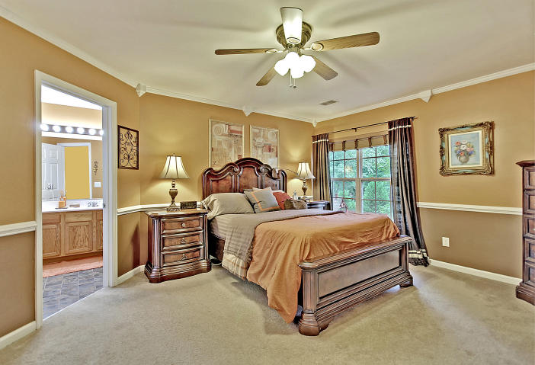
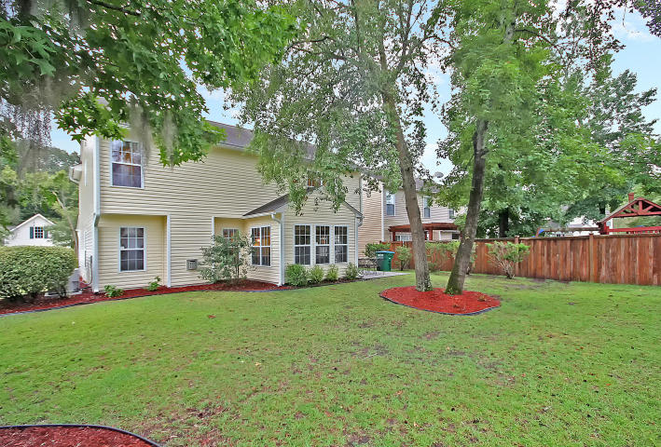

#1 BEST VALUE IN
SUMMERVILLE!
106 Arbor Oaks Drive Arbor Oaks ~ Summerville, SC 29485
MLS# 17020377 ~ $219,900
4 Bedrooms ~ 2½ Bathrooms
Absolute Bargain! Unbelievable Price!
4 bedroom, 2.5 bath home in great condition priced low and firm for your pre-approved buyer who wants a great deal on the nicest home in Summerville. Hurry, it won’t last long at this low, low price.
Since this is a super-value price, do your buyer a favor and submit a strong offer today before other offers come in.
Chip Walsh
843-822-4663
chipwalsh@gmail.com
The Boulevard Company, LLC 35 Broad Street Charleston, SC 29401
www.TeamWalshRealEstate.com

