Slide 1
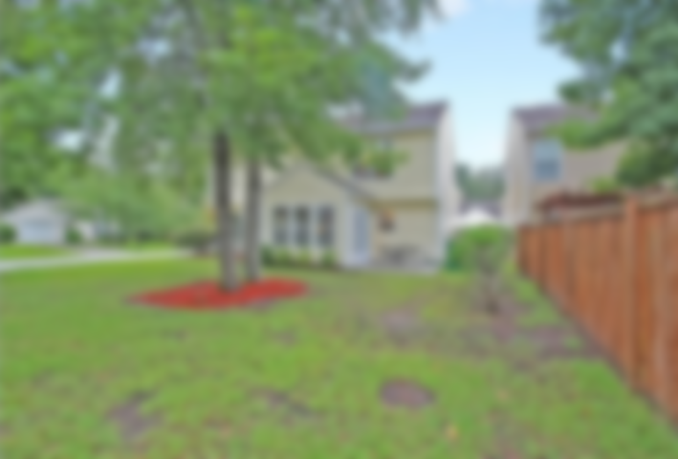
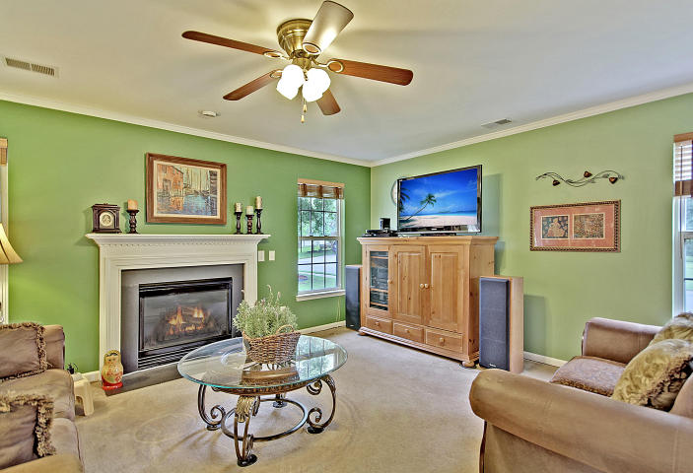
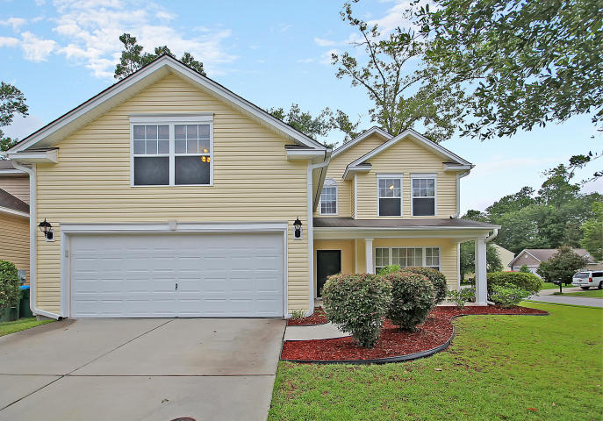
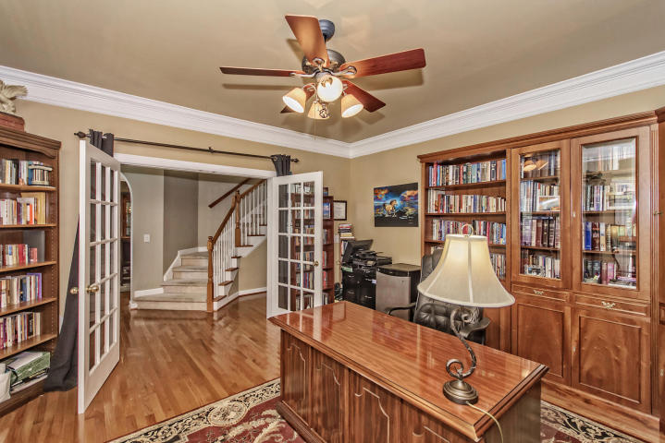
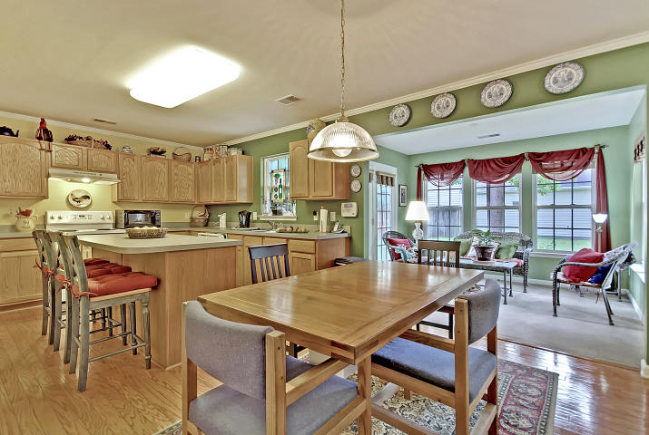
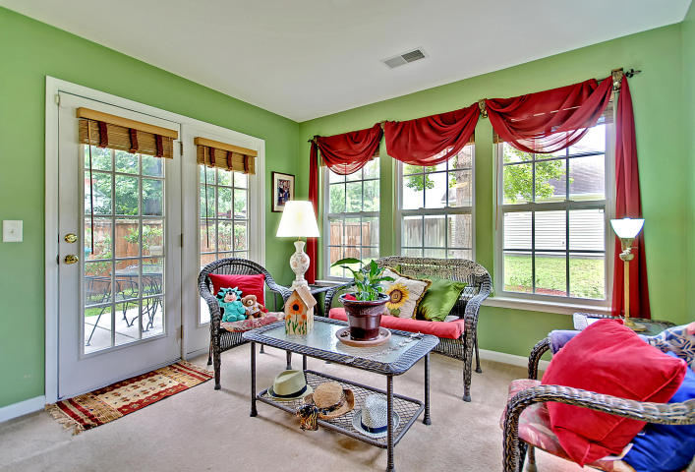
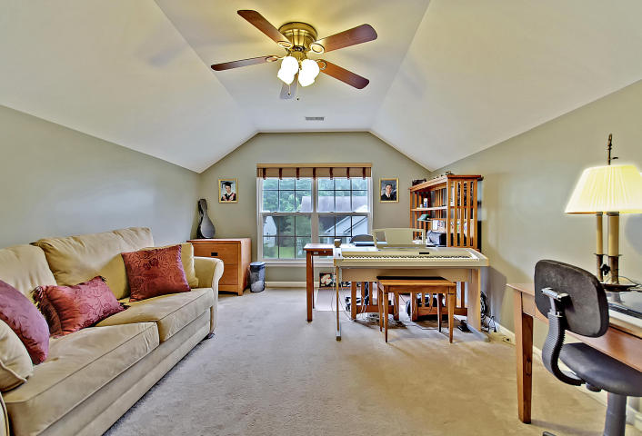
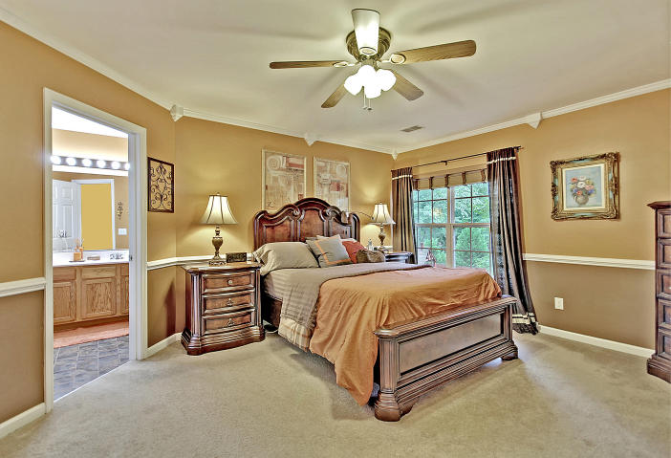
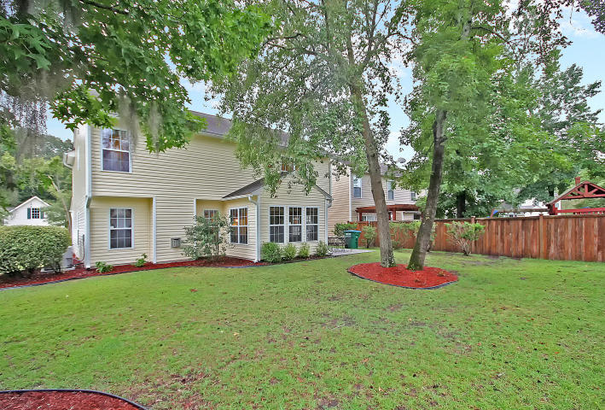

PRISTINE, BEAUTIFUL & MOVE-IN READY!
106 Arbor Oaks Drive Arbor Oaks ~ Summerville, SC 29485
MLS# 17020377 ~ $224,900
4 Bedroom, 2.5 bath home on a lushly landscaped corner lot in the very desirable Arbor Oaks Subdivision. Carpet and paint are just-like new. Charming, southern front covered porch welcomes you to an ultra-open floor plan where the gourmet, eat-in kitchen flows effortlessly to the over-sized great room with a roaring fireplace. Accompanying this wide-open kitchen/great room space that one could call “Entertainment Central” is a gorgeous, sunroom where the vibrant colors and oversized windows create a setting for morning coffee where one can experience both the feeling of being at one with nature and all of the comforts of being inside. The spacious Master Bedroom is accompanied by a spa-like Master Bath with dual vanities and large counter space. There is also a good-sized light and bright room for a study/office/piano room as well as a large room over the garage perfect for a bonus room, play room, media room and/or several other possibilities. This home is located in the award-winning Dorchester School District Two and has convenient access to all of the best that greater Charleston has to offer including the airport, Boeing, the new Mercedes and Volvo plants, the world-class sun-kissed beaches of Isle of Palms/Sullivans Island in addition to history of both downtown Summerville Charleston.
This home can all be YOURS for the BEST VALUE IN SUMMERVILLE!
Chip Walsh
843-822-4663
chipwalsh@gmail.com
The Boulevard Company, LLC 35 Broad Street Charleston, SC 29401
www.TeamWalshRealEstate.com

