Slide 1
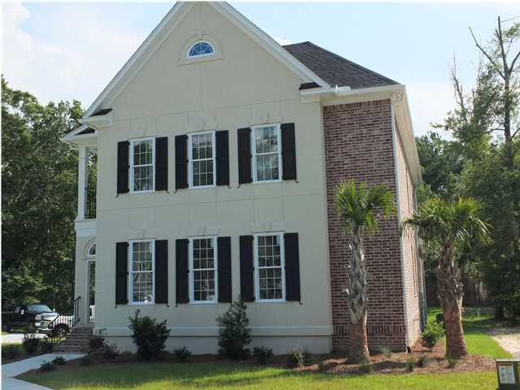
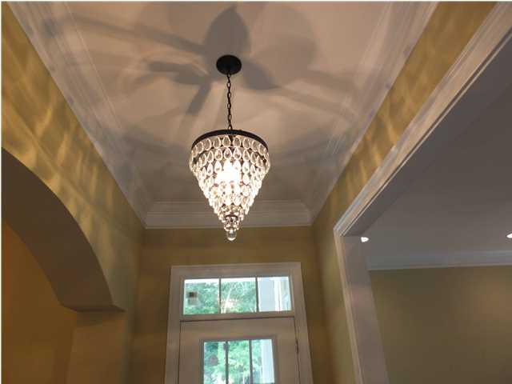

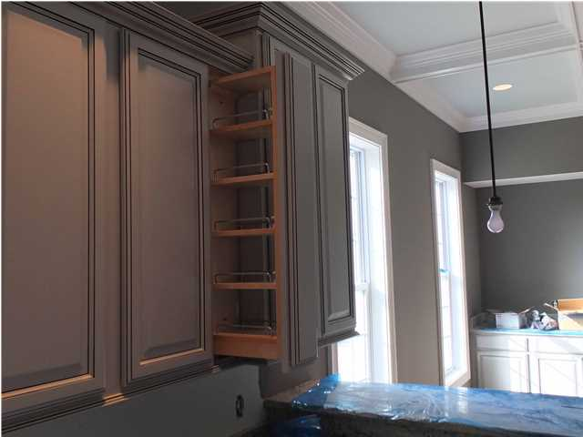
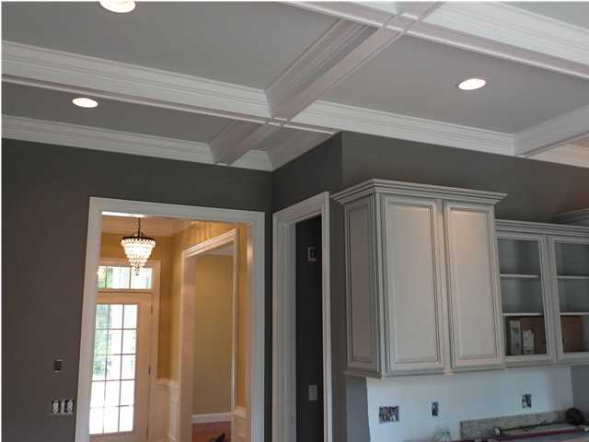

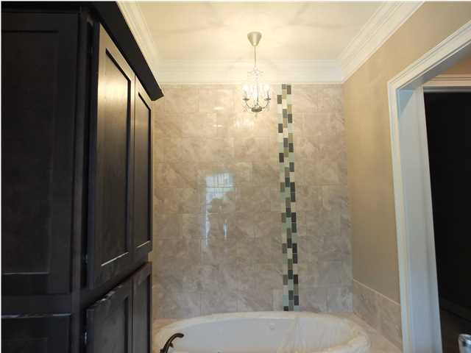
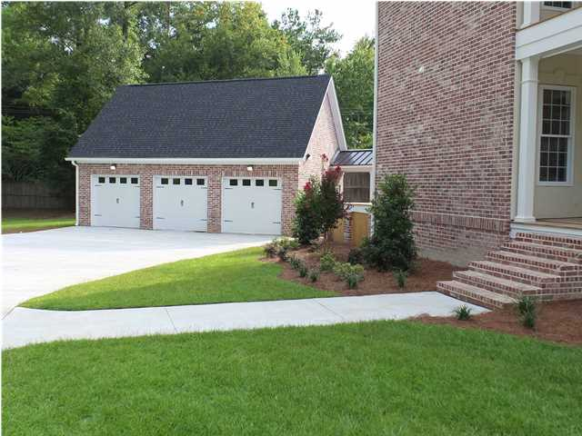
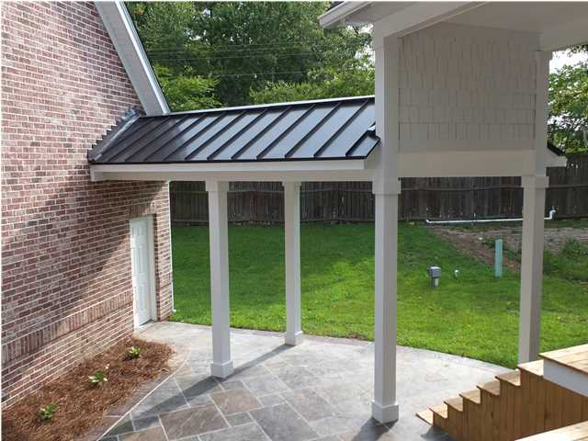
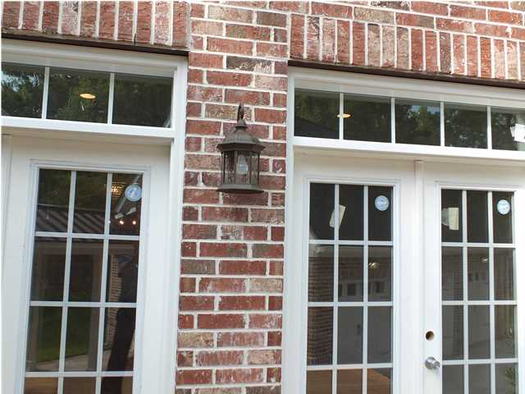
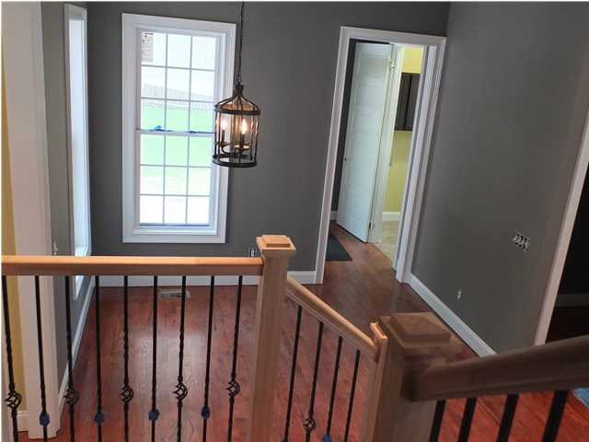


106 Aviary Ct Sylvan Acres - Summerville, SC MLS# 1415667 - $550,000
Brokers & Agents
Please Join us for our
OPEN HOUSE
Wine and Appetizers
will be served.
Qualified clients are welcome.
Friday 8/8/14
3:00-7:00p
Charleston Side House
New custom construction just completed
5 bedroom, 4.5 bath
Master bedroom downstairs
Doorless walk in shower
Built in cosmetic vanity
Gourmet kitchen upgrades
Deck and patio, covered walkway
Two sets of French doors to deck
10’ ceilings, 8’ doors
Extensive Custom trim
Coffered ceiling
Built in office upstairs
Energy efficient 2x6 exterior walls
Spray foam insulation throughout
Tankless hot water heater
Recirculating loop for instant hot water
Two fire places
3 car detached garage
Irrigated Lawn and Security system
Janis Flodin
843-729-0584 M
jflodin.bcd@gmail.com
B C D Properties LLC | 123 Piccadilly Loop | Summerville, SC 29483

