Slide 1
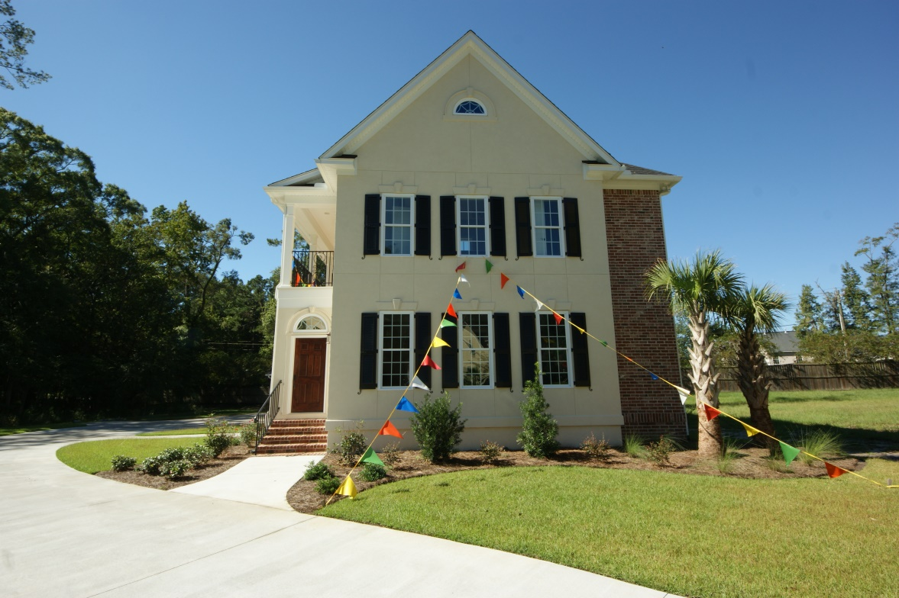
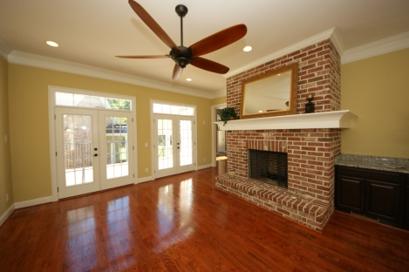
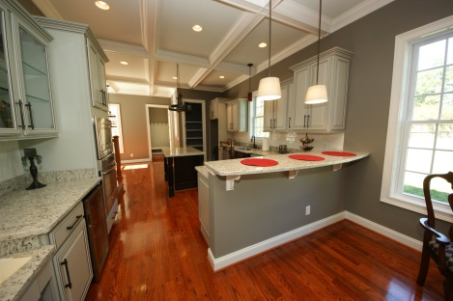

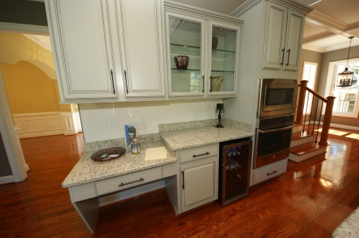

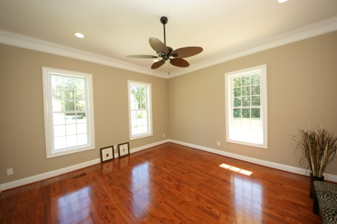
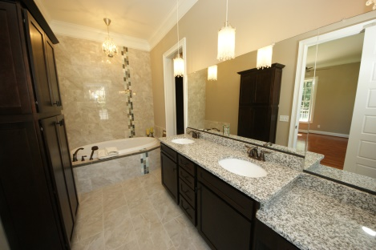
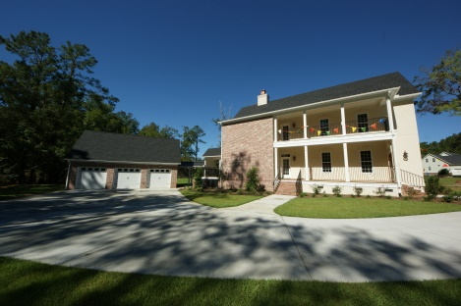
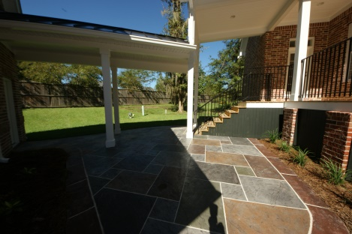
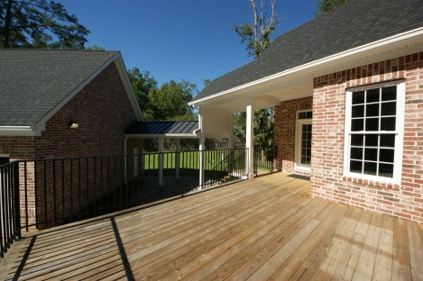
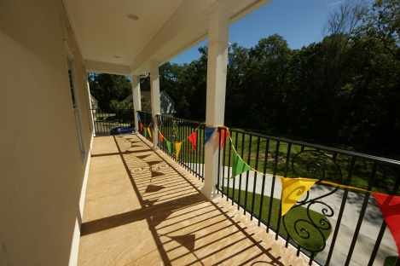



106 Aviary Ct Summerville SC MLS 1415667 $549,400 3485 square feet 5 bedroom | 4½ baths
$2,000 Buyers Agent Bonus at Closing!
Here are a few reasons to add this home to your list of must-shows:
Built by well known GREEN custom home builder and developer J & J Custom Homes
Charleston Historic style Side House surrounded by wooded border and Low Country style homes on cul-de-sac
Located in Dorchester 2 school district and walking distance to Pinewood Preparatory School
Energy efficiency spray foam insulation throughout plus 2x6 exterior walls
Gourmet features in kitchen with “keeping room” family area with gas fireplace
Living room with wood burning fireplace and two sets of French doors to deck
Stamped concrete patio and covered walkway to three car spacious garage
Gleaming hardwood floors
10’ ceilings, 8’ doors, coffered ceiling and custom trim throughout
Master suite downstairs with walk in shower, garden tub, huge walk-in closet
Custom built in office located upstairs for student or home office
Tankless hot water heater with recirculating loop for instant hot water
Security system, irrigated lawn
Janis Flodin
843-729-0584 M
jflodin.bcd@gmail.com
B C D Properties LLC | 123 Piccadilly Loop | Summerville, SC 29483

