Slide 1
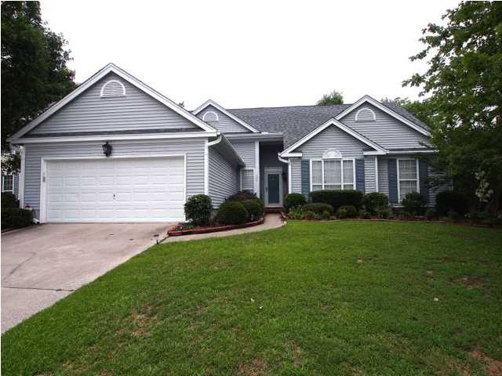
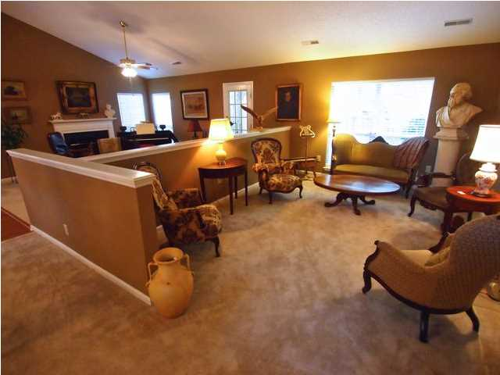
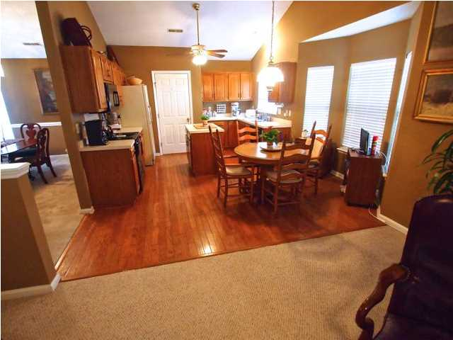
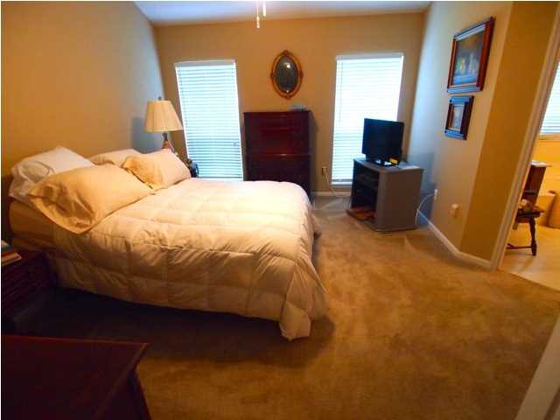
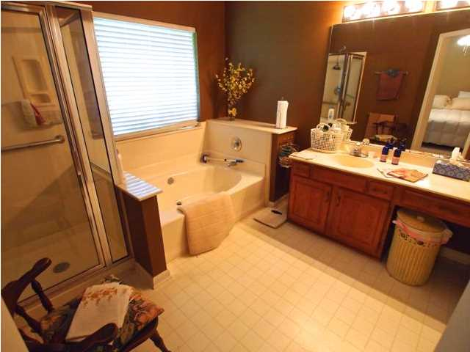
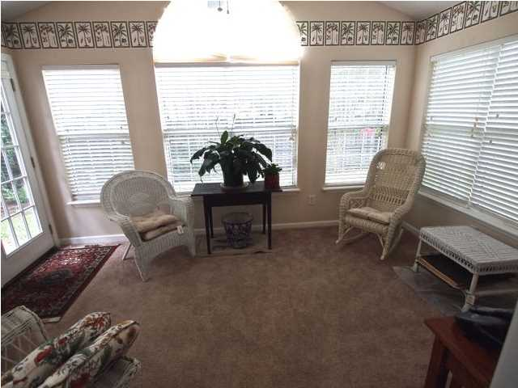
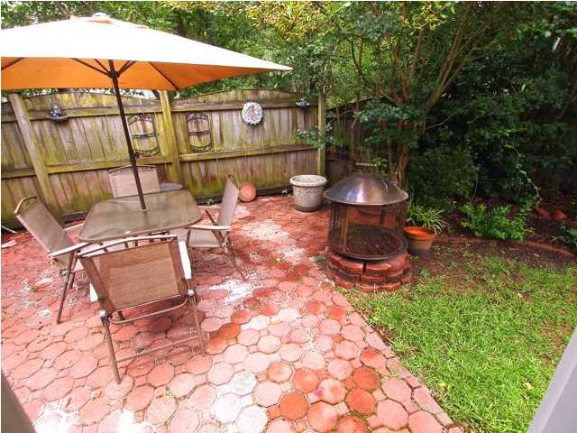

106 Barrie Ct Crowfield Plantation Goose Creek, SC MLS# 1417570 $192,000 2,030 Sq Ft - 3 Bedroom - 2 Bath
4% Commission with a Ratified Contract by July 15th
Want an open floor plan with formals too? Then come take a look at this well maintained home in the beautiful Crowfield Plantation. When you enter you will see the large formal living room, the large family room which has a fireplace, and the large formal dining room with heavy chair rail moldings. The large eat-in kitchen has lots of cabinets and counter space as well as an island with a hardwood floor. All this is canopied by a cathedral ceiling. Off the family room is a bright and airy sun room that overlooks a professionally landscaped yard which boasts of a patio as well. The Master bedroom is also large and the Master bath has a separate tub and shower with a large walk-in closet. There are two other good sized bedrooms and a full bath. There is also a separate laundry room- All THIS ON ONE FLOOR- This is truly a child and pet friendly home! Fenced-in and on a cul-de-sac. All of the expensive maintenance has been done-The shingles were replaced in 2012, water heater replace in 2012, stove replaced in 2012, microwave replaced in 2013. All you have to do is move in! Listing agent is related to the owner.
Liz & Bob Simonds
843-261-7138 O | 843-437-9696 M lizandbob@agentowned.com
AgentOwned Realty Co. Premier Group, Inc. | 141 A N. Main St | Summerville, SC 29483

