Slide 1
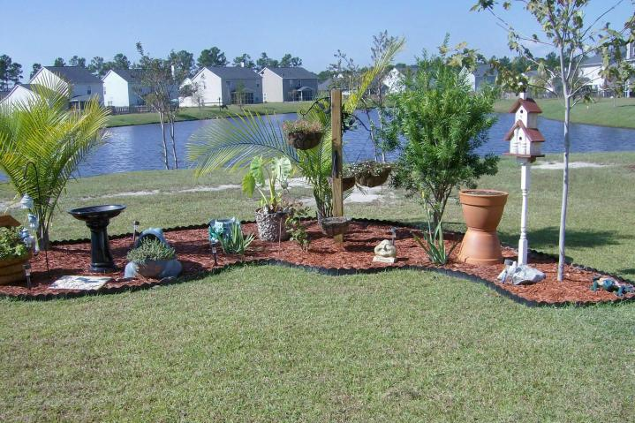

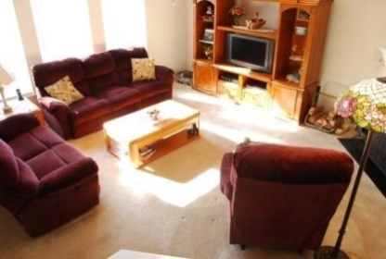
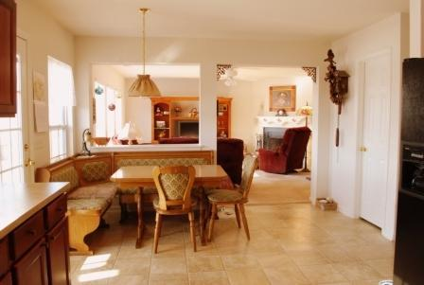
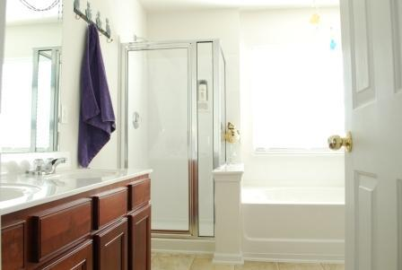

106 Buckfield Ct Weatherstone Summerville, SC MLS# 14030478 $1,650/Mo 2,730 Sq Ft - 5 Bedroom - 3 Bath
Close to Shopping, Dining, & Easy Access to I-26
This is a great open floor plan.
It has a living/dining combo, an eat-in kitchen with a walk-in pantry, and cabinets galore!
This kitchen overlooks a family room that has a fireplace.
There is a bedroom downstairs with a full bath across the hall.
Upstairs are 4 more bedrooms and two full baths.
The master bedroom is gigantic with a gigantic walk-in closet.
Off the kitchen is a screened-in porch that overlooks a pond.
Weatherstone boasts of a play park, swimming pool, and sidewalks.
The best part is that Weatherstone is a mile from I-26, shopping and dining!
Liz & Bob Simonds
843-261-7138 O | 843-437-9696 M lizandbob@agentowned.com
AgentOwned Realty Co. Premier Group, Inc. | 141 A N. Main St | Summerville, SC 29483

