Slide 1
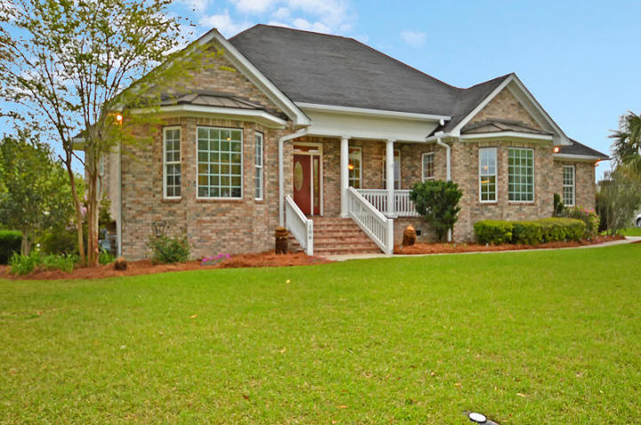
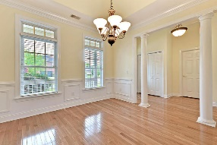
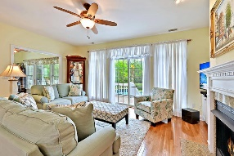
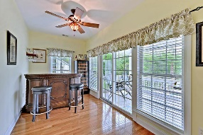
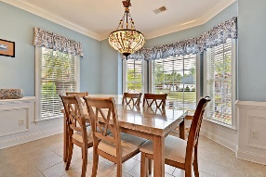
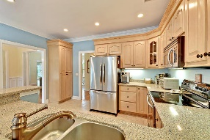
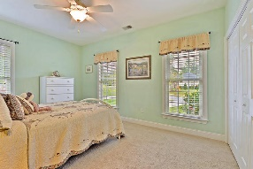
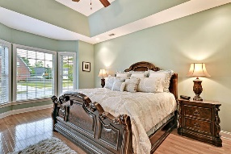
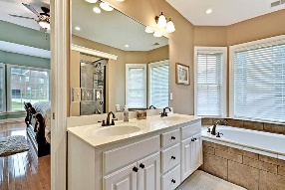
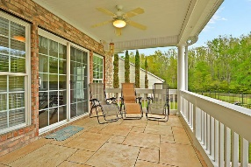
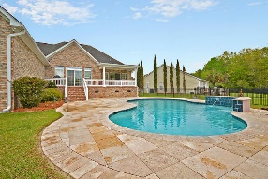
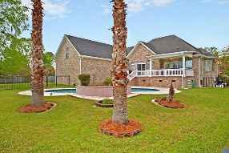
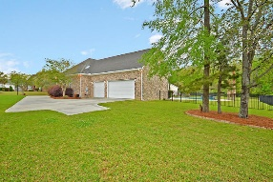


One Story With In-ground Pool In Crowfield!
106 Clearview Circle
Crowfield Plantation
Goose Creek, SC 29445
MLS# 18010051
$425,000
3 Bedrooms | 2½ Baths | 2,688 sf
This 2,688 Sq. Ft., one story, custom built, all-brick home is in IMMACULATE, move-in condition! Featuring a salt water in-ground pool, fenced-in backyard with privacy, pond / wooded views and a 3 CAR GARAGE. This home will not last long! Buyers will first notice the beautiful hardwood floors, tons of natural light, and extensive trim throughout the home. The master bedroom is spacious with tray ceilings, ceiling fan and an impressive master bathroom featuring dual vanities, jetted tub, separate tile shower and walk-in closet. The kitchen has stainless steel appliances, sitting / breakfast bar, custom cabinetry and eat-in kitchen area. There is a gas connection for a gas range if desired (current cooktop / range is electric). The family room is just off the kitchen and offers a natural gas fireplace and great views of the backyard pool and pond beyond. Downstairs, buyers will also find a sunroom / bonus room which opens to the covered back porch, a separate dining room with wainscoting and two additional bedrooms which share a full bathroom with tiled shower. Upstairs, buyers will find a large FROG / playroom or 4th bedroom that can be used for practically anything! The backyard offers a private setting around the in-ground pool with waterfall as well as a large pool patio! This home has many palm trees and sago palms and is professionally landscaped! Natural gas connection from the street is ready for a gas grill and available for a hot water heater or new kitchen cooktop if desired.
The Hamlets (Crowfield) is a golf course community with clubhouse and tennis courts as well as walking and jogging trails and memberships for golf and tennis are optional. This home is a must see!
Larry & Kathy Mazalatis
Larry Cell 843-693-0529
Kathy Cell 843-693-0159
Office 843-871-9133
AGENTOWNED PREMIERE GROUP | 1800 TROLLEY RD | SUMMERVILLE, SC 29485

