Slide 1
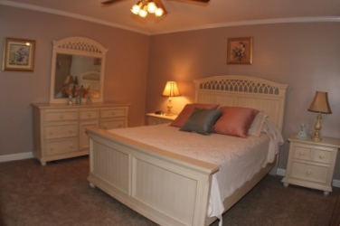
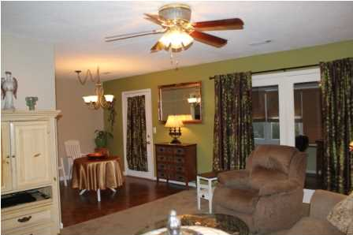
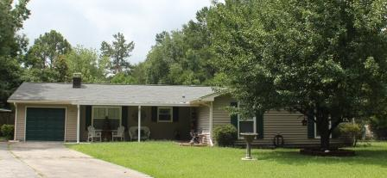
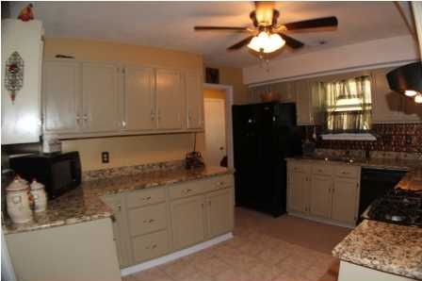
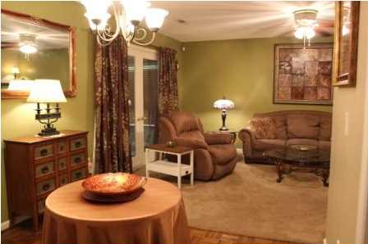
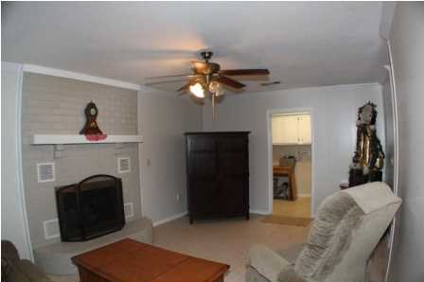
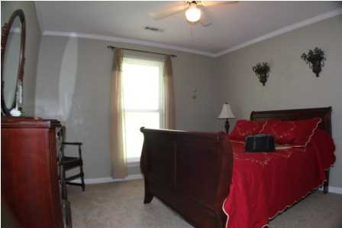
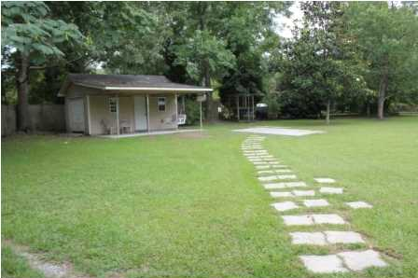
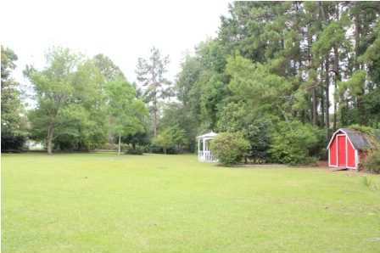


S’ville’s Best Kept Secret
$1,000 Agent Bonus if closed by October 17, 2014
106 Confederate Ct
Corey Woods ~ Summerville
MLS# 1419520 ~ $174,900
Meticulously maintained ranch style home located in sought-after Dorchester County 2 School District in desirable Corey Woods. This 2200 square foot home is nestled on a .75 acre lot at the end of the cud-de-sac. An open floor plan with a splash of warm colors throughout featuring 4 comfortably-sized bedrooms, 2 full bathrooms. Huge kitchen has been tastefully decorated and accentuated with granite countertop, offers tons of cabinet space and all kitchen appliances are efficiently situated. Spacious living room, accommodating dining room area perfect for a small or large family. Additional room with a cozy fireplace can be used as a den, family room or study. Approximately 200 square foot sun room is not included in the square footage. And, as an added bonus this home comes with an extra large laundry room with pantry. This charming home has been upgraded with ceiling fans in almost every single room, lighting fixtures, crown molding and tile. Plush new carpet and fresh new paint throughout. Attached one car garage. The back of the house is an unexpected surprise. A massively park-like backyard with lots of trees and bushes. Very private and serene. Birds singing. Bees buzzing. Butterflies dancing. Greenery everywhere. Gazebo. Two storage sheds, one with electricity, one without. Transferable Termite Bond. This warm and inviting home can be yours. Corey Woods is in the heart of Summerville. Centrally located. Close to shopping centers, movie theaters, restaurants, hospitals and clinics. Hop on the interstate and you're minutes away from downtown Charleston and the beaches. Make an appointment today and Step N2 UR Future.
For More Information Contact:
Charles and Diana
803.807.1628 843.670.3293
SteppingStoneRealtyInc.com
SteppingStoneRealty@Gmx.com

