Slide 1
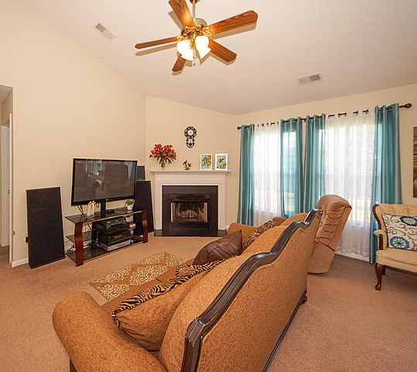
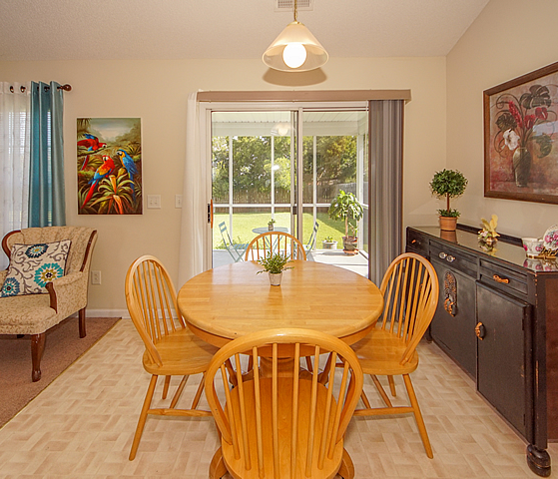
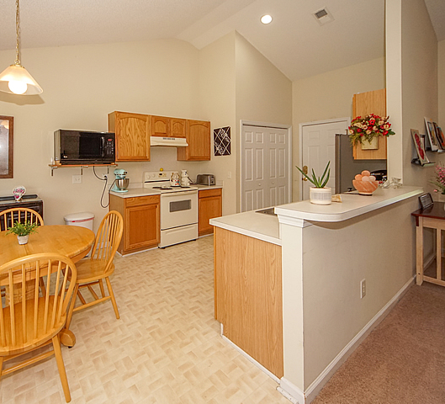

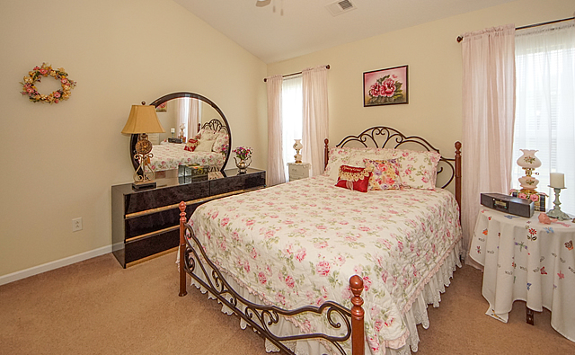
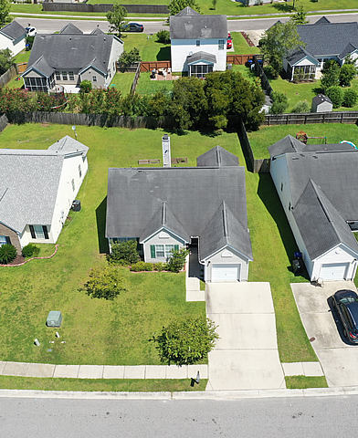
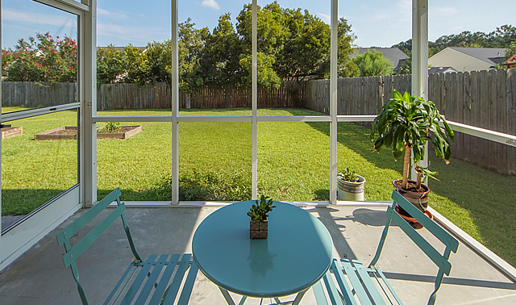

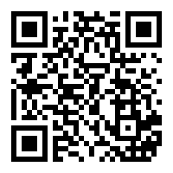



WOW - what a great Summerville location! Easy access to Nexton, I-26, Azalea Square (Target, Mellow Mushroom, etc.). This listing offers a fantastic opportunity to get in to Weatherstone for under $200K. Weatherstone features a neighborhood pool, playground, volleyball court and basketball court. Now about the home! 106 Delafield Dr has been extremely well maintained and is super clean / move-in ready***Open floorplan with vaulted ceilings***Nice kitchen counter space with breakfast bar***Living room featuring fireplace***Master bathroom with garden tub***Ceiling fans throughout***One-car garage with two-car driveway***Screened porch overlooking private backyard***Well maintained landscape***Transferable termite bond***Don't miss this great home in a great Summerville neighborhood!
106 Delafield Drive
Weatherstone
Summerville, SC 29483
MLS# 20022821 ~ $194,900
Jeff Gallman
Broker-in-Charge | Owner
Bottletree Properties, LLC
Direct: 843-729-5741
jeff@bottletreeproperties.com BottletreeProperties.com
/BottletreeProperties
/BottletreeProperties
/BottletreeProps
virtual tour

