Slide 1
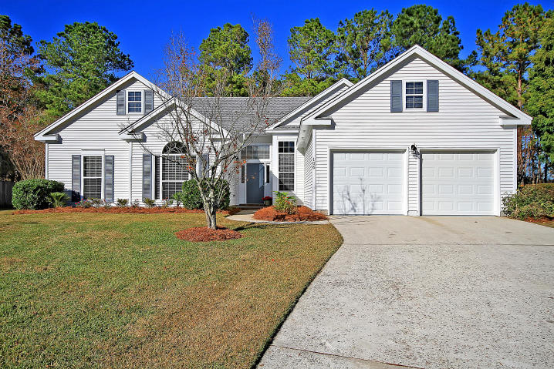
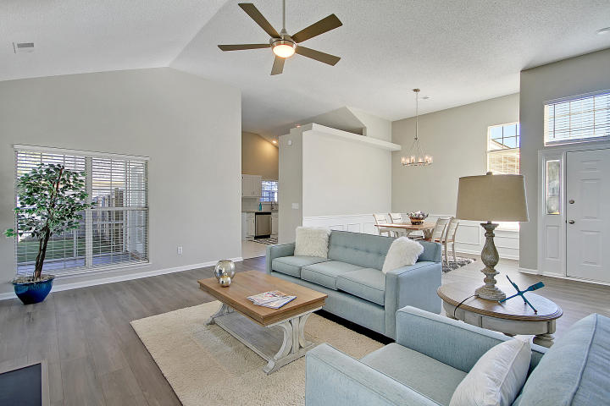
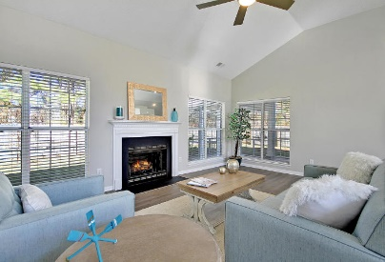
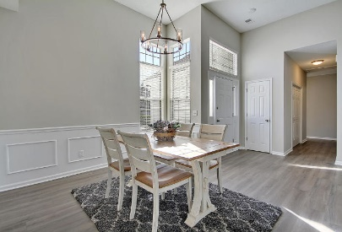
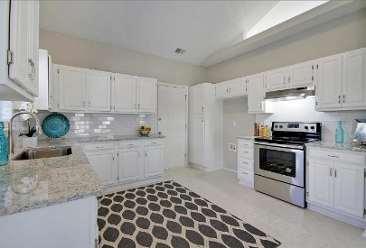
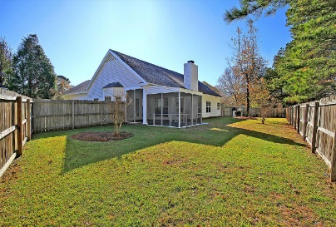
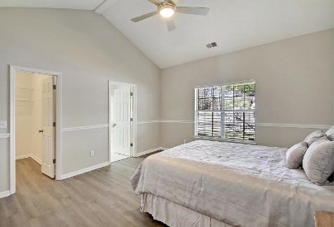
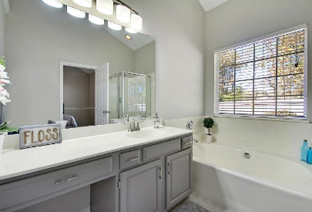
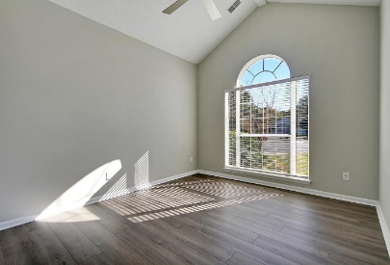
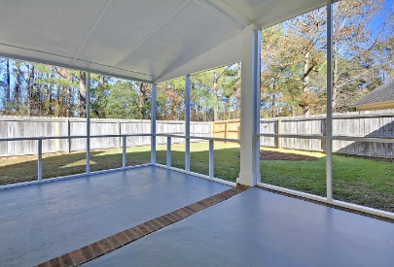


106 Durrell Court Crowfield Plantation | Goose Creek, SC 29445 MLS# 19033091 | $230,000
UPDATED 3/2 in Crowfield Plantation!
Welcome Home! A great find in the desirable Crowfield Subdivision, this freshly updated, single-story home is waiting to welcome you! As you walk through the front door, you'll notice the beautiful new hardwood laminate floors and fresh Sherwin Williams paint throughout. The bright kitchen boasts gorgeous new granite countertops, freshly painted cabinets with new hardware, new subway tile backsplash, new sink, new faucet, new disposal and new stainless steel appliances. Home upgrades include all new light fixtures, ceiling fans, door hardware, toilets, bathroom faucets and mirror. Walk out to your updated screened porch for entertaining! This home features a spacious yard with enclosed privacy fence and is freshly powerwashed with newly painted shutters. Come see this gem for yourself!
Michele Basler
(843) 813-0330
charleston917@gmail.com
Brand Name Real Estate | 4 Carriage Lane Suite 106 | Charleston, SC 29407

