Slide 1
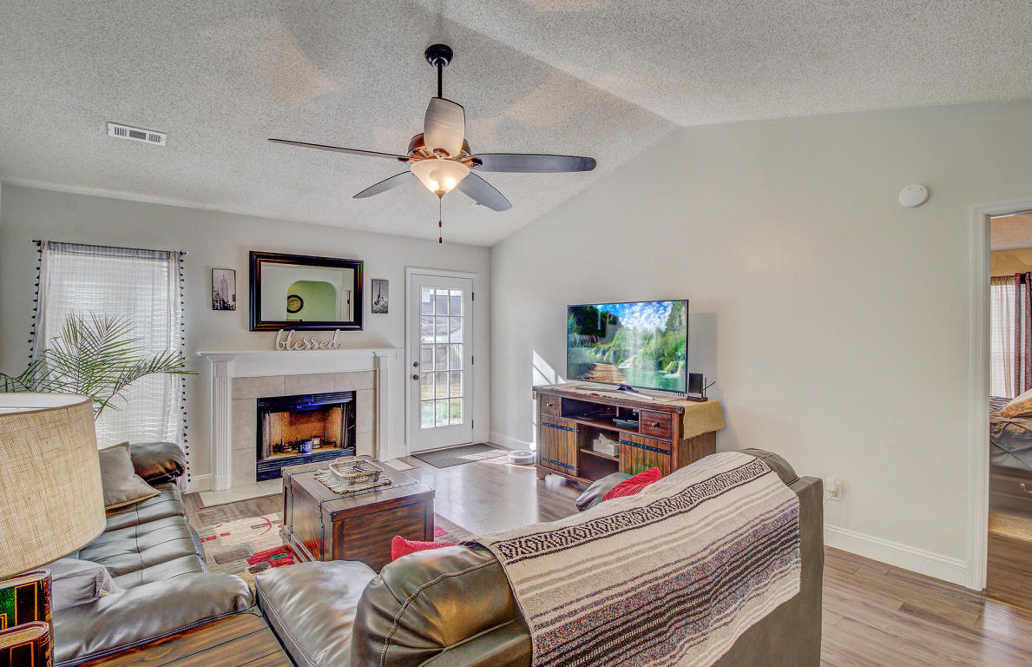
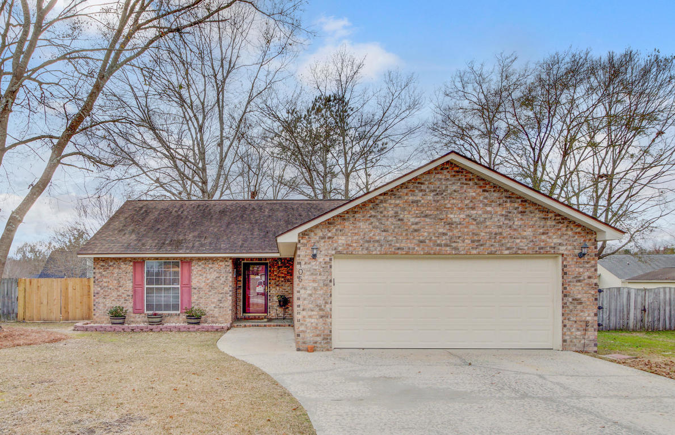
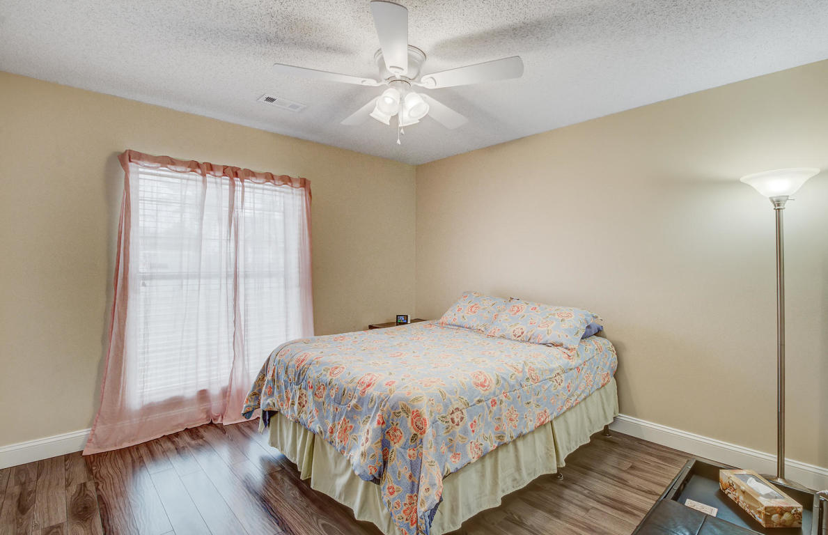
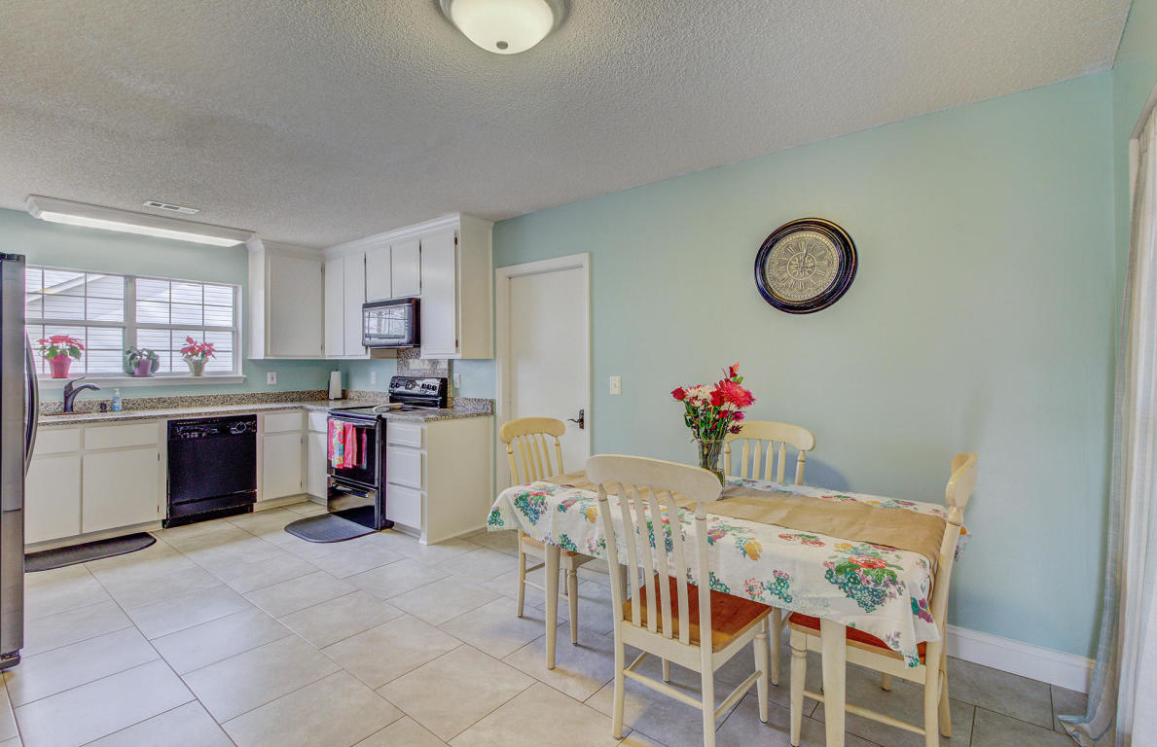
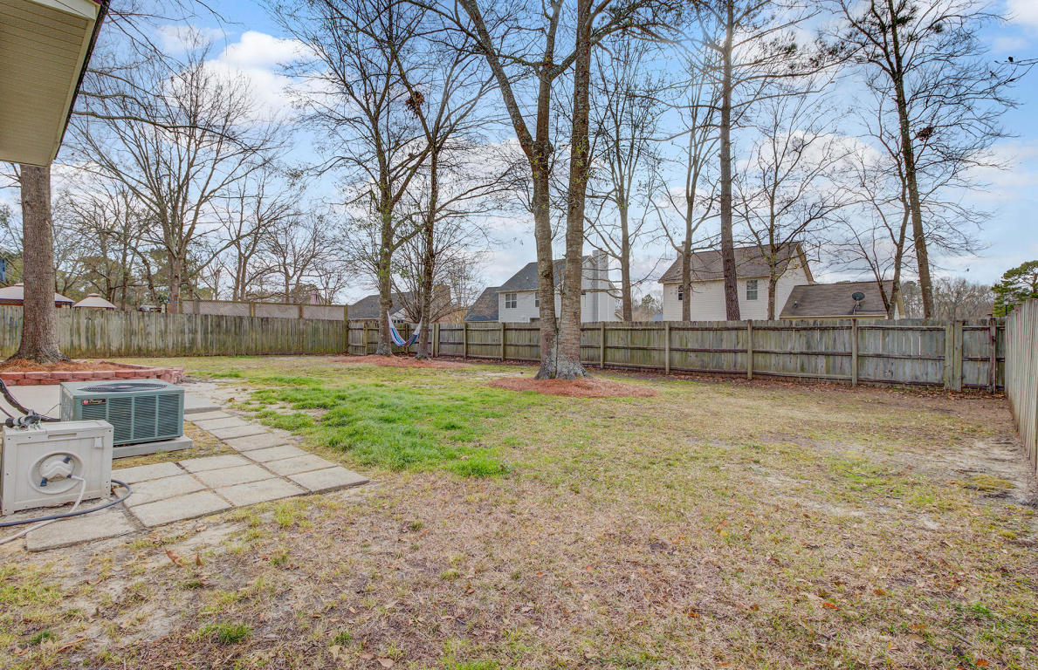
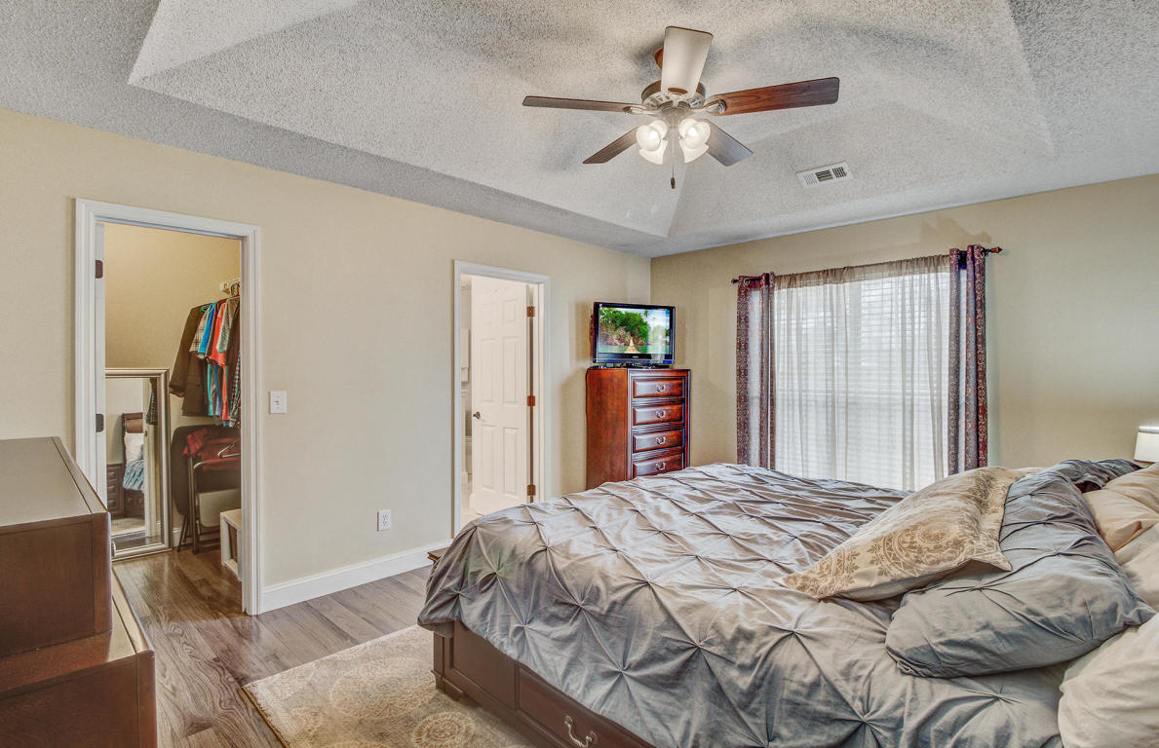
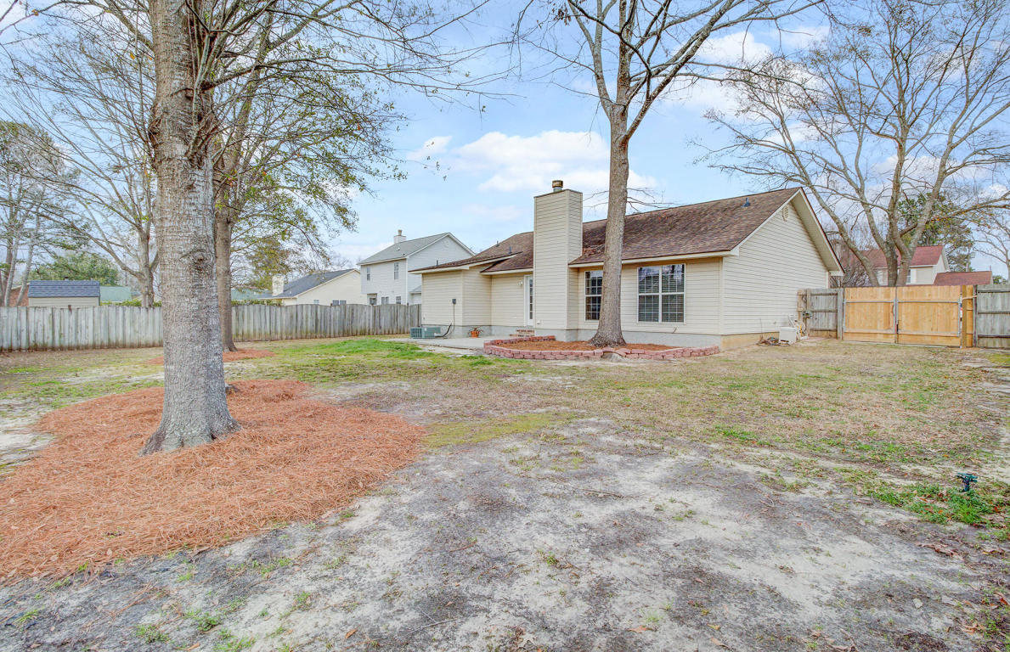


JUST LISTED! Three Simple Words: Move-In Ready!
106 Elaine Street
Ryan Creek
Goose Creek, SC 29445
MLS# 20004062 | $225,000
Three simple words: move-in ready! The current owners have done the hard work and now it is time for the YOU to reap the benefits! Step inside 106 Elaine Street and you will be impressed with the impeccably maintained and updated home. Gleaming wood floors and tasteful colors throughout say, ''Welcome Home.'' A pretty fireplace is the focal point upon entry- and makes for a cozy home on those chilly mid-winter days in Charleston. The family room is the heart of this three bedroom, two bath home. A desirable split floor plan design, this is true one level living at its finest. The kitchen is HUGE- and you will love the brand new granite counters and freshly painted cabinets. This is a light and bright room you will love spending time in- preparing and enjoying wonderful meals for family and friends. The master suite is large enough for a king sized bed and has a generous sized walk in closet. The en suite bath is the owner's retreat- have a spa like experience as you soak in your garden tub at the end of a long day. The gorgeous granite counters, pretty new light fixtures and open shelves all add to the beauty of this master bathroom. The two guest bedrooms on the opposite side of the home share a bathroom that was updated tastefully as well. The back yard is immense- perfect for playing with children and pets or hosting barbecues with friends, family, and neighbors. Fully enclosed with a wood privacy fence, this is the ideal place to store your boat, camper, or trailer! There are double gates on each side of the house, and no restrictive covenants in this community! Your two car garage provides ample parking and storage plus the large driveway can accommodate additional vehicles. As an added bonus, sidewalks line both sides of the street making this a great neighborhood for walking. All the conveniences located along St. James Blvd. are a short ride up the street. Commuters will love easy access to Rivers Avenue/Rt. 52, St. James Blvd., University Blvd, and I-26. Now is the time to make this beautiful home yours- so schedule your tour before this fantastic opportunity passes you by!
Check out the virtual tour here: https://www.zillow.com/view-3d-home/057ef18d-85da-4ac0-bcab-789a179ad448
Ellen O'Neil
Broker/Owner, ABR, e-PRO, CNE
Charleston Realtor of Distinction
(843) 300-8530
www.EllenONeilProperties.com

