Slide 1
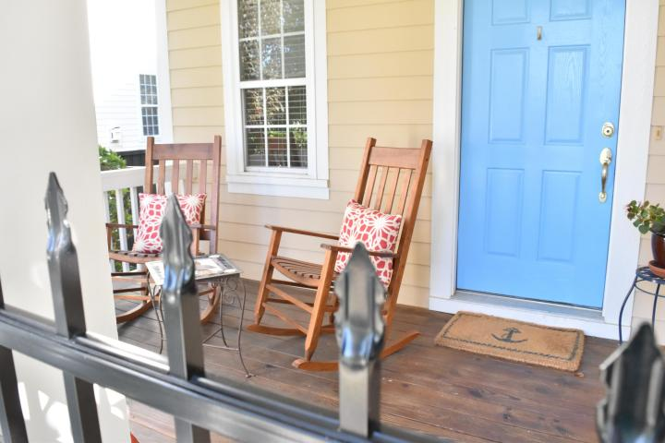
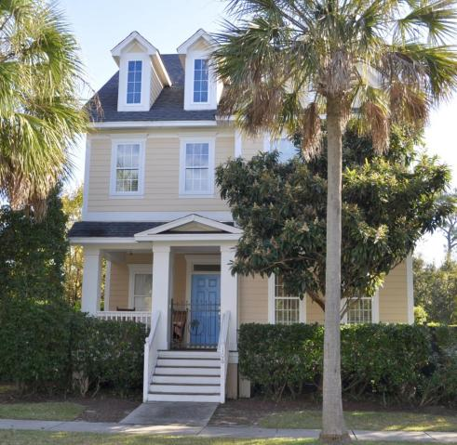
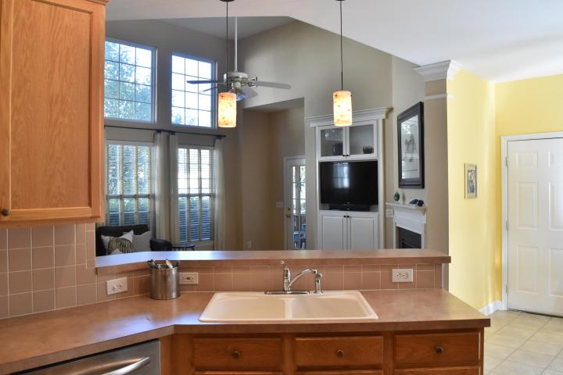
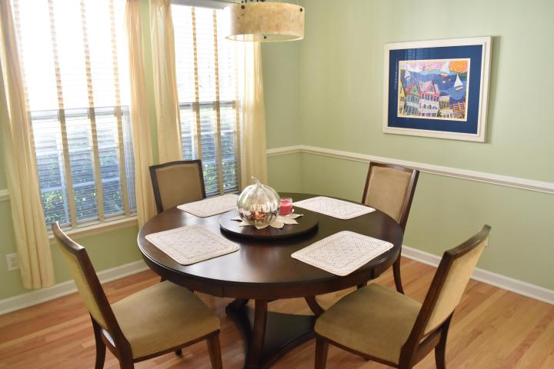
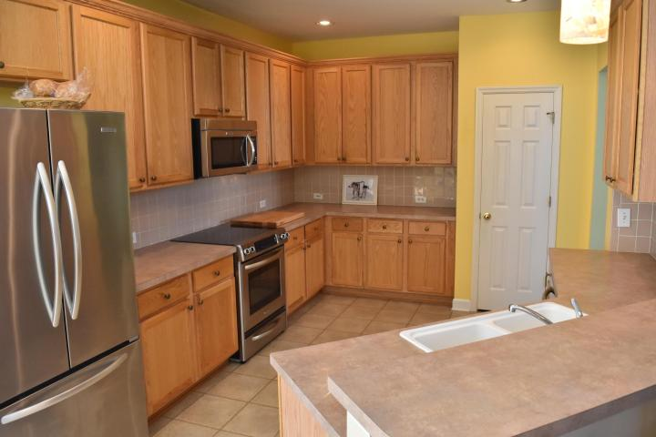
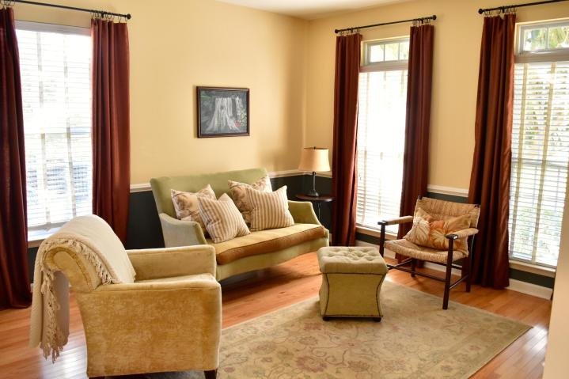
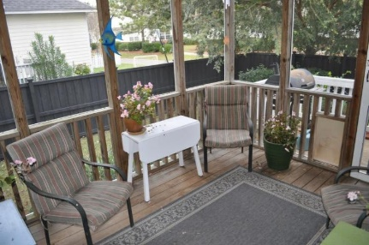
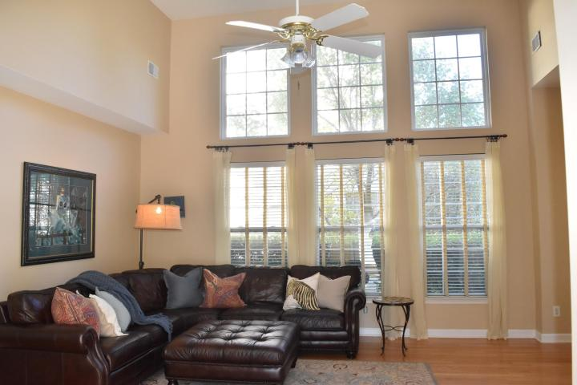
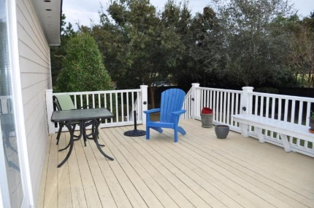
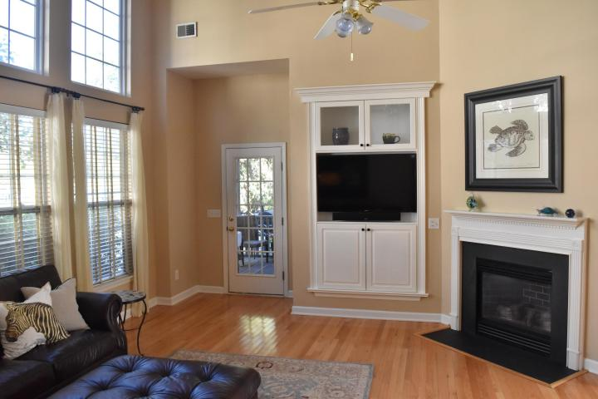
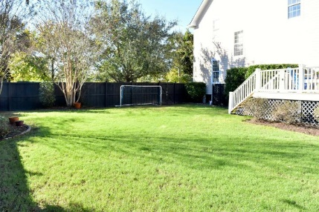


106 Etiwan Park Street
Daniel Island
Charleston, SC 29492
MLS# 15029432 | $509,000
Daniel Island Living At Its Best
Great Location on Daniel Island
Large Corner Lot
6 Ft. Privacy Fence
Large Deck
Screened Porch
Open Floor Plan
Living, Family & Dining Areas
3BR ~ 2.5BA ~ 2095 SF
Donna Landry
Mobile - (225) 921-2111
donna.landry@cbunited.com
Betsy Sarsfield
Mobile - (843) 608-1048
betsysarsfield23@gmail.com
Coldwell Banker United of Charleston | 35 Broad St | Charleston, SC 29401 | www.thebestincharleston.com

