Slide 1

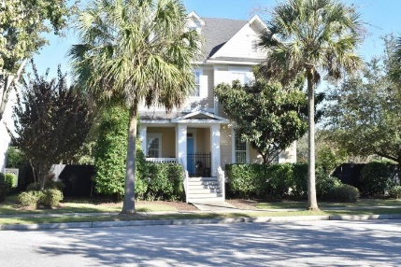
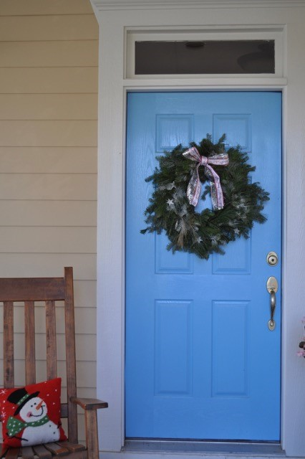
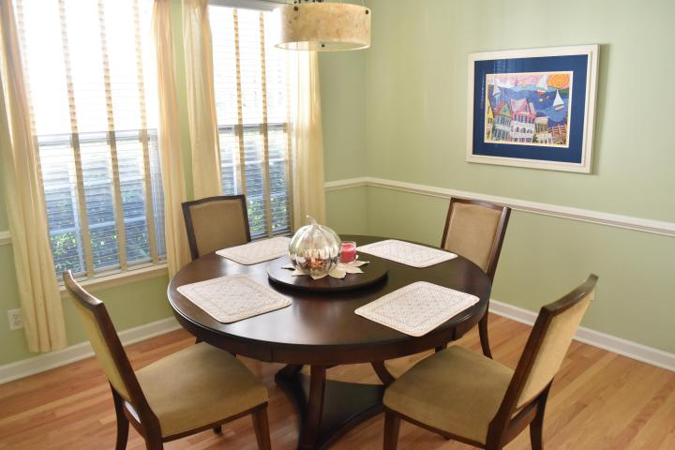
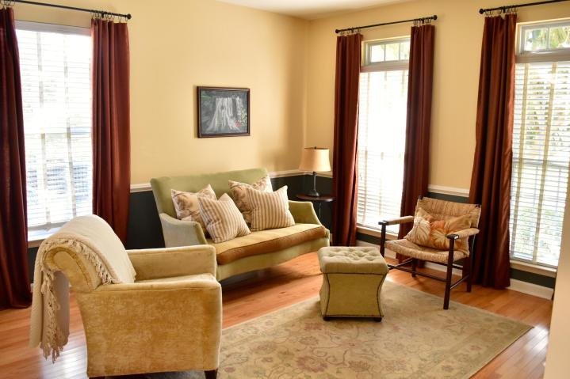
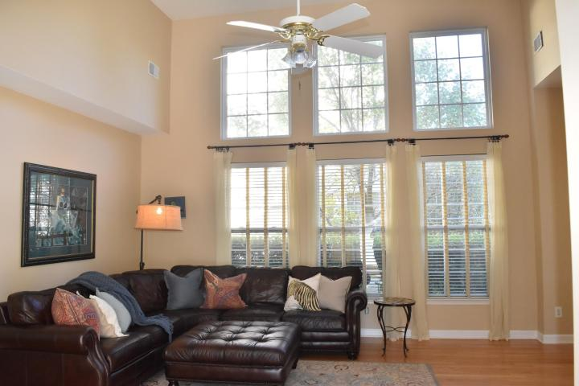


106 Etiwan Park Street Daniel Island ~ Charleston, SC 29492 MLS# 15029432 ~ $509,000
Home for the Holidays
Large Corner Lot ~ 6 Ft. Privacy Fence ~ New Exterior Paint
Hardwoods & High Ceilings
Stainless Appliances & Breakfast Area
Master Suite ~ Walk-In Closet ~ Dual Vanities ~ Soaking Tub
This is the Daniel Island home your clients have been waiting for!
Donna Landry
Mobile - (225) 921-2111
donna.landry@cbunited.com
Betsy Sarsfield
Mobile - (843) 608-1048
betsysarsfield23@gmail.com
Coldwell Banker United of Charleston | 35 Broad St | Charleston, SC 29401 | www.thebestincharleston.com

