Slide 1
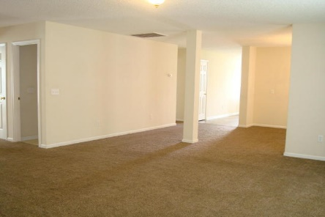
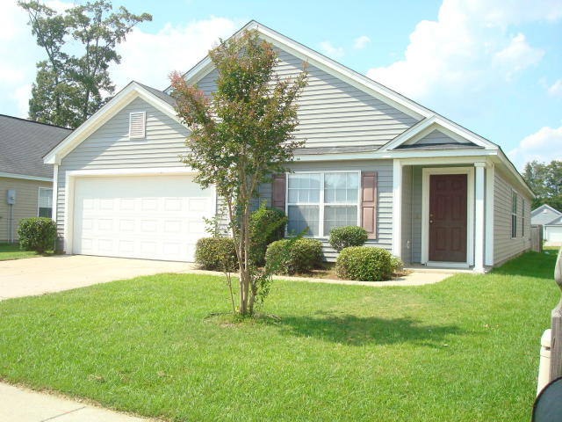
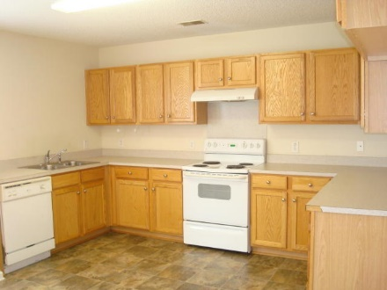
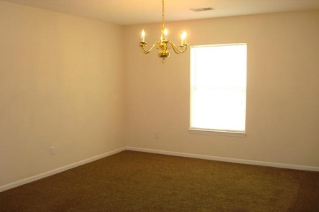
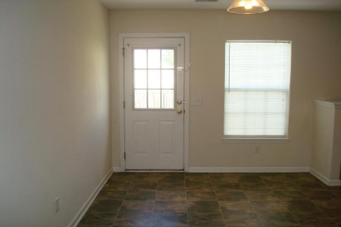
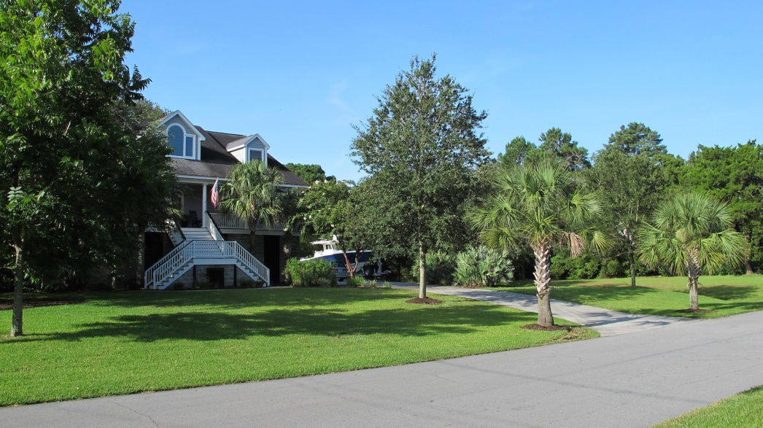
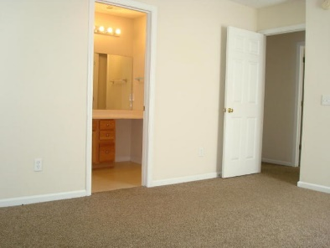
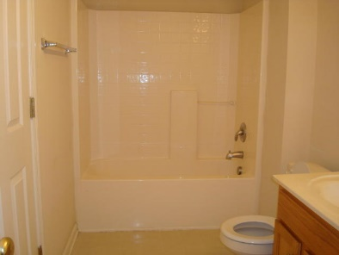
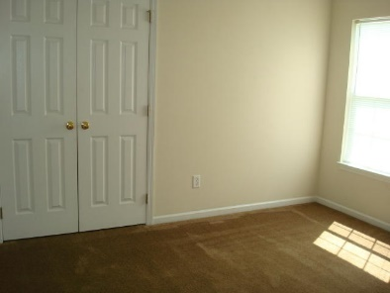
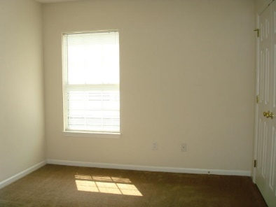
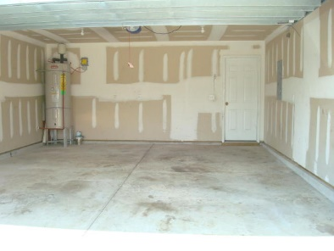


Lease Purchase Option Now Available!!
Goose Creek 4 Bedroom Ranch Ready to Go!
Price Reduced
106 Maypop Drive
Longleaf | MLS# 15019612 | $165,400
MOVE RIGHT IN! This inviting one story home has it all! Upon entry, as you stand in the spacious foyer looking into the home, you will easily be able to visualize the convenience and joy of living in this fantastic house! There is an open floor plan making it perfect for families or entertaining. The cook in the house will love this kitchen! There are plenty of cabinets and lots of counter space for preparing your favorite meals. It is an eat in kitchen with a big pantry! The door off the kitchen leads to a large patio perfect for grilling and an outdoor sitting area. There is a separate dining room which is open to the large family room. There are four bedrooms in this well thought out floor plan. The master bedroom is along the back side of the house overlooking the rear yard. It has a large walk in closet and the master bath has a linen closet inside it, too! Great storage throughout this home! The second and third bedrooms have a Jack and Jill style bathroom. The fourth bedroom is generously sized, too. There is a separate laundry room between the garage an hallway. You will love the neutral colors throughout the home, which is truly move in ready. The majority of the floor coverings are 1-2 years old. This is a well maintained home! Longleaf is a wonderful community with sidewalks on both sides of the streets. It is an easy walk to Dogwood Park where you can enjoy the playground, ball fields and basketball courts. This community is conveniently located close to shopping, restaurants, schools, and a short ride to Highways 52, 26 and 526. A four bedroom home in such a wonderful community won't last long at this price!
Ellen O'Neil
843-300-8530
ellen@ellenoneilrealty.com
www.EllenONeilRealty.com
Ellen O'Neil Realty | Mt. Pleasant, SC 29466

