Slide 1

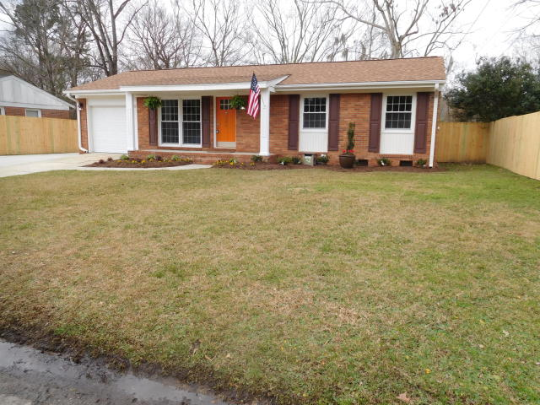
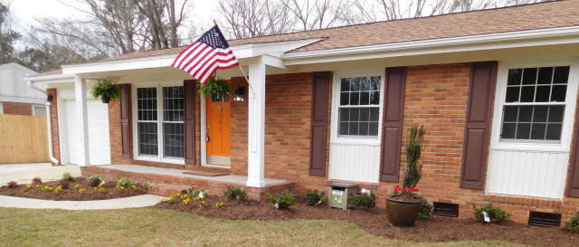
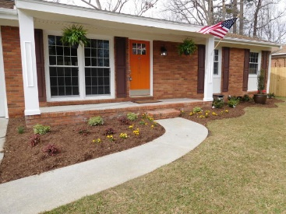
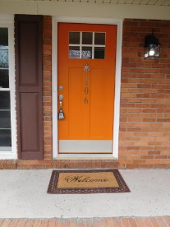
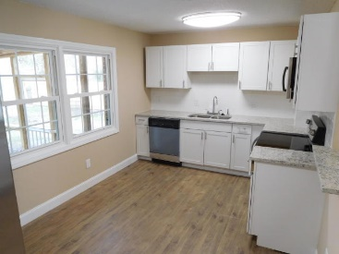
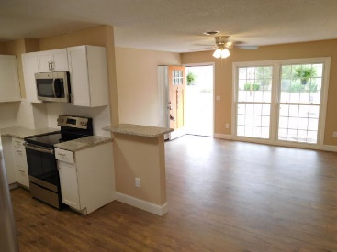
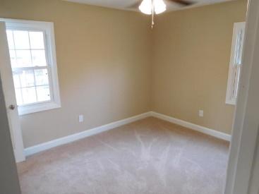
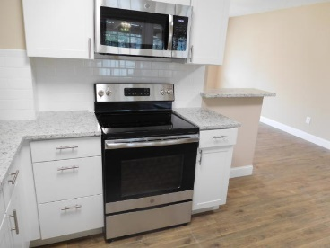
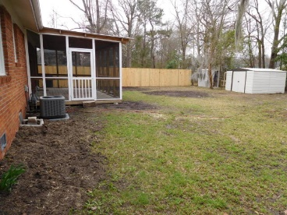
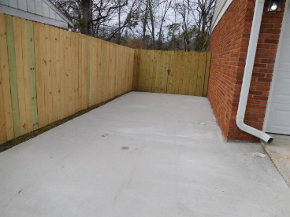
Don C. Mason, CIAS, CNE
(843) 364-9090
nibsc@aol.com
Totally Renovated
Under $200k
No HOA
106 Realtor Road
Pineview Hills
Goose Creek, SC 29445
MLS# 20004571 ~ $199,000
Property Subtypes: Executive Suites, Office Building
Building Size (RSF): 2,400 SF
Sale Price: $379,000
Cooperation Compensation: 3%
Property Use Type: Investment/Professional Office
Usable Size (USF): 2,400
Sale Terms: Cash to Seller
Agency Type: Exclusive Right to Sell/Lease
Fresh & clean. Move-in ready. West View Schools. 3 Bed 2 Bath all brick 1 car garage. Large screen porch in a large backyard with a privacy fence. Very large second driveway. Plenty of room to store the boat or camper.
Like new inside. All new kitchen cabinets, granite counter tops, white subway tiled back splash. All new stainless appliances. Both bathrooms are all new. Vanities, tub, shower, toilets. all new lights, ceiling fans. All new flooring through out the home.
New architectural shingled roof. Topped with professional landscaping. Newer vinyl windows and heat & air.
Real Estate Advocates LC
7613 Hwy 544 | Myrtle Beach, SC 29588
www.realestateadvocates.com

