Slide 1

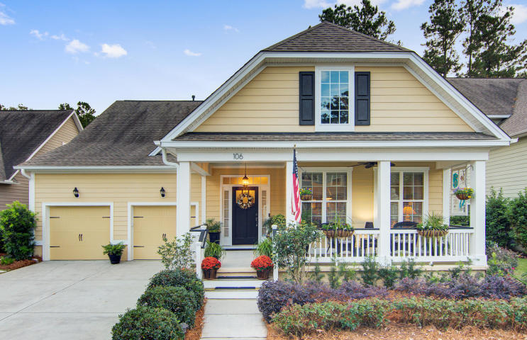
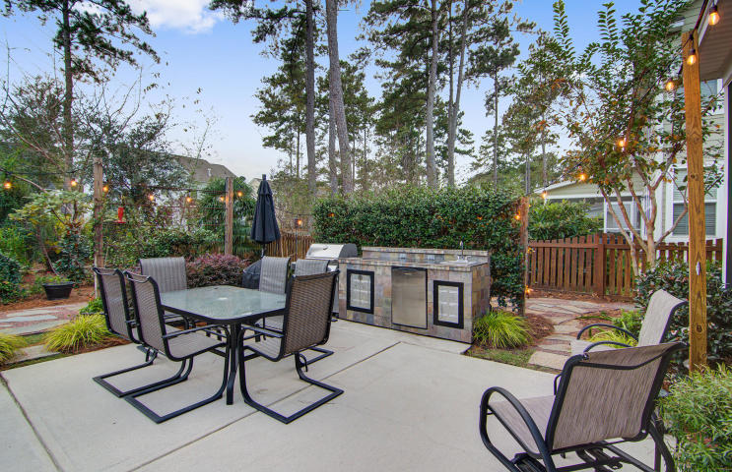
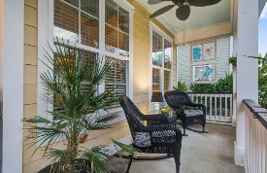
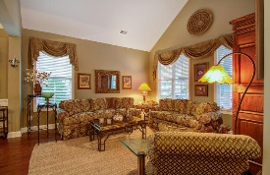
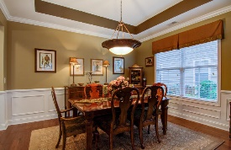
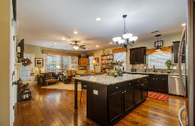
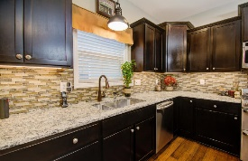
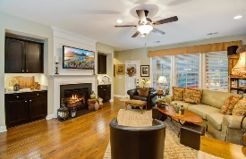

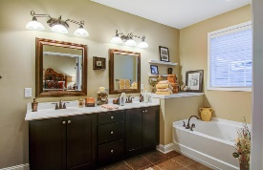
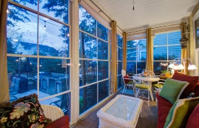
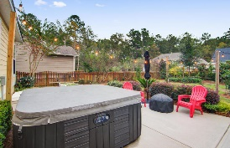
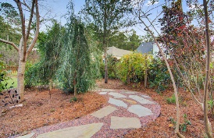
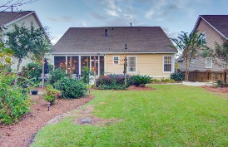


The Ponds - Picturesque & Serene
106 Ribbon Road
Summerville, SC 29483 ~ MLS# 18030530 ~ $449,900
Located on a quiet street within The Ponds, this picturesque home offers 4 bedrooms, 4 full baths, and an open layout with plenty of space for entertaining, both inside and out. One of the most popular original floorplans in The Ponds, The Crepe Myrtle, was designed to optimize first floor living. A charming full front porch welcomes guests into the foyer, adjacent to the formal living and dining rooms. In the back of the home is a spacious family room with a gas fireplace surrounded by beautiful built-in shelving with cabinets and granite countertops. Chat with family or guests as you prepare a meal in the gourmet kitchen, complete with a gorgeous custom backsplash, upgraded stainless steel appliances, granite countertops, and a huge island with additional seating. Beautiful hand-scraped hickory floors are featured throughout all of the main living spaces, with tile in all 4 baths and the convenient downstairs laundry room. Tucked away to the left is the owner's suite, boasting a large walk-in closet and a private bathroom with dual vanities, a garden tub, and a separate walk-in shower. Completing the 1st floor is another bedroom and a full bath, the perfect location for a home office or playroom. Wood stairs lead to the 2nd floor, where you'll find two nicely sized bedrooms featuring upgraded carpet, each with their own full bath. Last, but not least, is the backyard sanctuary that creates the perfect environment for relaxation. Step out into the multifunctional 3-season room and enjoy your morning coffee or an evening cocktail as the sun sets over your secluded backyard sanctuary. The fully fenced yard includes a huge patio with an impressive outdoor kitchen and a custom built stone walkway that winds throughout a plethora of professional landscaping. Other noteworthy features of this amazing home include generous amounts of indoor storage space, a 2 car attached garage with overhead storage and epoxy floors, yard irrigation, and a recently painted neutral interior. An AHS Home Warranty will also convey to the new owners. The Ponds offers residents a neighborhood pool, fishing pond, play parks, clubhouse, and a YMCA. Plus, it's located in the award winning Dorchester II school district and you'll be just minutes away from historic downtown Summerville shopping and dining as well as Downtown Charleston and its beautiful beaches.
Belita Shapiro
(843) 830-8105
belitashapiro@gmail.com
www.belitashapiro.com
AgentOwned Premiere Group | 1800 Trolley Rd | Summerville, SC 29485

