Slide 1
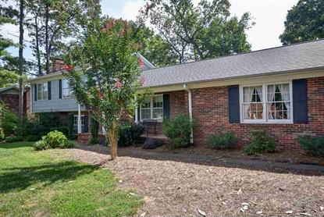
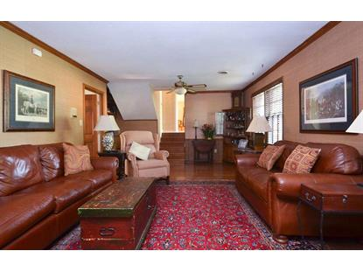
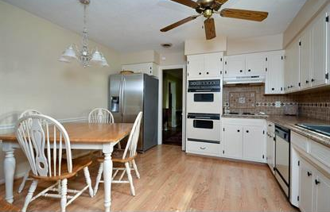
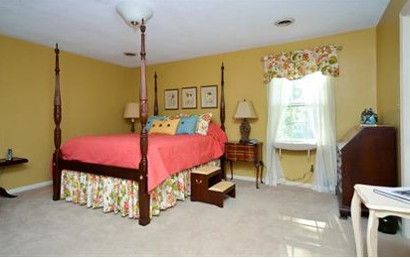
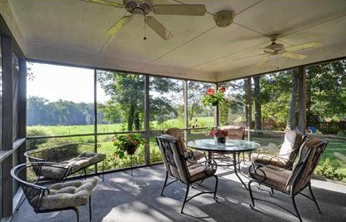
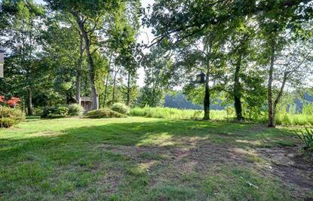


Backs up to Fenced Pasture with Show Horses
106 Rockwood Drive, Spartanburg, SC 29301
Extremely well maintained, 4 bedroom, 2.5 bath home perfect for the growing family. The freshly painted kitchen has lots of cabinet space and double-ovens. The enclosed double garage with new door leads to the mud room with washer, dryer area and half bath. Entertain with ease in the spacious living room. The nice sized dining room is perfect for all the special events. From the dining room you will pass through lovely French doors to spend your leisurely time on the 16X16 screened porch overlooking the level backyard which is totally fenced. This home is situated on a beautiful lot with many mature hardwood trees. The lower level of this home could be an in-law suite. This is where you have another large family room with wooden blinds, bookcases, hardwood floors, brick wall featuring the gas log fireplace, raised hearth and mantle. Here you will also have the 4th bedroom for your guest or in-law privacy plus another full bath. You can also walk to the back yard from this level.
MLS# 217234 ~ $145,000
Peggy Wilson
Realtor, Broker, GRI, ABR
864 415-3958
peggy@realtysc.com
www.realtysc.com

